Slide 1


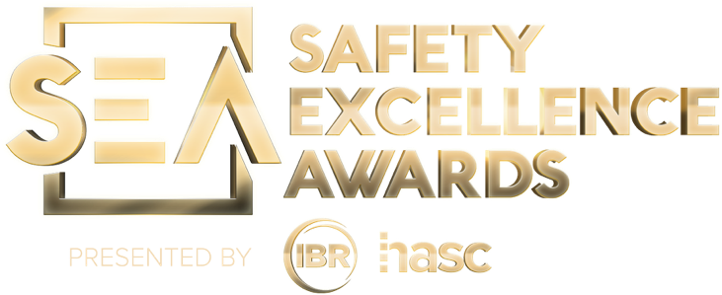

2026 SAFETY EXCELLENCE AWARDS | BEST PRACTICES SEMINAR
TECHNICAL SUPPORT MEDIUM
BEST IN CLASS
Envent Corporation provides vapor control, degassing, and environmental solutions for the refining industry. Envent's experienced team helps refineries maintain compliance, safety, and efficiency by safely managing hydrocarbons and VOCs during maintenance, turnaround, and startup activities. Envent provides nationwide mobile vapor control, tank and pipeline degassing, and temporary emission control solutions that meet all federal, state, and local air quality requirements, including EPA and OSHA standards.

Slide 2


Slide 3
2026 SAFETY EXCELLENCE AWARDS | BEST PRACTICES SEMINAR
Military &
International Outreach
AGENDA
Who We Are
Awards & Recognition
Retention & Career Development
International Workforce Outreach
Replicating Envent’s Model
Summary & Wrap Up
Q&A

Slide 4

Who We Are
2026 SAFETY EXCELLENCE AWARDS | BEST PRACTICES SEMINAR
Envent Corporation delivers industrial support services, environmental, and specialty equipment across North America. We build a workforce grounded in discipline, safety, and excellence. The values that align naturally with military service.
Safety First
Diverse Teams
Growth Mindset
Service Ethos
Military-grade discipline applied to worksite safety culture
International & veteran talent enriches our capabilities
Continuous upskilling and career ladder programs
We serve clients the way veterans serve, with commitment

Slide 5

Awards & Recognition
2026 SAFETY EXCELLENCE AWARDS | BEST PRACTICES SEMINAR
Federal & State Recognition for Veteran Employment Excellence
The Honoring Investments in Recruiting and Employing American Military Veterans (HIRE Vets) Medallion Program is the only federal award recognizing exceptional achievement in veteran employment.
HIRE Vets:
2025 Gold Medallion Award Recipient — U.S. Department of Labor
Texas:
Recognized by Texas We Hire Vets
Safety:
2026 Best in Class Safety Excellence Award Recipient
Veteran Workforce:
20%+ of Envent workforce are veterans — 90%+ one-year retention rate

Slide 6
Retention & Career Development
2026 SAFETY EXCELLENCE AWARDS | BEST PRACTICES SEMINAR
Career Ladder Framework
Every veteran hire receives a written career map showing progression from entry-level to supervisor and beyond. We don't just hire, we invest.
Our Retention Pledge
✓ Transparent communication
✓ Flexible scheduling for VA appointments
✓ Mental health support resources
✓ Zero tolerance for bias
Tuition Assistance
Tuition assistance for certifications and degrees in environmental science, safety, and project management.
Leadership Fast-Track
NCO and officer backgrounds enter an accelerated leadership pipeline with coaching, stretch assignments, and management exposure.
Recognition Programs
Monthly safety achievement awards and an annual Veteran Appreciation reinforce belonging and loyalty.

Slide 7
International Workforce Outreach
2026 SAFETY EXCELLENCE AWARDS | BEST PRACTICES SEMINAR
Expanding our talent pool beyond borders
Envent participates in the Inov Contacto / AICEP program — a Portuguese government-backed initiative placing early-career professionals in global companies. It provides access to multilingual, highly educated talent who demonstrate strong adaptability, technical knowledge, and a results-driven mindset aligned with Envent's operational and safety expectations.
Inov Contacto / AICEP
International internship program backed by the Portuguese government (AICEP), placing bilingual, technically skilled interns in U.S. companies like Envent.
Why It Works for Envent
Interns bring fresh perspectives, often multilingual capabilities, and strong academic foundations while enriching teams and expanding our capabilities across operations.
Shared Values
Participants demonstrate strong discipline, adaptability, and technical training that translates directly into Envent's safety-first culture.
International Synergies
International hires bring diverse, strong technical foundations and adaptability. Continuously enhancing collaboration and supporting safe, efficient operations.

Slide 8
Replicating Envent’s Model
2026 SAFETY EXCELLENCE AWARDS | BEST PRACTICES SEMINAR
Actionable steps any organization can take
1. START
Audit Your Culture:
Survey current veteran employees. Identify friction points. Commit leadership to making changes before recruiting more veterans.
3. CREATE
Skills Translation Guide:
Map common MOS codes to your job descriptions. This removes unconscious bias and helps hiring managers recognize value.
2. BUILD
Formal Partnerships:
Contact your nearest military installation's Transition Office or research internship programs. A handshake agreement costs nothing and opens major pipelines.
4. APPLY
HIRE Vets Award: Apply at HIREVets.gov.
Inov Contacto / AICEP Program: https://www.portugalglobal.pt/en/academy/inov-contacto/
5. MEASURE
& Iterate:
Track veteran and intern to hire rate, retention, promotion rate, and time-to-productivity. Report quarterly. Celebrate wins. Fix what is not working.

Slide 9
Summary
2026 SAFETY EXCELLENCE AWARDS | BEST PRACTICES SEMINAR
We are proud to serve those who served us.
Contact: HR — HR@envent.net · Safety — Safety@envent.net
1. Veterans Deliver
2. Structure Retains
3. Recognition Matters
4. Repeatable Process
Veterans bring irreplaceable skills — leadership, discipline, and adaptability that strengthen every team.
Structured outreach plus mentorship drives higher retention and faster career growth.
The HIRE Vets Medallion signals a genuine commitment to the nation's heroes.
Start with culture, build the pipeline, measure results, and improve always.

Slide 10

QUESTIONS?

