Slide 1




2026 SAFETY EXCELLENCE AWARDS | BEST PRACTICES SEMINAR
TECHNICAL SUPPORT LARGE
BEST IN CLASS
Kent is a global integrated energy services company with over 100 years of history. We leverage decades of experience and groundbreaking solutions across conventional energy, low carbon, and renewables. We operate across the full asset lifecycle, from early advisory, feasibility, and FEED through to EPC delivery, construction management, commissioning, late-life asset management, and decommissioning. With over 60 years of experience operating in the USA, we’re helping operators deliver reliable, future-ready energy assets.

Slide 2


Slide 3
2026 SAFETY EXCELLENCE AWARDS | BEST PRACTICES SEMINAR
BEST PRACTICE
AGENDA / OUTLINE
Purpose
Execution & Implementation
Benefits & Results
Examples
Future Use & Applications
Summary & Wrap Up
Q&A

Slide 4

Best Practice - Laser Scan Technology
2026 SAFETY EXCELLENCE AWARDS | BEST PRACTICES SEMINAR
The purpose of our geomatics surveying practice is to provide accurate, reliable, and fit-for-purpose spatial data that supports safer, faster, and more predictable project execution.
In our business, geomatics is not just “Laser Scanning” or “Surveying.” It is the foundation for design validation, existing condition documentation, construction layout, dimensional control, laser scanning, and field verification.
Our goal is simple:
Bring the field to the project team,
reduce unnecessary field exposure,
and resolve uncertainty before it becomes rework.

Slide 5

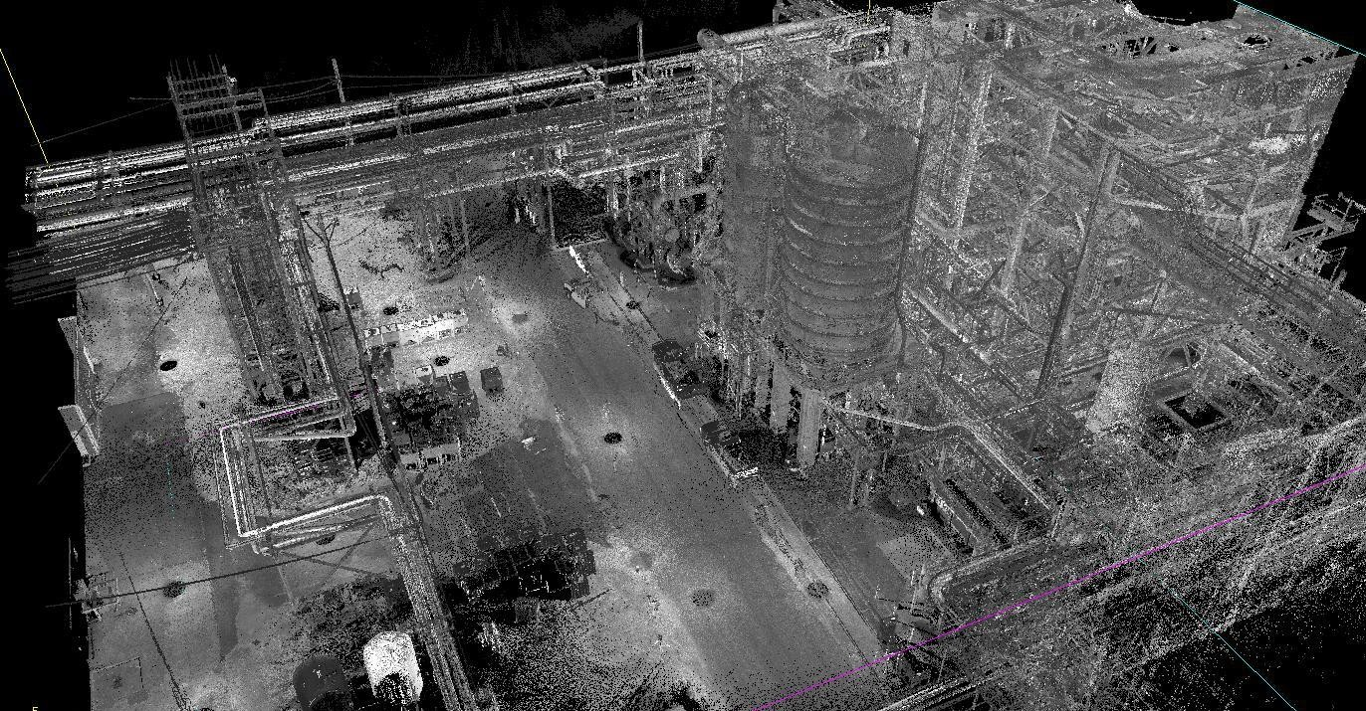
Digital Reality – Point Cloud
2026 SAFETY EXCELLENCE AWARDS | BEST PRACTICES SEMINAR

Slide 6

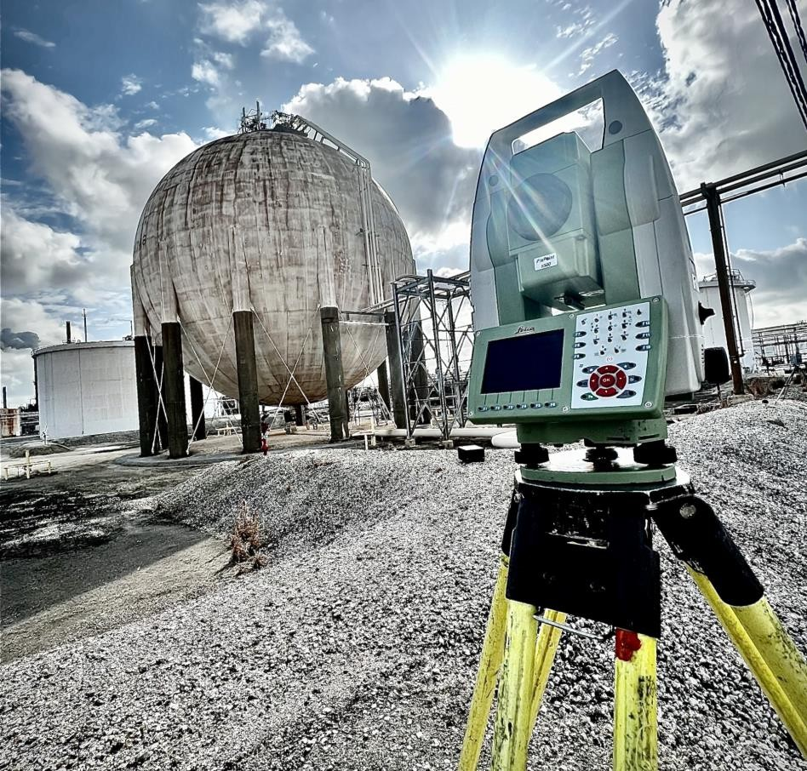

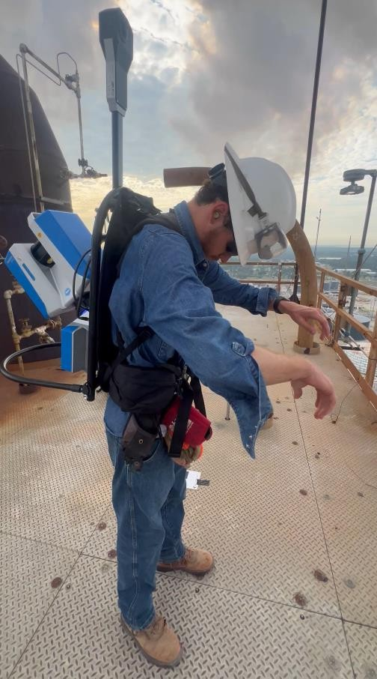
Technology
2026 SAFETY EXCELLENCE AWARDS | BEST PRACTICES SEMINAR

Slide 7
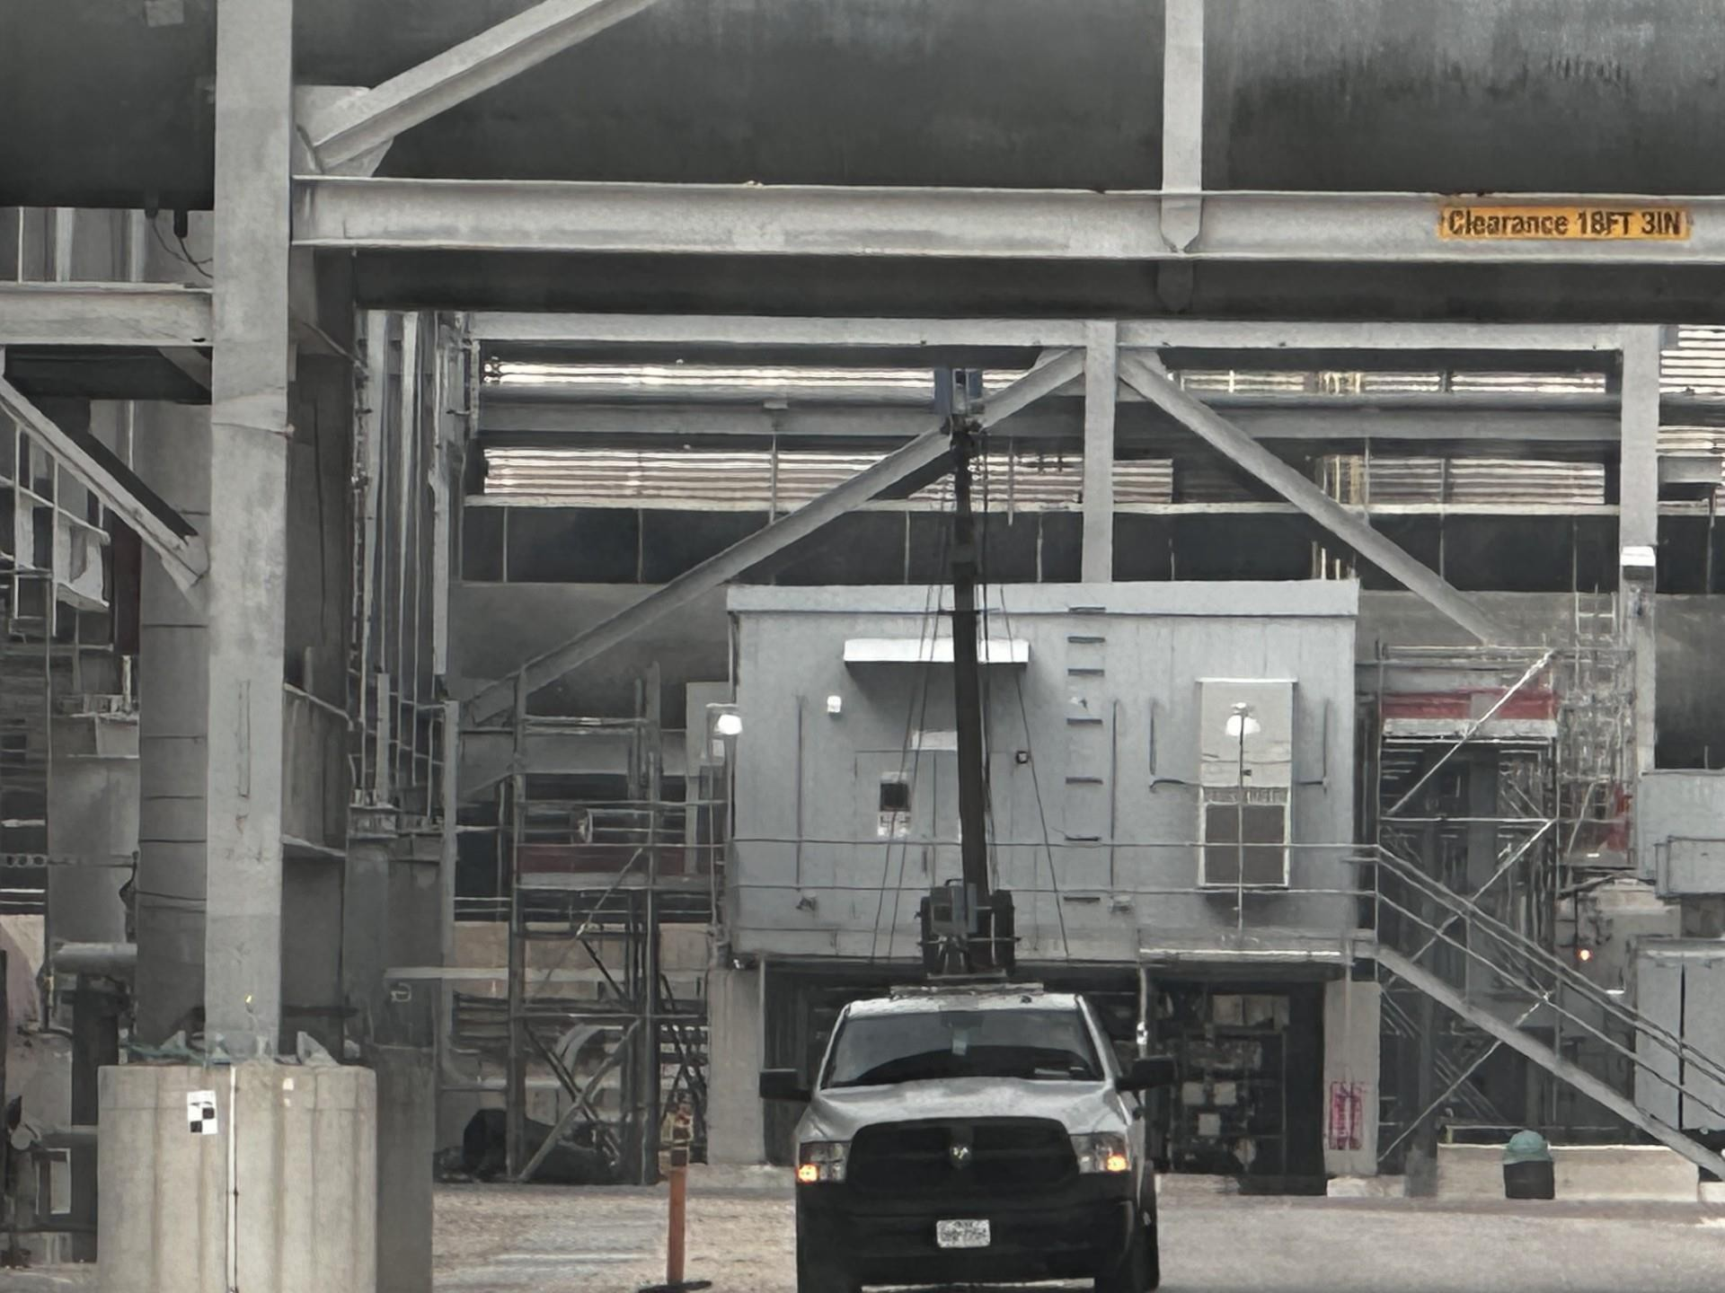
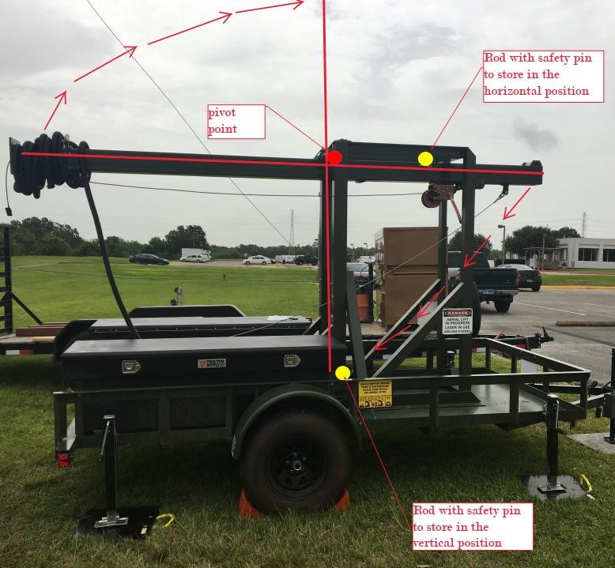
Innovations
2026 SAFETY EXCELLENCE AWARDS | BEST PRACTICES SEMINAR

Slide 8
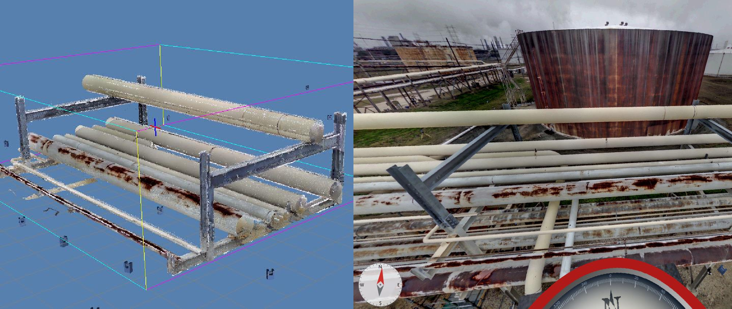
Innovations at Work
2026 SAFETY EXCELLENCE AWARDS | BEST PRACTICES SEMINAR

Slide 9
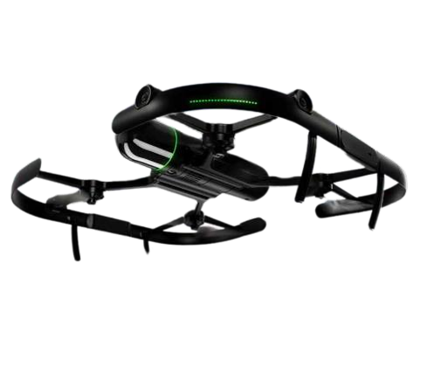
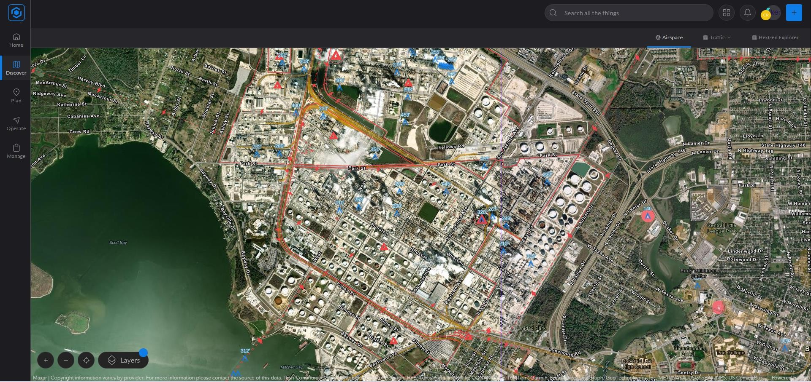
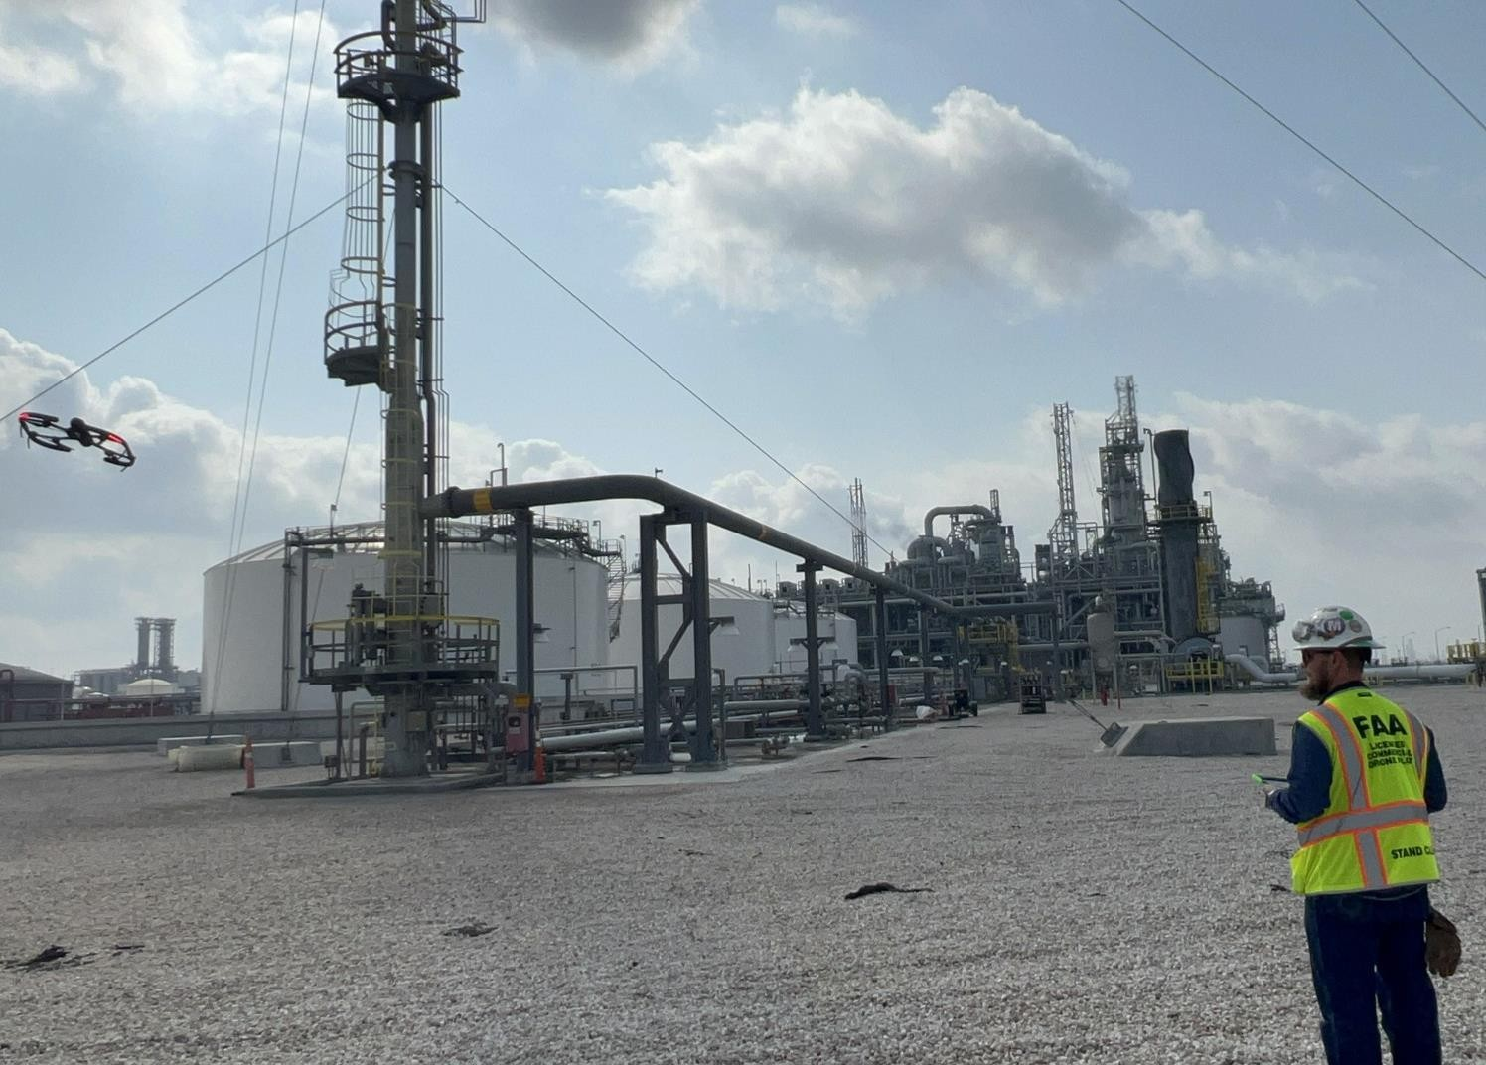
UAS
2026 SAFETY EXCELLENCE AWARDS | BEST PRACTICES SEMINAR

Slide 10
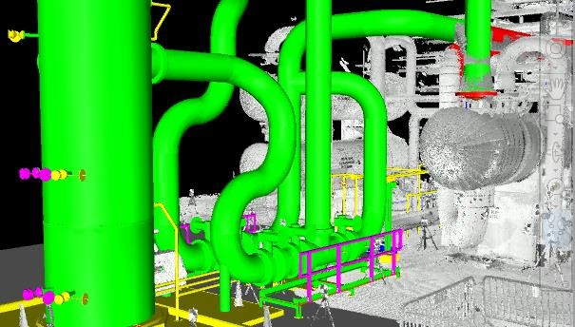
2026 SAFETY EXCELLENCE AWARDS | BEST PRACTICES SEMINAR

Slide 11
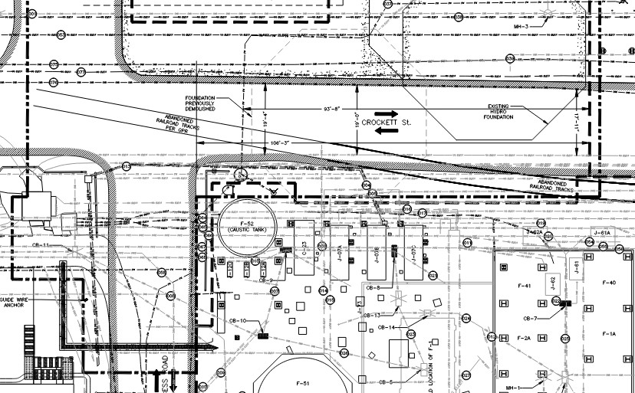
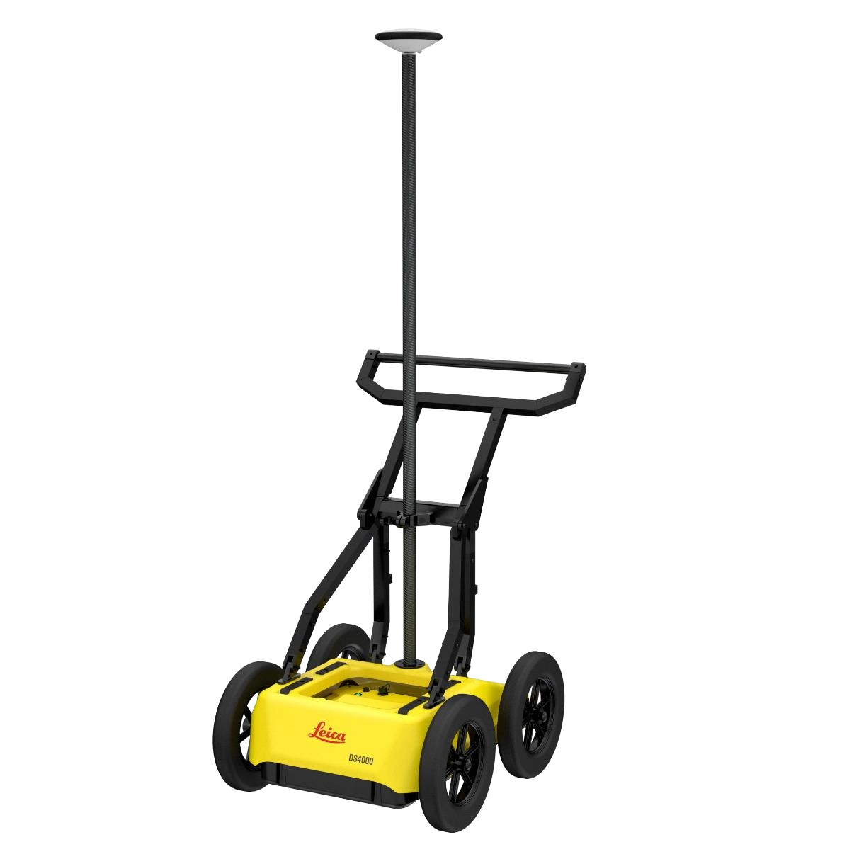
2026 SAFETY EXCELLENCE AWARDS | BEST PRACTICES SEMINAR

Slide 12
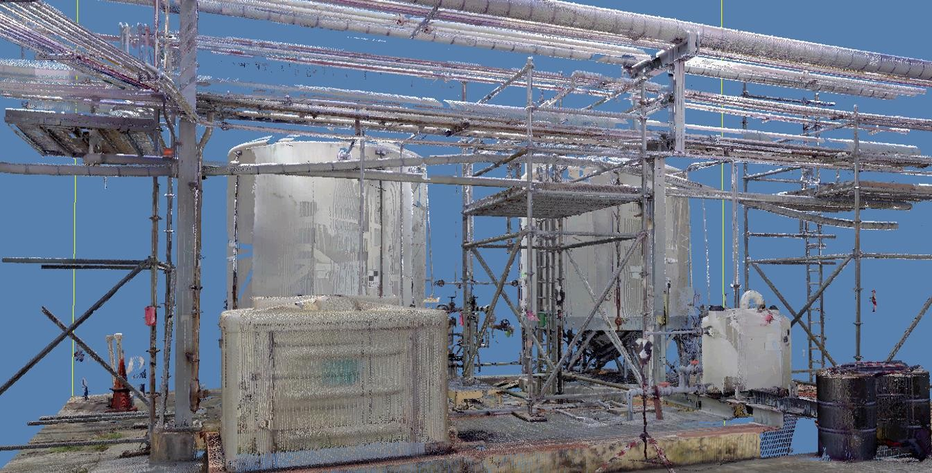
2026 SAFETY EXCELLENCE AWARDS | BEST PRACTICES SEMINAR

Slide 13
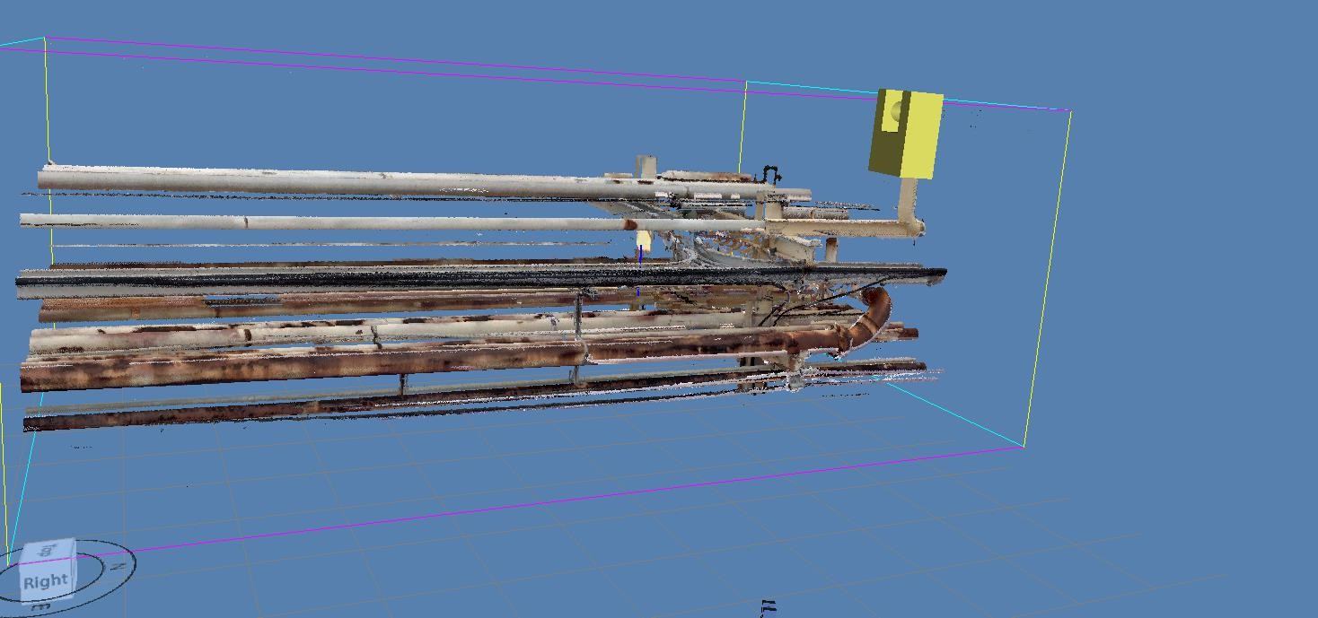
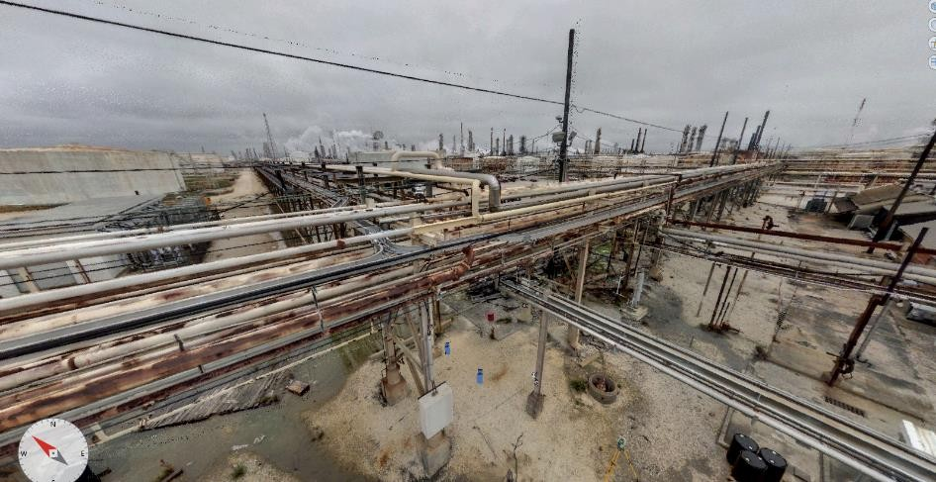
2026 SAFETY EXCELLENCE AWARDS | BEST PRACTICES SEMINAR

Slide 14

QUESTIONS?

