Slide 1




2026 SAFETY EXCELLENCE AWARDS | BEST PRACTICES SEMINAR
SPECIALIZED SERVICES
BEST IN CLASS
DBG Services L.P. stands alone as the only janitorial company in the United States to earn OSHA’s prestigious VPP Star designation. Focused solely on the petrochemical industry, DBG delivers best-in-class janitorial, grounds maintenance, pest control, turnaround (TA) support, and complete facilities management services—driven by a commitment to safety, quality, and operational excellence.

Slide 2


Slide 3
2026 SAFETY EXCELLENCE AWARDS | BEST PRACTICES SEMINAR
BEST PRACTICE
AGENDA / OUTLINE
Introduction & General Review
Best Practice - GFCI
Q&A

Slide 4

Introduction & General Review
2026 SAFETY EXCELLENCE AWARDS | BEST PRACTICES SEMINAR
Presented By:
Cathy Biggs – Corporate Safety Mgr./VPP Coordinator/TC Safety Mgr./CSST
Kelly McCarty – Operations Manager/CSST/North Safety Manager
DBG Services, L. P. is an Industrial Facilities Maintenance Provider and is currently active at over 12 locations from Texas City to Houston, Deer Park, and Mont Belvieu.
Our services consist of:
Janitorial Services
Grounds Maintenance / Vegetation Control
Water Services
Bulk Trash Maintenance
Pest Control Services
#1 Priority → Employee Safety, Quality & Customer Satisfaction
Mission Statement:
“We will operate a safe
and environmentally sound organization,
providing quality service in a
competitive, profitable manner.”

Slide 5
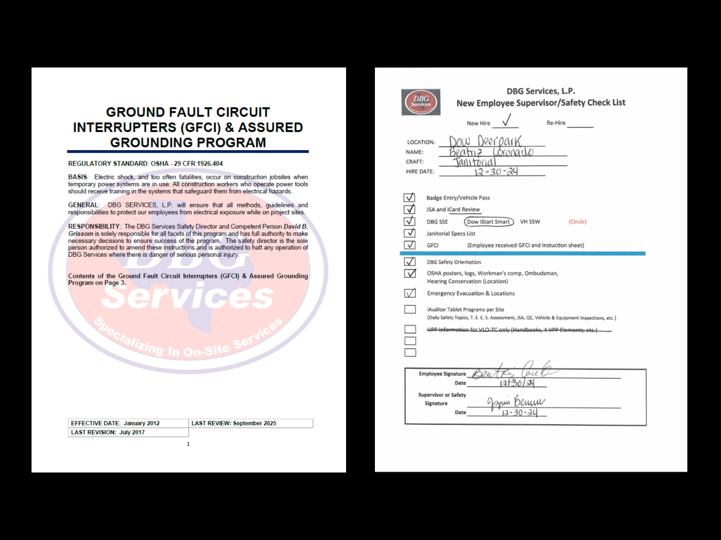
Best Practice - GFCI
2026 SAFETY EXCELLENCE AWARDS | BEST PRACTICES SEMINAR
DBG Services Ground Fault Circuit Interrupters (GFCI) & Assured Grounding Program:
DBG Services is not qualified to assure the continuity of the electrical appliance to the equipment and must advise assistance from the facility I&E Department.
GFCI training is conducted with employees during safety orientation and is covered through the HASC Janitorial Training.
Employees may reference the Janitorial Safety Training on the DBG Services Inspections App.

Slide 6

2026 SAFETY EXCELLENCE AWARDS | BEST PRACTICES SEMINAR

Slide 7

2026 SAFETY EXCELLENCE AWARDS | BEST PRACTICES SEMINAR

Slide 8
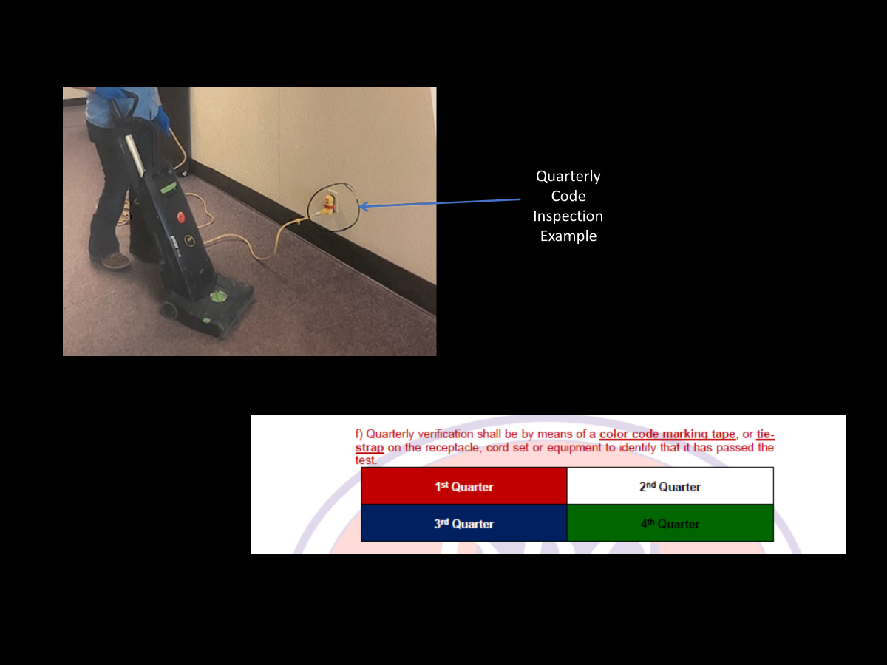
2026 SAFETY EXCELLENCE AWARDS | BEST PRACTICES SEMINAR

Slide 9
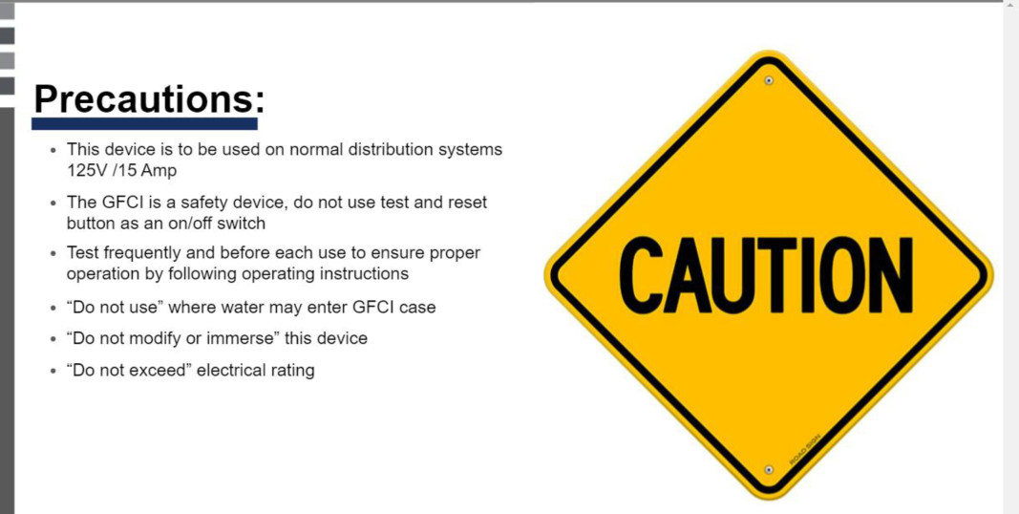
2026 SAFETY EXCELLENCE AWARDS | BEST PRACTICES SEMINAR

Slide 10
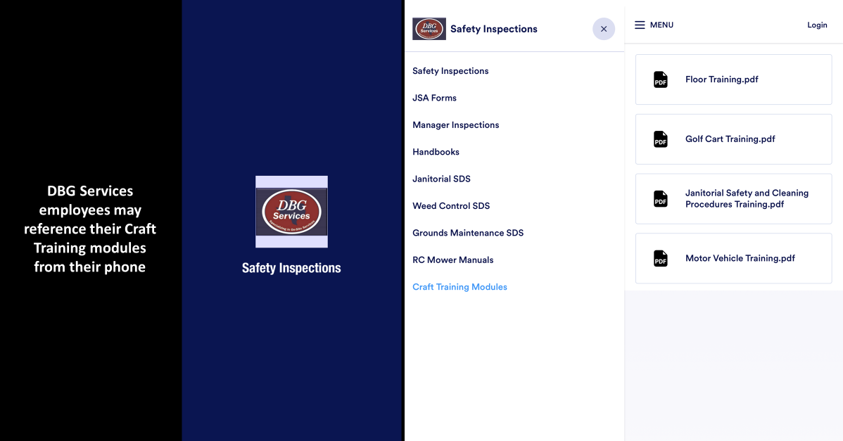
2026 SAFETY EXCELLENCE AWARDS | BEST PRACTICES SEMINAR

Slide 11

QUESTIONS?

