Slide 1



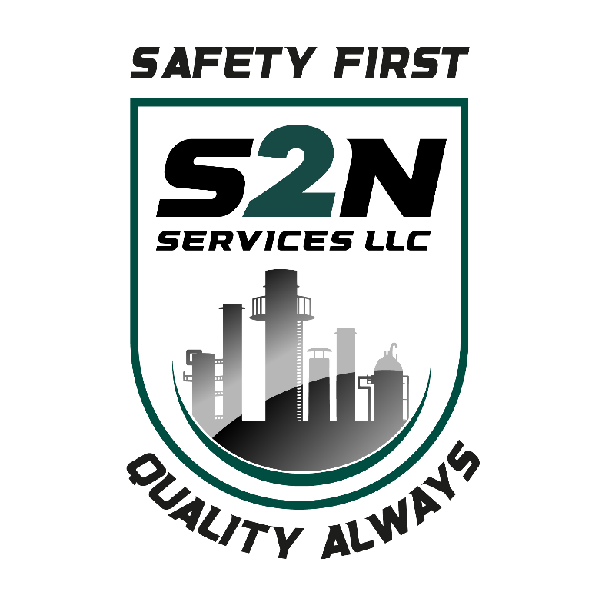
2026 SAFETY EXCELLENCE AWARDS | BEST PRACTICES SEMINAR
SOFT CRAFTS SMALL
BEST IN CLASS
S2N Services delivers high-quality soft craft solutions for the oil & gas industry, executing complex work across LNG, petrochemical, and midstream facilities. Our crews combine experience and strict safety discipline to outperform expectations on every project. From corrosion protection to insulation systems and engineered access, S2N sets the benchmark for quality, reliability, and execution. Every project we execute reflects a culture built on discipline and accountability.

Slide 2


Slide 3
2026 SAFETY EXCELLENCE AWARDS | BEST PRACTICES SEMINAR
BEST PRACTICE
AGENDA / OUTLINE
Purpose
Execution & Implementation
Benefits & Results
Examples
Future Use & Applications
Summary & Wrap Up
Q&A

Slide 4

Vehicle 360 Awareness Program
Best Practice
2026 SAFETY EXCELLENCE AWARDS | BEST PRACTICES SEMINAR
Why did we establish this program?
  For the prevention of vehicle accidents during backing.
  Safety for the employees for first move forward.

Slide 5
Vehicle 360 Awareness Program
Best Practice
2026 SAFETY EXCELLENCE AWARDS | BEST PRACTICES SEMINAR
Companies provide;
  Vehicles with side and rearview mirrors
  Cameras for recording during driving
  Blind spot warnings (some vehicles)
  Back up cameras in vehicles with infrared guidance.
    And still there are accidents

Slide 6
Vehicle 360 Awareness Program
Best Practice
2026 SAFETY EXCELLENCE AWARDS | BEST PRACTICES SEMINAR
Most drivers spend less than one percent of their driving time in reverse.
(NSC) estimates that one out of every four vehicle accidents occur while backing.
The National Highway Traffic and Safety Administration estimates that 210 people are killed every year backing accidents.

Slide 7
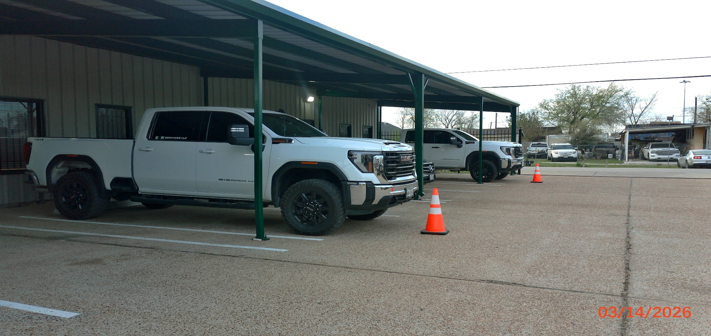
Vehicle 360 Awareness Program
Best Practice
2026 SAFETY EXCELLENCE AWARDS | BEST PRACTICES SEMINAR

Slide 8
Vehicle 360 Awareness Program
Best Practice
2026 SAFETY EXCELLENCE AWARDS | BEST PRACTICES SEMINAR
360 walk around vehicle inspection
  Ensures the area is hazard free.
  Allows to inspect for objects during vehicle being parked.
  Allows to inspect if damage has occurred during being parked.
  No obstructions either in front of or behind of the vehicle.
  The path of travel is clear and unobstructed.

Slide 9
Vehicle 360 Awareness Program
Best Practice
2026 SAFETY EXCELLENCE AWARDS | BEST PRACTICES SEMINAR
360 walk around vehicle inspection
  Verify that the vehicle will go under low clearances.
  Roll down the windows to hear any noise.
  Adjust mirrors to make the blind spot as small as possible.

Slide 10
Vehicle 360 Awareness Program
Best Practice
2026 SAFETY EXCELLENCE AWARDS | BEST PRACTICES SEMINAR
The 6 S's of safe backing (NSC) are:
Seatbelt: Always ensure your seatbelt is securely fastened before starting the vehicle or beginning to reverse.
Situate: Adjust seating position, seatbelt, and mirrors.
Sweep: Perform a 360-degree sweep of the area around your vehicle, be aware of blind spots, pedestrians, and obstacles.

Slide 11
Vehicle 360 Awareness Program
Best Practice
2026 SAFETY EXCELLENCE AWARDS | BEST PRACTICES SEMINAR
The 6 S's of safe backing continued;
Scan: Look for moving objects behind and around your vehicle.
Swivel: Physically swivel your head to constantly check your surroundings, look out the rear window, check mirrors
Stop: Come to a complete, controlled stop once the maneuver is finished, or stop immediately if you spot an unexpected hazard.

Slide 12
Vehicle 360 Awareness Program
Best Practice
2026 SAFETY EXCELLENCE AWARDS | BEST PRACTICES SEMINAR
By following these steps, we can eliminate
  Backing incidents involving striking of objects or pedestrians.
  Property damage
  Incidents with vehicles

Slide 13

QUESTIONS?

