Slide 1



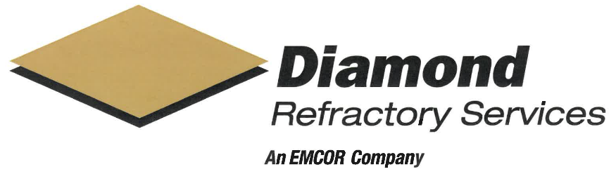
2026 SAFETY EXCELLENCE AWARDS | BEST PRACTICES SEMINAR
SOFT CRAFTS MEDIUM
BEST IN CLASS
Founded in 1999 and headquartered in Houston Texas, Diamond Refractory Services is a premier industrial specialist protecting critical facilities from extreme corrosion and temperature. Renowned for their award-winning safety culture and elite technical expertise, they deliver world-class refractory installation and repair for the refinery and petrochemical sectors, backed by over 200 years of combined management experience.

Slide 2


Slide 3
2026 SAFETY EXCELLENCE AWARDS | BEST PRACTICES SEMINAR
BEST PRACTICE
AGENDA / OUTLINE
Purpose
Execution & Implementation
Benefits & Results
Examples
Future Use & Applications
Summary & Wrap Up
Q&A

Slide 4

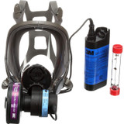

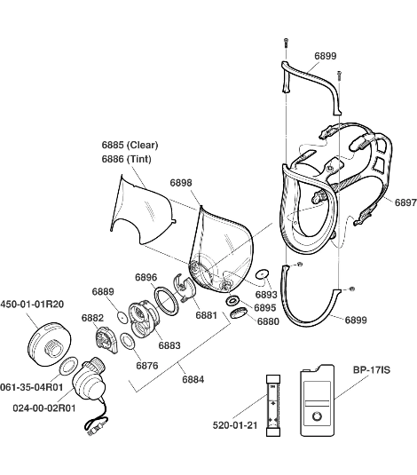
Battery Powered PAPR Respirators
2026 SAFETY EXCELLENCE AWARDS | BEST PRACTICES SEMINAR
Purpose –
Improve worker respiratory protection in high-exposure environments
Reduce inhalation risks from dust, silica, and airborne contaminants
Provide a higher level of protection and comfort than standard filter respirators

Slide 5
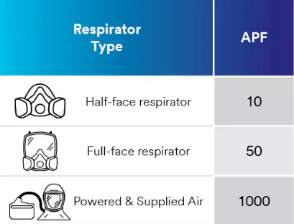
Execution and Implementation
2026 SAFETY EXCELLENCE AWARDS | BEST PRACTICES SEMINAR
Identified high risk tasks ( refractory tear-out, mixing, installation)
Evaluated respirator options and selected 3M 6000 Series PAPR
Steps implemented –
Purchase and distribution (2015)
Fit testing and medical clearance
Hands-on training for employees
Enforced use of equipment
Ongoing inspections and maintenance program

Slide 6
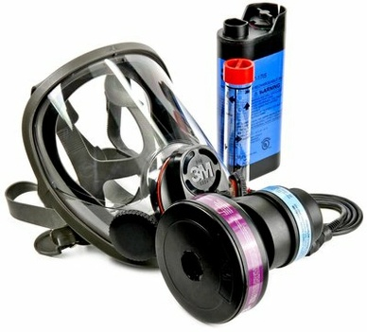
Benefits and Results
2026 SAFETY EXCELLENCE AWARDS | BEST PRACTICES SEMINAR
Improved worker safety - Provides a high protection factor (APF) of up to1,000 significantly reducing the opportunity for exposure to respirable silica, dust, and airborne contaminants
OSHA compliance - Strengthens compliance with OSHA Respiratory Protection Standards (29 CFR 1926.103/ 1910.134
Increased comfort / Reduced fatigue - Battery-powered airflow reduces breathing resistance
Safer work environment - Implementation of PAPRs fosters a safer workplace, boosting morale and employee confidence in health priorities.​

Slide 7
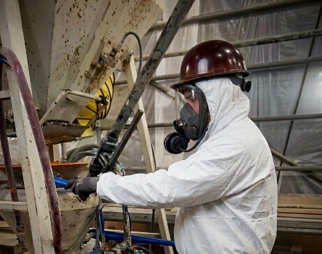
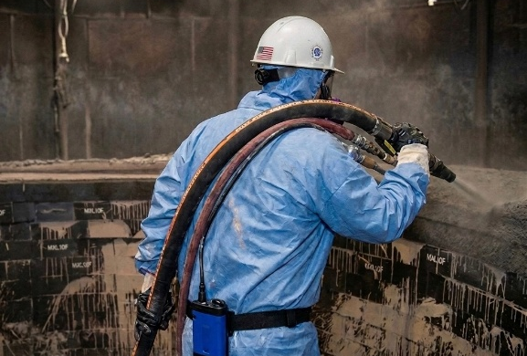
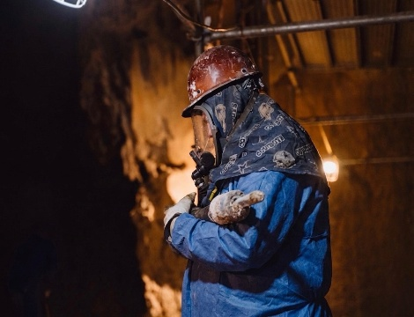
Examples
2026 SAFETY EXCELLENCE AWARDS | BEST PRACTICES SEMINAR
Refractory demolition with high levels of airborne silica dust
Confined space operations where respirable silica is present
Material mixing and handling producing airborne particulates
Work environments where airflow improves tolerance of PPE

Slide 8
Future Use & Applications
2026 SAFETY EXCELLENCE AWARDS | BEST PRACTICES SEMINAR
Continue use in high respirable silica-generating operations
Maintain implementation during tasks with elevated exposure risks
Continue to use PAPR equipment as a best practice contributing to zero overexposure incidents and improved safety performance metrics

Slide 9
Summary
2026 SAFETY EXCELLENCE AWARDS | BEST PRACTICES SEMINAR
PAPR systems provide superior respiratory protection in high-risk environments
Improve both safety and worker compliance
Support OSHA regulatory compliance for respirable crystalline silica

Slide 10

QUESTIONS?

