Slide 1
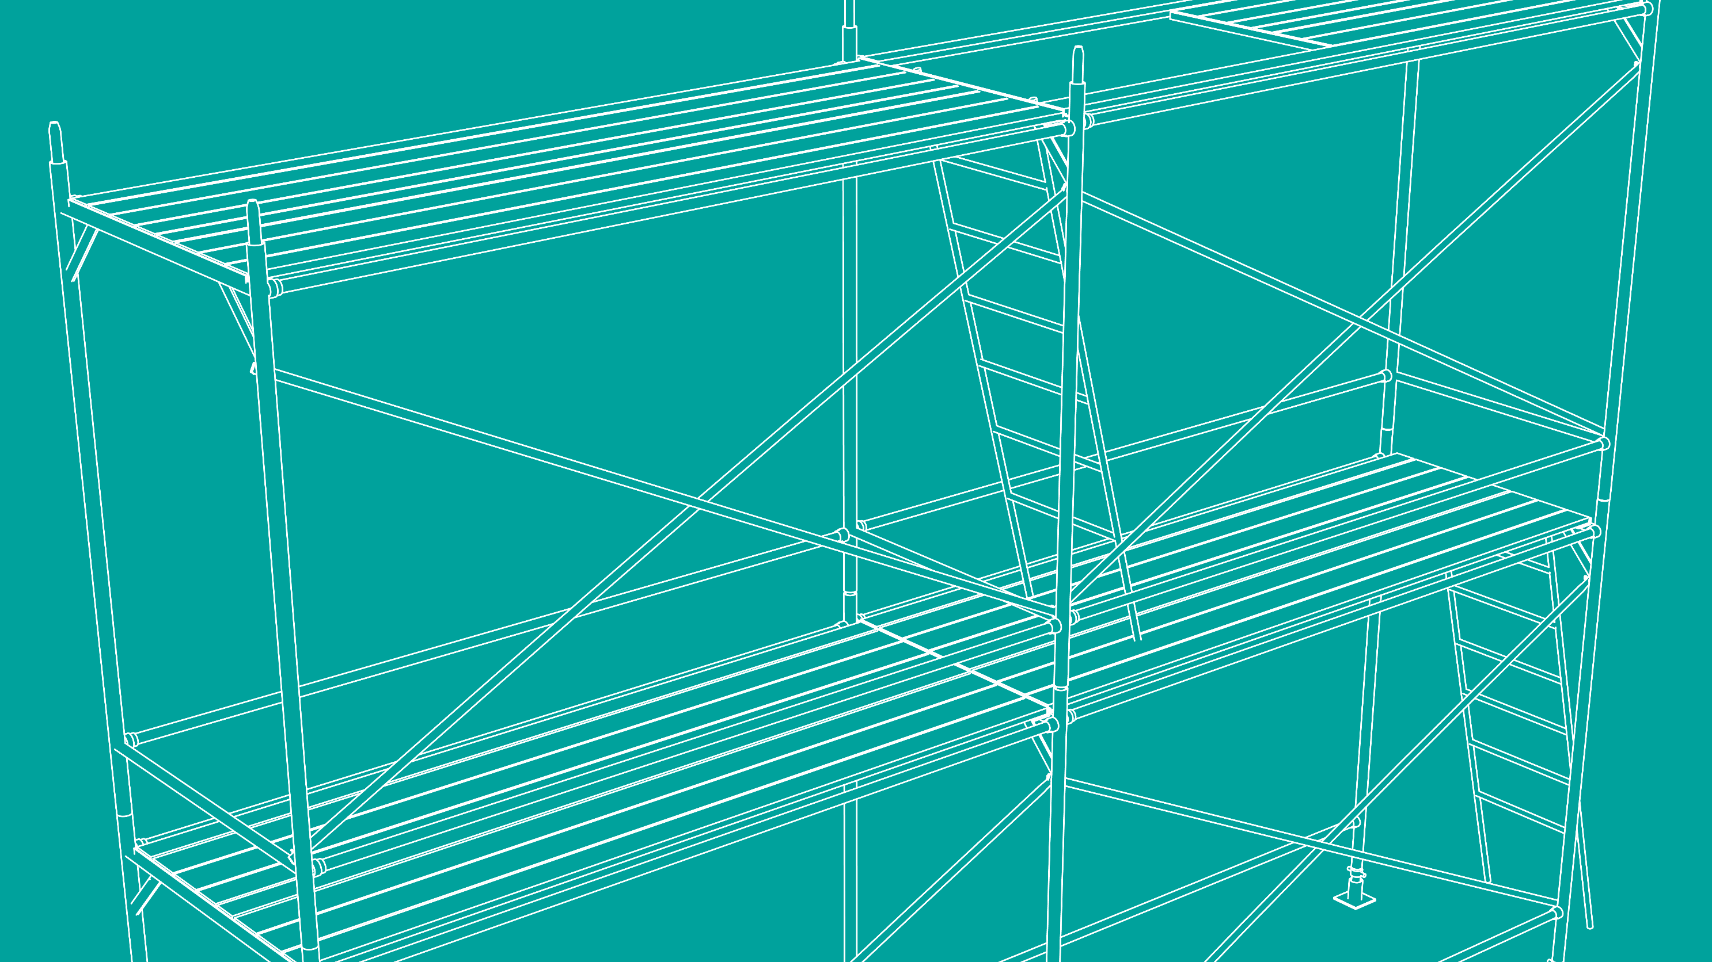



2026 SAFETY EXCELLENCE AWARDS | BEST PRACTICES SEMINAR
SOFT CRAFTS LARGE
BEST IN CLASS
At Excel Modular Scaffold, our strength is our people, driving our growth and success. We boast the best talent retention record, with highly trained and seasoned professionals. Our mission: to deliver first-class scaffold, insulation, paint, and abatement services with the best industry experts.

Slide 2


Slide 3
2026 SAFETY EXCELLENCE AWARDS | BEST PRACTICES SEMINAR
BEST PRACTICE
AGENDA / OUTLINE
Purpose
Execution & Implementation
Benefits & Results
Examples
Future Use & Applications
Summary & Wrap Up
Q&A

Slide 4

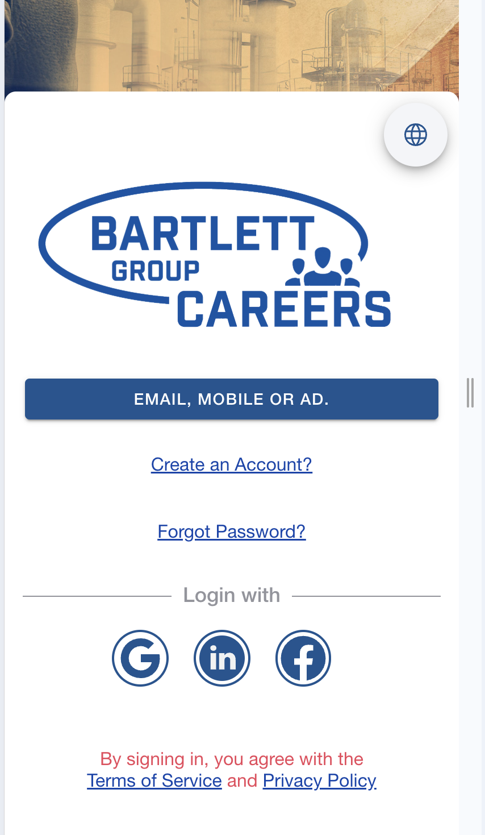
APP-BASED HIRING
2026 SAFETY EXCELLENCE AWARDS | BEST PRACTICES SEMINAR
Electronic hiring procedure facilitates early application initiation.
Applicants can start the process remotely.
Streamlines hiring process.
New hires promptly access company training upon
onboarding.
Establishes a knowledgeable workforce from day one.

Slide 5

INTERNAL TRAINING
AND TESTING
2026 SAFETY EXCELLENCE AWARDS | BEST PRACTICES SEMINAR
Central hub for employee development.
Accessible to all employees and applicants.
Simplifies regulatory training.
Reduces reliance on paperwork.
Boosts operational efficiency.
Swift distribution of training materials and notices.
Ensures uniformity across the workforce.

Slide 6
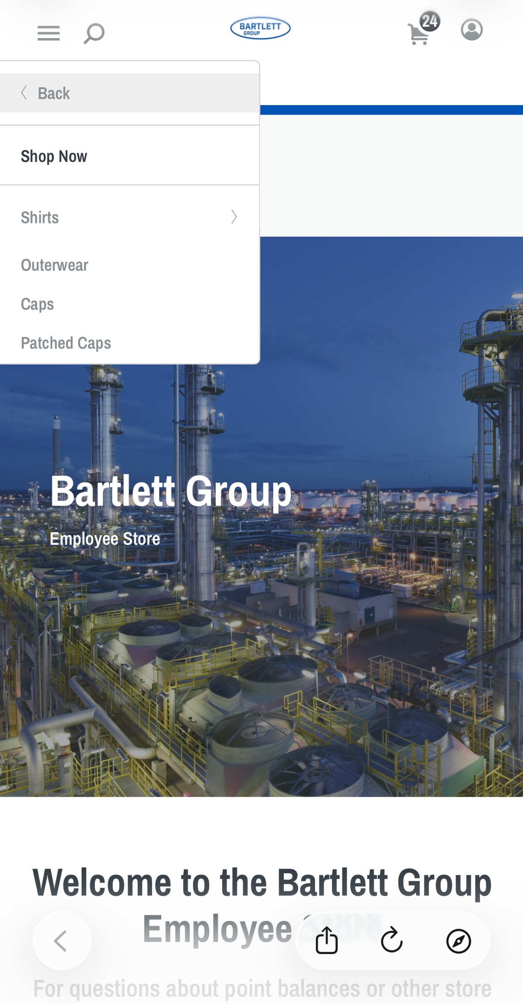
COMPANY STORE
2026 SAFETY EXCELLENCE AWARDS | BEST PRACTICES SEMINAR
Accumulate safety points through:
  Attending safety meetings
  Engaging in safe actions
  Completing training
Redeem points for:
  Company-branded merchandise
  Workwear
  Tools
Promotes:
  Safety awareness
  Employee motivation
  Participation

Slide 7

DOCUMENT
ACCESS
2026 SAFETY EXCELLENCE AWARDS | BEST PRACTICES SEMINAR
Instant access to important documents:
  Health, safety and environmental plans (HSEPs)
  Technical documents
  Safety notices
  Tech tips
Improves safety compliance:
  Ensures immediate availability of safety protocols.
  Helps employees adhere to safety guidelines effectively.

Slide 8
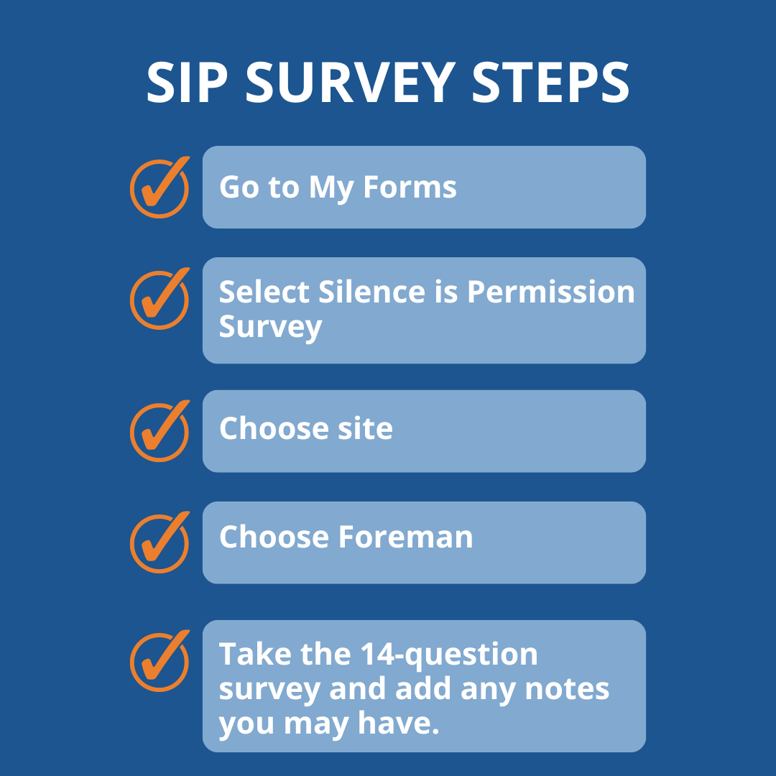
BEHAVIOR-BASED
SAFETY
2026 SAFETY EXCELLENCE AWARDS | BEST PRACTICES SEMINAR
Integrates Bartlett’s "Silence is Permission" (SIP) safety initiative.
SIP submissions feature automates tracking and reporting of safety data.
Eliminates manual data entry by administrators.
Reporting capabilities identify trends for proactive risk management.
Enables targeted training or safety tips.

Slide 9
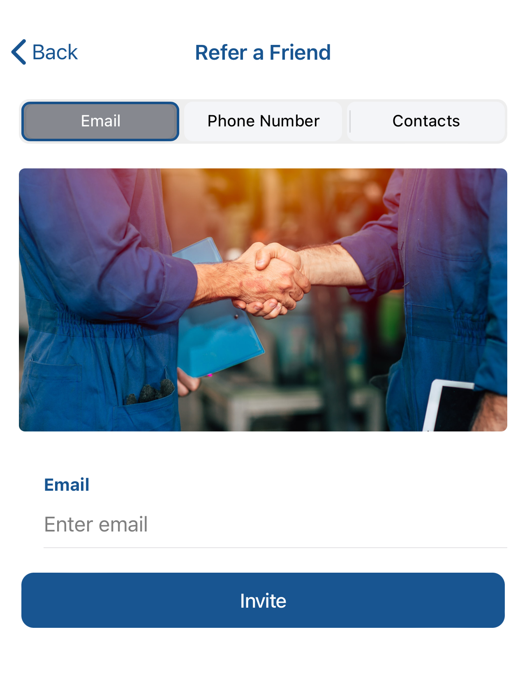

REFER A FRIEND
2026 SAFETY EXCELLENCE AWARDS | BEST PRACTICES SEMINAR
"Refer a Friend" feature simplifies referral process.
Current employees can recommend potential candidates easily.
Referrals directed to download the app and initiate application process.
Ensures seamless integration of new hires into digital-first approach.

Slide 10
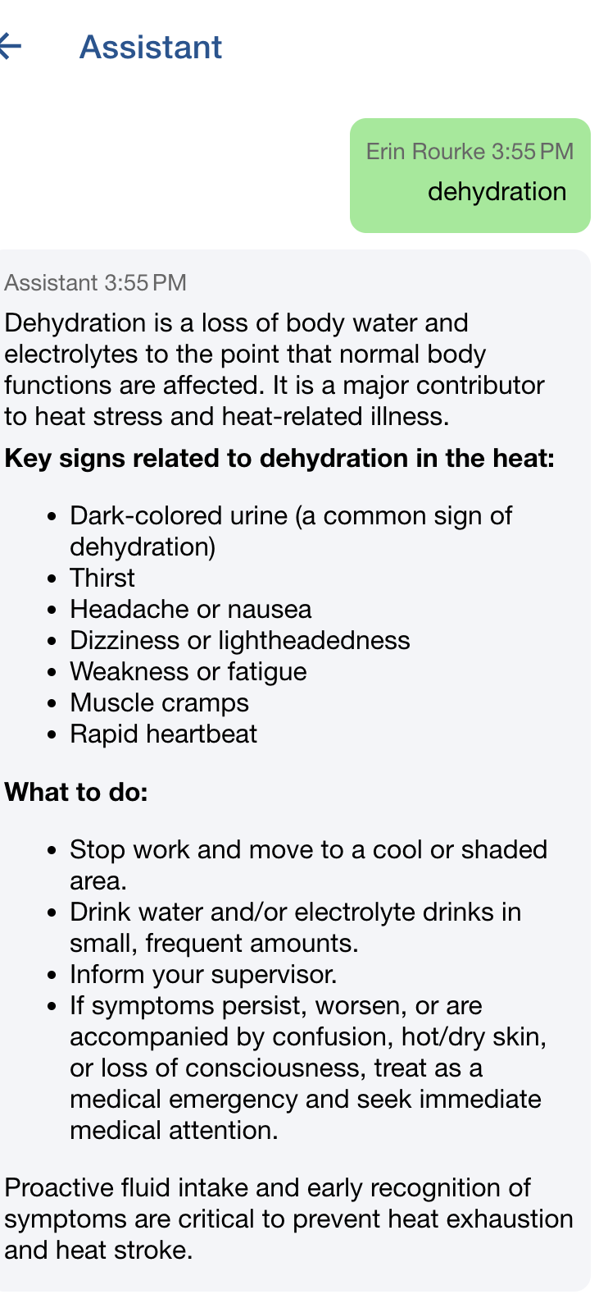
SAFETY ASSISTANT
2026 SAFETY EXCELLENCE AWARDS | BEST PRACTICES SEMINAR
AI based model that houses all of Excel’s policies and procedures as well as general information for quick guide access from anywhere

Slide 11
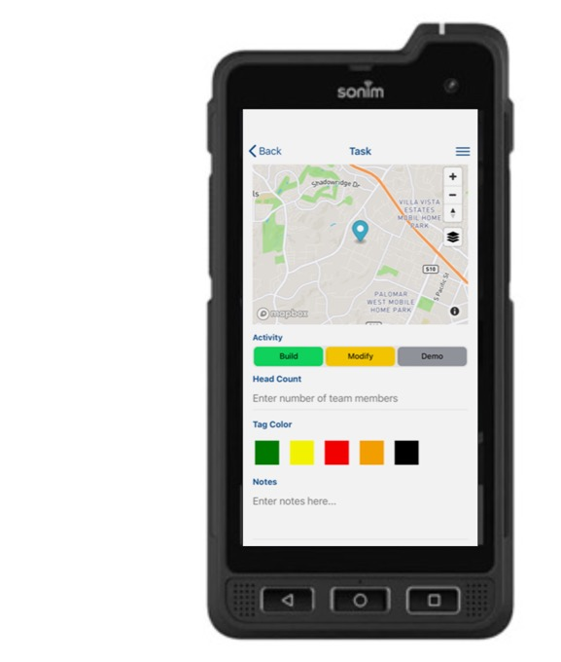
SCAFFOLD INSPECTIONS/
GEO-LOCATING
2026 SAFETY EXCELLENCE AWARDS | BEST PRACTICES SEMINAR
iPhones and Androids allow supervisors to keep up with daily inspections
Geo-locating allows scaffold visibility
Ties into web based planning system showing detailed locations of scaffolds before being built for execution planning

Slide 12
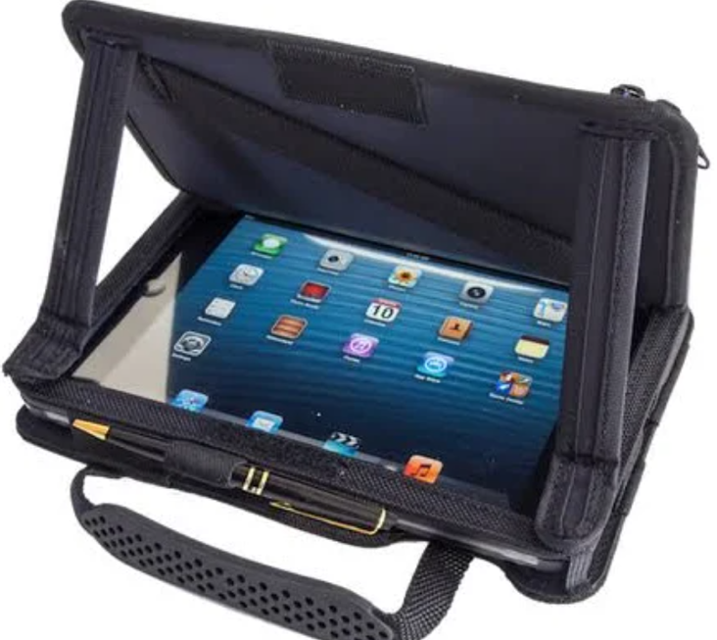
WEB-BASED PROJECT
MANAGEMENT PROGRAM
2026 SAFETY EXCELLENCE AWARDS | BEST PRACTICES SEMINAR
Workforce & Admin: Hiring, HR, employee management
Site Operations: Job site management, mobile timekeeping
Craft Execution: Design, estimating, tagging, inspections, geolocation mapping
Safety: Incident reporting, SIP & SWO leading indicators
Field Force: Task assignment, offline field data capture, photo annotation
Planning & Requests: Gantt-based look-ahead planning and coordination
Billing & Reporting: Accurate billing, dashboards, and portfolio analytics

Slide 13
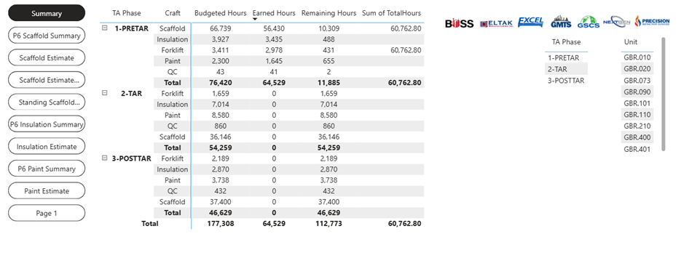
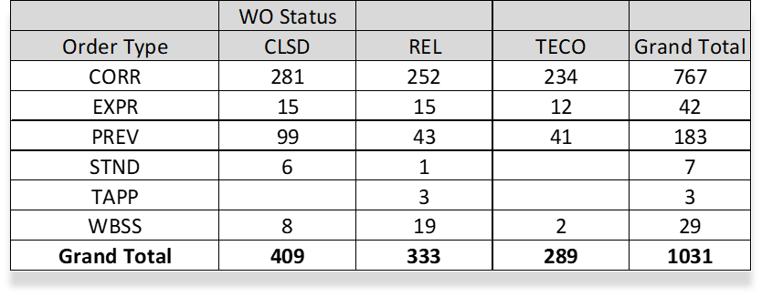
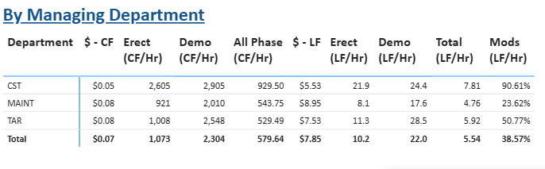
COST TRACKING &
REPORTING
2026 SAFETY EXCELLENCE AWARDS | BEST PRACTICES SEMINAR
Daily/Monthly updated costs provided.
Estimates can be compared to actual performance.
System compiles historical data for future reference.
Scaffolds can be transferred through stages to measure the effective utilization of scaffolds.
Time, scaffold tracking and invoicing can be customizable.

Slide 14
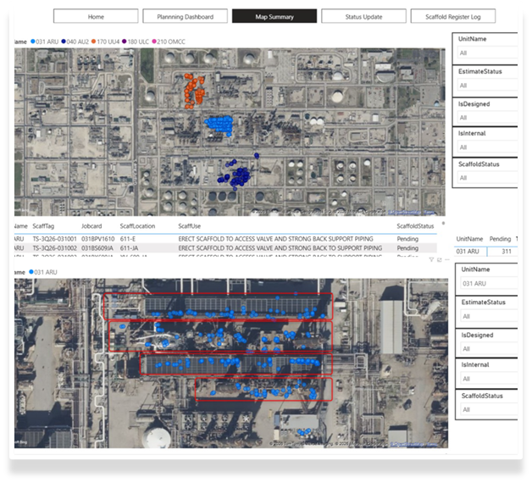
PLANNING, SCHEDULING
& ESTIMATING
2026 SAFETY EXCELLENCE AWARDS | BEST PRACTICES SEMINAR
Centralized view of scope, hours, and status across crafts
Identifies estimating and design gaps
Forecasts labor demand and crew loading
Aligns planning with execution
Outcome Goal: Reduced risk, improved productivity

Slide 15
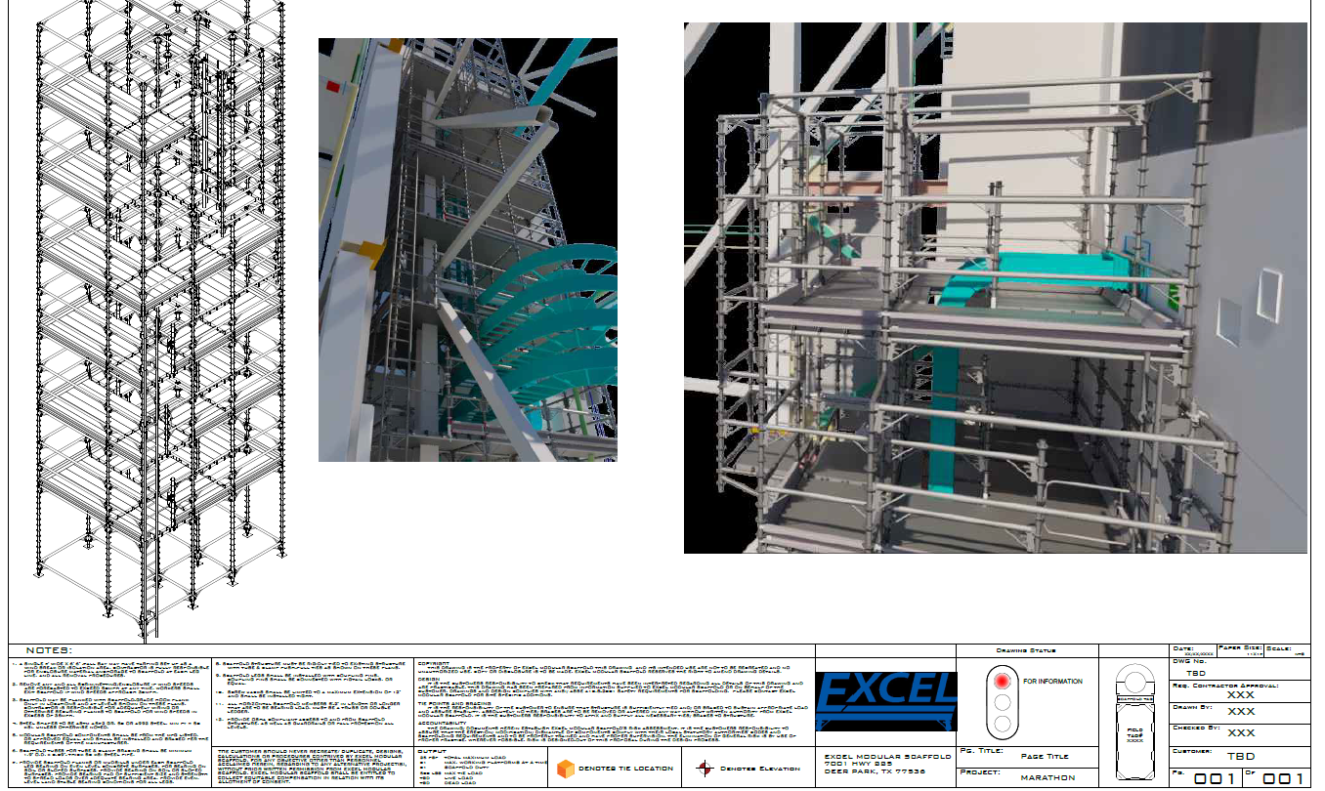
SCAFFOLD
DESIGN
2026 SAFETY EXCELLENCE AWARDS | BEST PRACTICES SEMINAR
Accurate 3D scaffold designs developed directly from laser scan point clouds.
Model-based quantities (cubic feet, decks, components) tied directly to scaffold scope.
Design validation in Navisworks, allowing stakeholders to review access, work fronts, and constructability virtually.
Historical Data for repeat scaffolding needs. Unit Blinding, Repeat Scopes.

Slide 16

QUESTIONS?

