Slide 1




2026 SAFETY EXCELLENCE AWARDS | BEST PRACTICES SEMINAR
INDUSTRIAL CLEANING SMALL
BEST IN CLASS
Since 1988, Sunrise has partnered with leading petrochemical producers across North America to provide on-site material management, polymer spill containment, and removal services. Nested within active facilities, Sunrise uses specialized equipment and recovery systems to safely contain and remove materials off-site in a responsible manner. Sunrise is an active member in Operation Clean Sweep® (OCS).

Slide 2


Slide 3

2026 SAFETY EXCELLENCE AWARDS | BEST PRACTICES SEMINAR
BEST PRACTICE
AGENDA / OUTLINE
Purpose
Execution & Implementation
Benefits & Results
Examples
Future Use & Applications
Summary & Wrap Up
Q&A

Slide 4

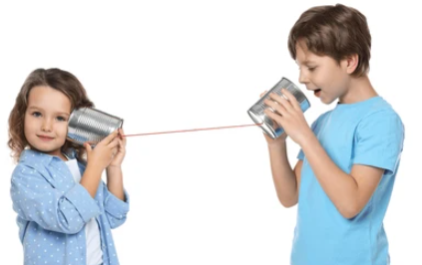
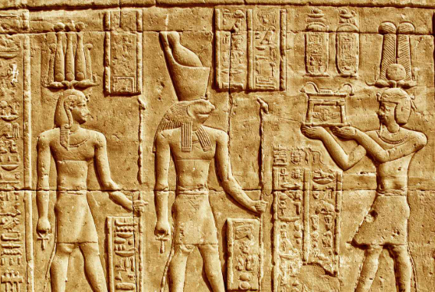



Best Practice
Alert Communication System
2026 SAFETY EXCELLENCE AWARDS | BEST PRACTICES SEMINAR

Slide 5

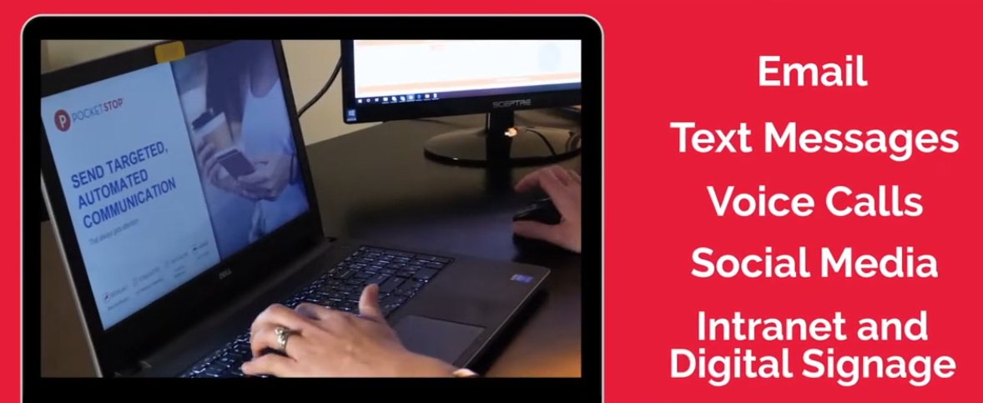
Communication That Creates Action
2026 SAFETY EXCELLENCE AWARDS | BEST PRACTICES SEMINAR

Slide 6
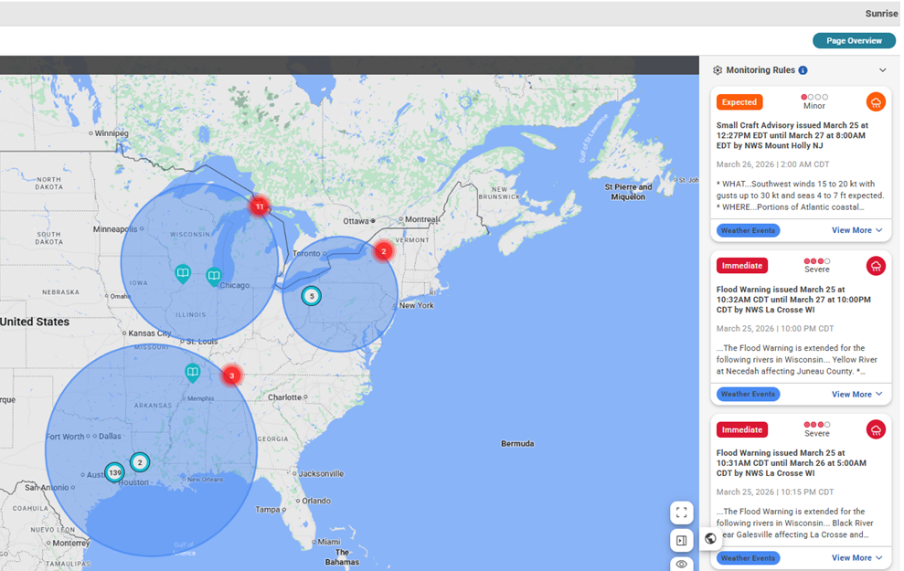
Controlled Message Integrity
2026 SAFETY EXCELLENCE AWARDS | BEST PRACTICES SEMINAR
A message can be sent directly to the intended group without being diluted, altered, or reinterpreted as it moves through layers of supervision.

Slide 7
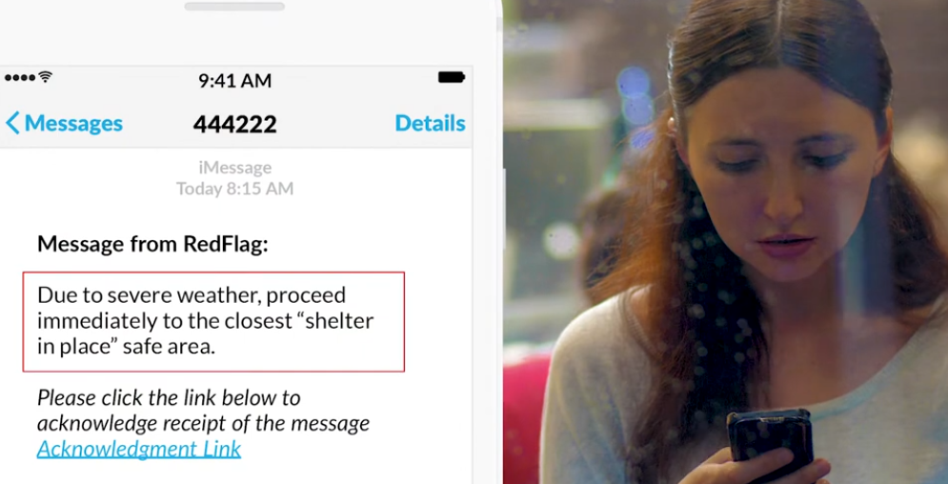
Multi-Channel Message Delivery
2026 SAFETY EXCELLENCE AWARDS | BEST PRACTICES SEMINAR
Alerts use text, email, phone, and other channels, increasing the likelihood that the message is received quickly.

Slide 8
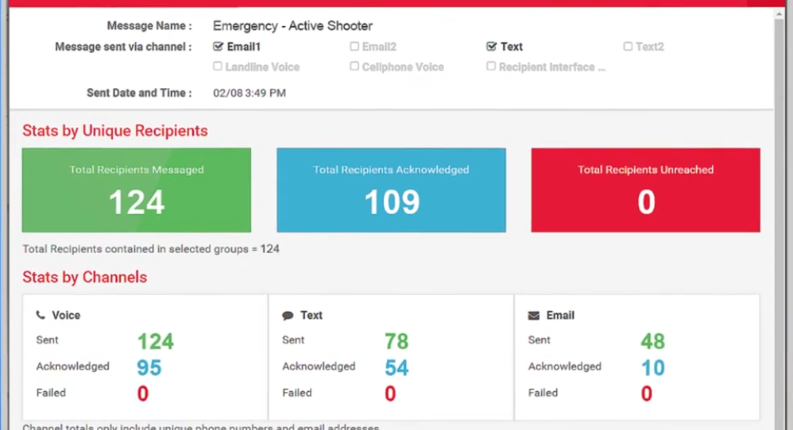
Confirmation, Traceability & Transparency
2026 SAFETY EXCELLENCE AWARDS | BEST PRACTICES SEMINAR
Real-time dashboard reporting shows who received, read, and confirmed, creating accountability during critical events

Slide 9
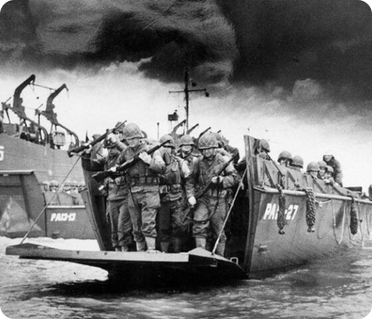
D-Day Example
2026 SAFETY EXCELLENCE AWARDS | BEST PRACTICES SEMINAR
“Invasion tonight, be prepared”
Targeted message:
        Navy
        Infantry
        Paratroopers

Slide 10
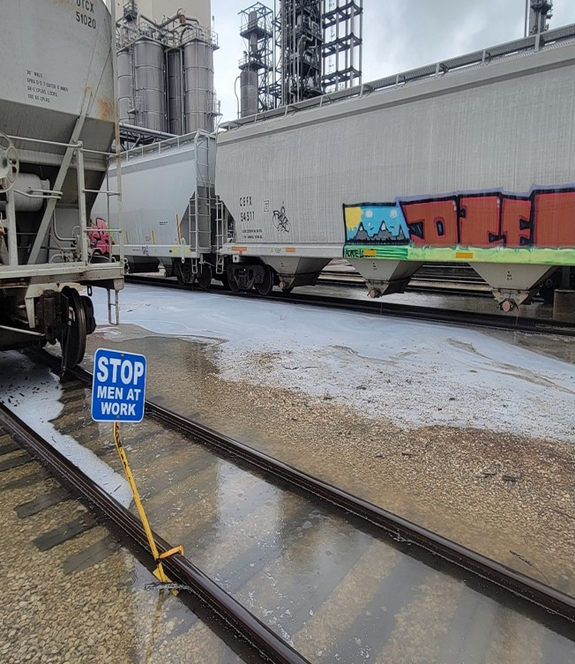
Sunrise Example – Polymer Spill
2026 SAFETY EXCELLENCE AWARDS | BEST PRACTICES SEMINAR
Drivers – “use Gate #3”
Vac Crews – “start containment”
OCS Leader – “report quantities and spill regions”

Slide 11
Summary
2026 SAFETY EXCELLENCE AWARDS | BEST PRACTICES SEMINAR
Effective Communication =
  Right Message
        Right People
            Right Time

Slide 12

QUESTIONS?

