Slide 1




2026 SAFETY EXCELLENCE AWARDS | BEST PRACTICES SEMINAR
INDUSTRIAL CLEANING LARGE
BEST IN CLASS
HPC Industrial, powered by Clean Harbors, is the premier industrial cleaning and environmental services company in North America. We are committed to innovation in technology and automation to improve safety and sustainability across the industry. Our national network and comprehensive menu of services mean that we are a true one-stop shop, providing customizable solutions and operational efficiency without sacrificing value.

Slide 2


Slide 3

2026 SAFETY EXCELLENCE AWARDS | BEST PRACTICES SEMINAR
BEST PRACTICE
AGENDA / OUTLINE
Purpose
Execution & Implementation
Benefits & Results
Examples
Future Use & Applications
Summary & Wrap Up
Q&A

Slide 4

2026 SAFETY EXCELLENCE AWARDS | BEST PRACTICES SEMINAR
CSE Permit Scan and Review Process

Slide 5
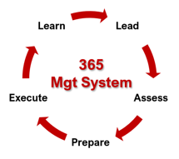
Contents
2026 SAFETY EXCELLENCE AWARDS | BEST PRACTICES SEMINAR
CSE Information and Documents Needed for Approval
Information and Documentation entered in the Pre-Permit Review Program for Approvals
Uploading of completed permit into the CSE Permit Scanning App for evaluation for completion
Review of CSE Permits by H&S and Branch Manager with the CSES
Active review of our permits allows us to learn how work is being performed, improve, and prevent injury.

Slide 6
2026 SAFETY EXCELLENCE AWARDS | BEST PRACTICES SEMINAR
CSE Document Needed
HPC JSAs
JSA Hazard Assessment Form (Completed)
SDS of known Chemicals
Verification of Confine Space Ventilation
Known dimensions of equipment being entered (Lenth, Width, Hight, Manways)
Recue Plan (Customer or Third Party)

Slide 7
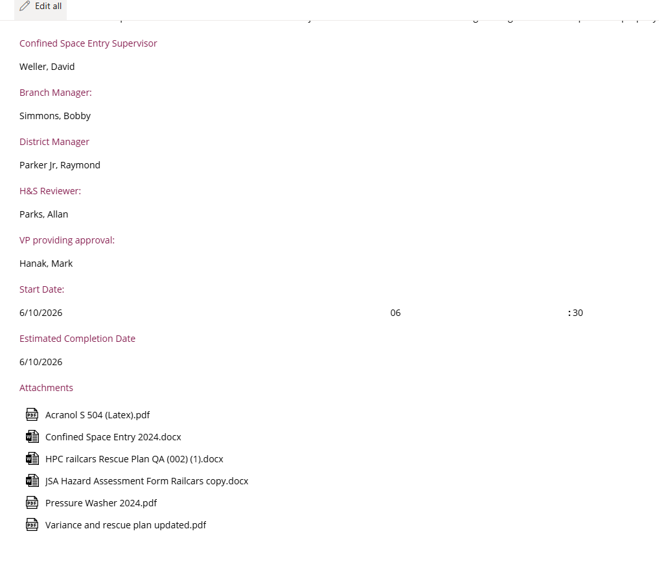
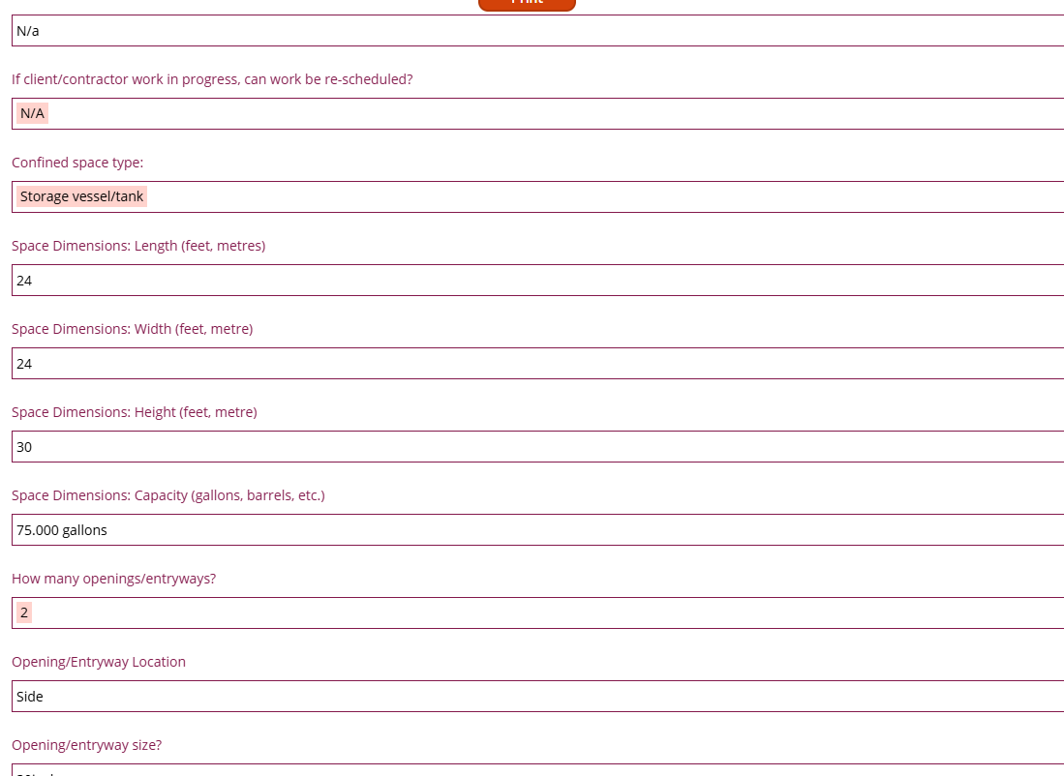
Online Completion of Pre-Permit Approval Process
2026 SAFETY EXCELLENCE AWARDS | BEST PRACTICES SEMINAR
An Authorized CSES will enter the required info and documents into the Pre-Permit Approval Form
Approval are needed from
  Branch Manager
  District Manager
  H&S Manager
  District VP

Slide 8
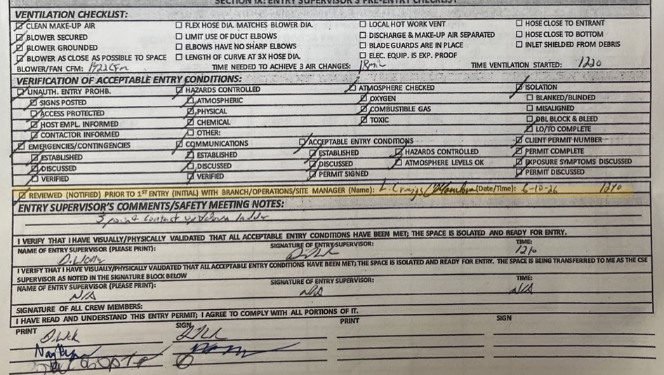
Permit Approval Prior to Enty
2026 SAFETY EXCELLENCE AWARDS | BEST PRACTICES SEMINAR
Prior to Entry into Confine Space the CSES must call the Branch Manager to go over the PPE, LEL, Hazards and Permit Requirements and document it on the CSE Permit.

Slide 9
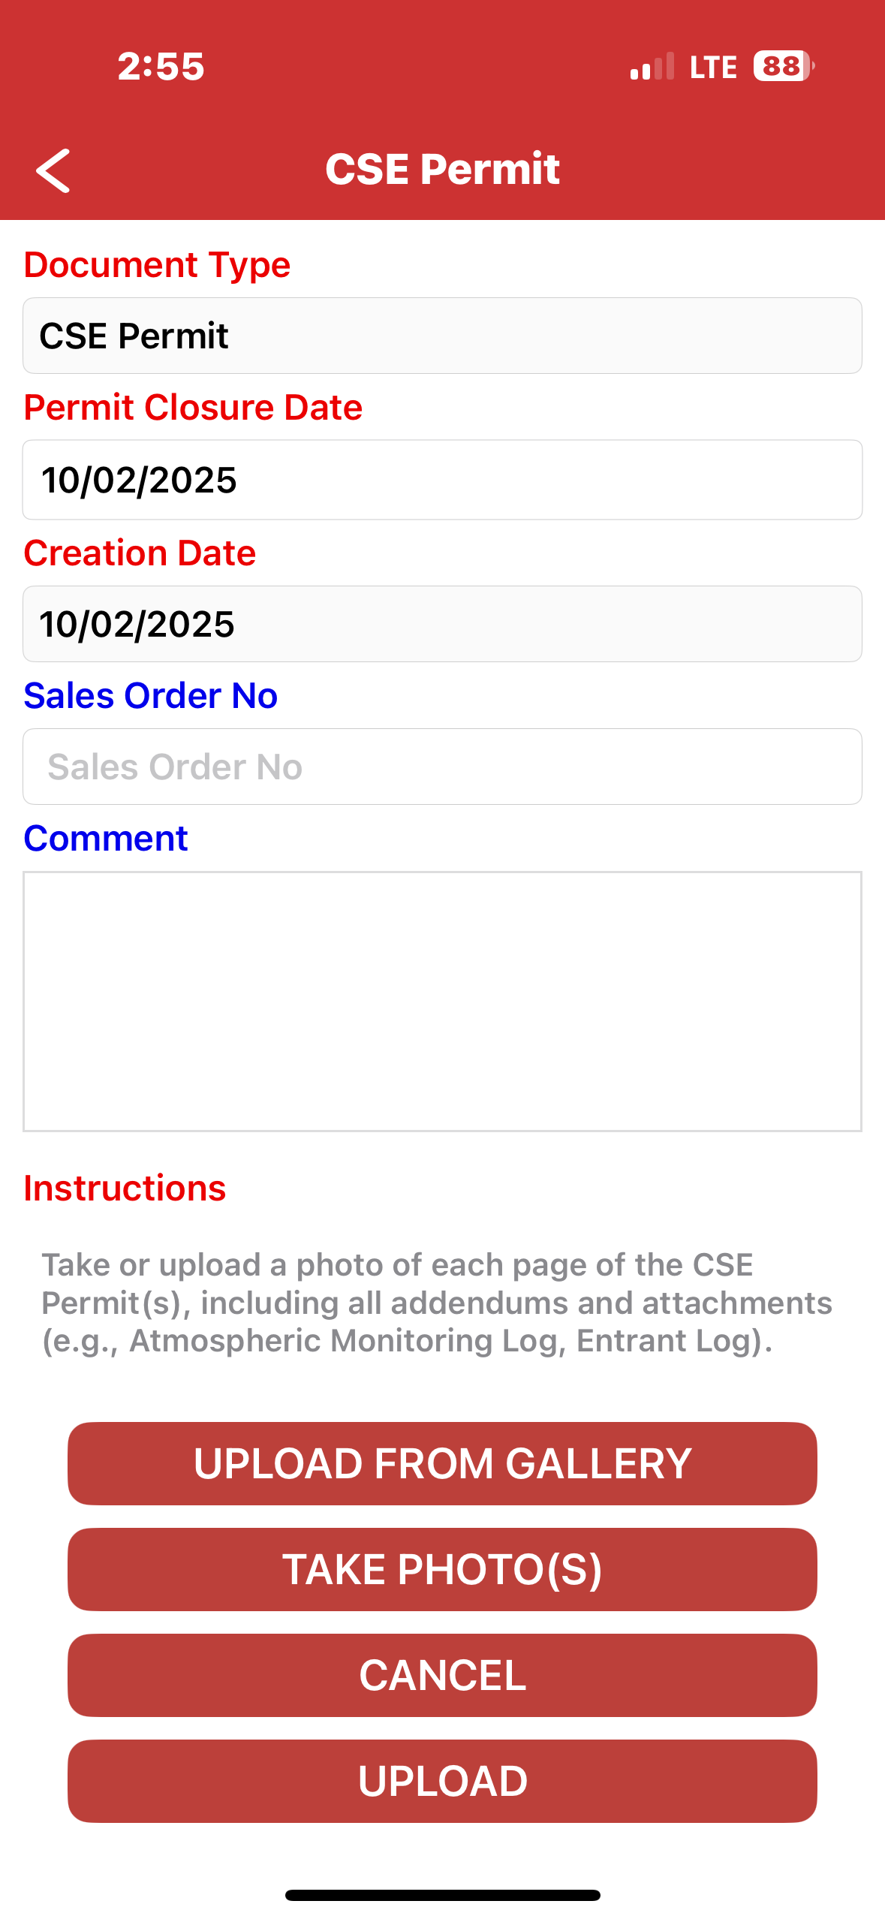

Confined Space Entry (CSE) Permit Scanned Into Mobile Scanning App
2026 SAFETY EXCELLENCE AWARDS | BEST PRACTICES SEMINAR
Upon CSE job completion the CSES must upload/scan CSE Permit into the Permit Scanning App for Review by GCC

Slide 10
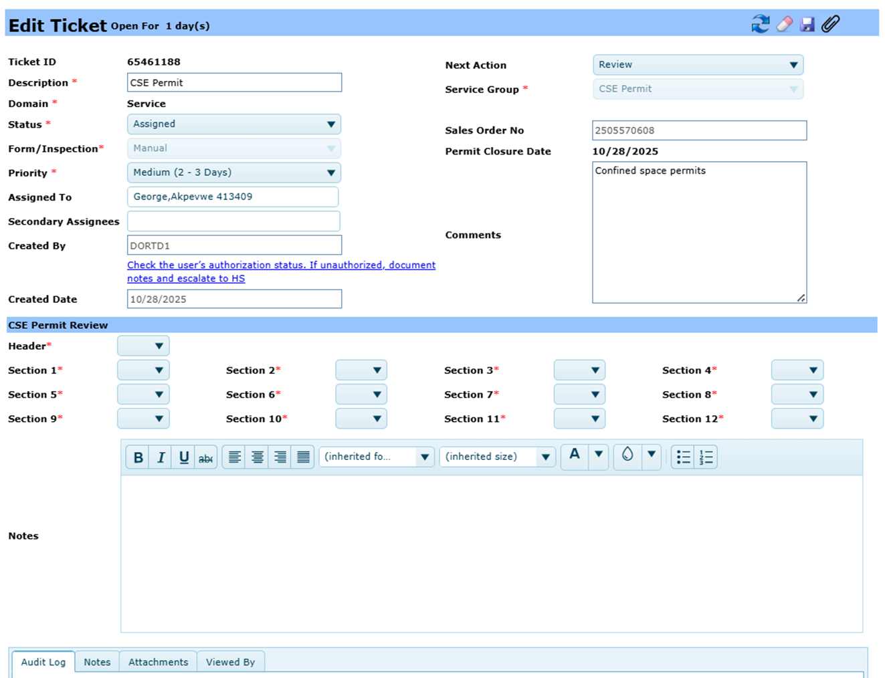
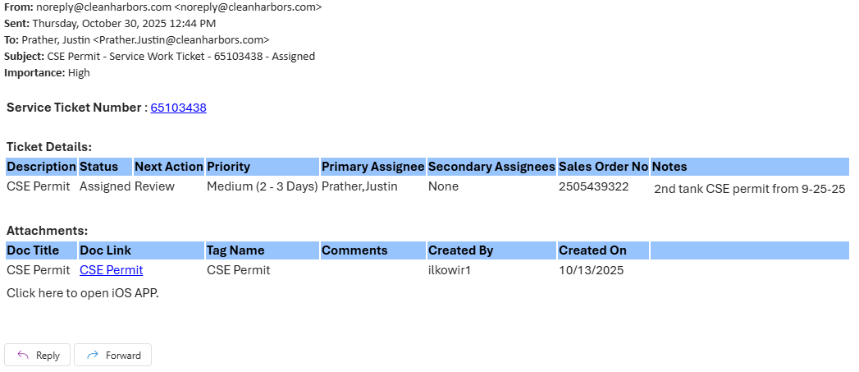
GCC CSE Permit Review
2026 SAFETY EXCELLENCE AWARDS | BEST PRACTICES SEMINAR
After Scanning the Permit into the System GCC will grade the permit for omissions on the permit
Once grading of the permit is completed the results will be sent out to the Branch Manager and the H&S Manager for Review
Note: Each BM will receive an email for each CSE Permit associated with their branch. The email contains a hyperlink to open the record on the Workbench.

Slide 11
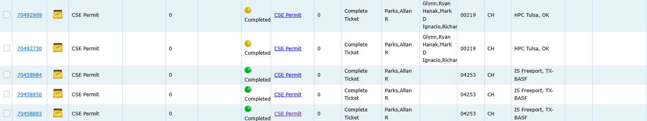
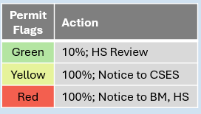
Branch Manager and H&S Manager CSE Permit Review
2026 SAFETY EXCELLENCE AWARDS | BEST PRACTICES SEMINAR
If omissions are found on permit the H&S Manager and Branch Manager will need to go over the Permit with the CSES be closing out the Permit
If no omission the H&S Manager will review 10% of the permit that are flagged green

Slide 12

Continuous Improvements to Come
2026 SAFETY EXCELLENCE AWARDS | BEST PRACTICES SEMINAR
Electronic CSE Permits
Flawless CSE Permit Capability
Automatically Uploaded to HPC Industrial Cloud
Real Time Remote CSE Review by HS&E
Everyone goes home safe to their loved ones everyday.

Slide 13

2026 SAFETY EXCELLENCE AWARDS | BEST PRACTICES SEMINAR
3 Safety Philosophies
Nothing is worth getting injured over
All near misses and accidents are preventable
Safety must actively be managed
6 Golden Rules of Safety
I will drive responsibly without distractions or impairments
I will think before I start and know my safety plan every day
I will only undertake the work in which I am trained
I will take responsibility for my safety and those around me at work, home or in-transit
I will intervene in any unsafe act
I will report all incidents and near misses

Slide 14

QUESTIONS?

