Slide 1




2026 SAFETY EXCELLENCE AWARDS | BEST PRACTICES SEMINAR
HARD CRAFTS SMALL
BEST IN CLASS
FTS Industrial Services is a leader in electrical, instrumentation, high voltage and thermal solutions, delivering 24/7 turnkey support across critical industries. With a strong safety-first culture, certified teams, and commitment to OSHA standards, FTS protects people and assets on every project. We proudly thank the IBR Roundtable and are honored to be part of this program.

Slide 2
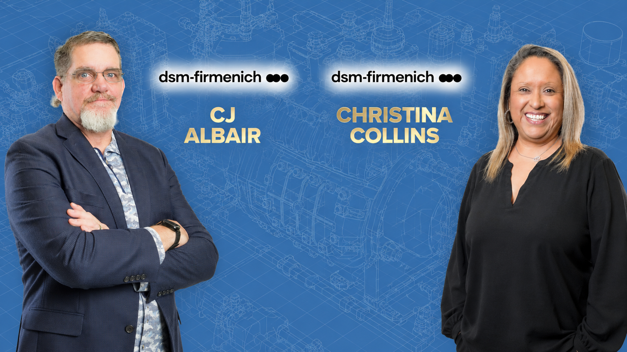

Slide 3
2026 SAFETY EXCELLENCE AWARDS | BEST PRACTICES SEMINAR
BEST PRACTICE
AGENDA / OUTLINE
Purpose
Execution & Implementation
Benefits & Results
Examples
Future Use & Applications
Summary & Wrap Up
Q&A

Slide 4

Why we created our Safety Board
2026 SAFETY EXCELLENCE AWARDS | BEST PRACTICES SEMINAR
Better communication between management and field employees.
To increase employee involvement in safety programs
To recognize employees and their achievements
To encourage employee feedback and continuous improvements
To strengthen our overall safety culture
We wanted to improve the way FTS communicated company updates and announcements and ensure every employee had access to the resources needed to actively participate in creating a safer workplace.

Slide 5
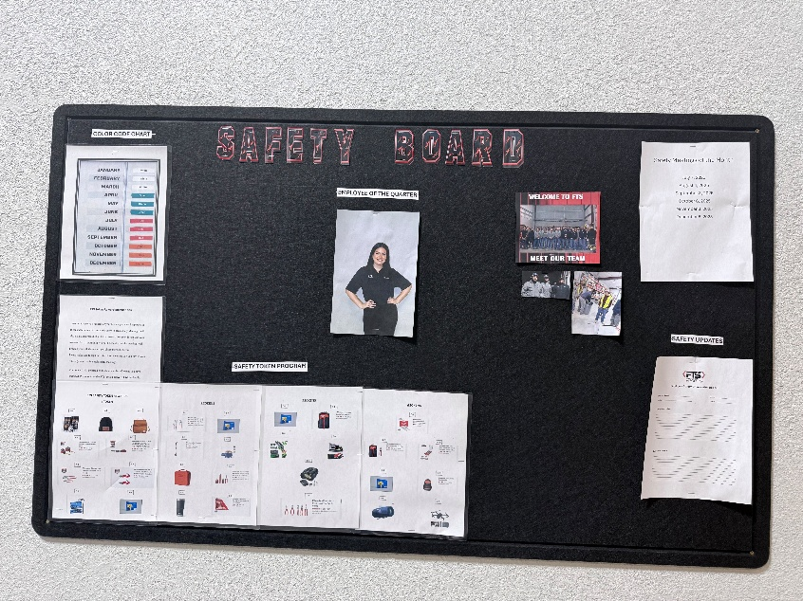
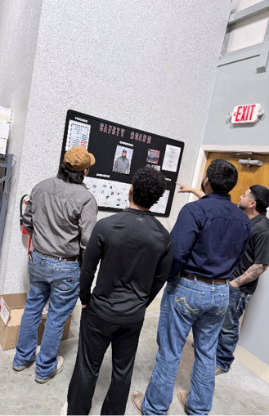
Execution and Implementation
2026 SAFETY EXCELLENCE AWARDS | BEST PRACTICES SEMINAR
Our safety board was installed in a common employee area at the FTS Shop to maximize visibility, accessibility, and engagement.
Our safety department maintains and updates the board regularly to ensure information remains current.

Slide 6
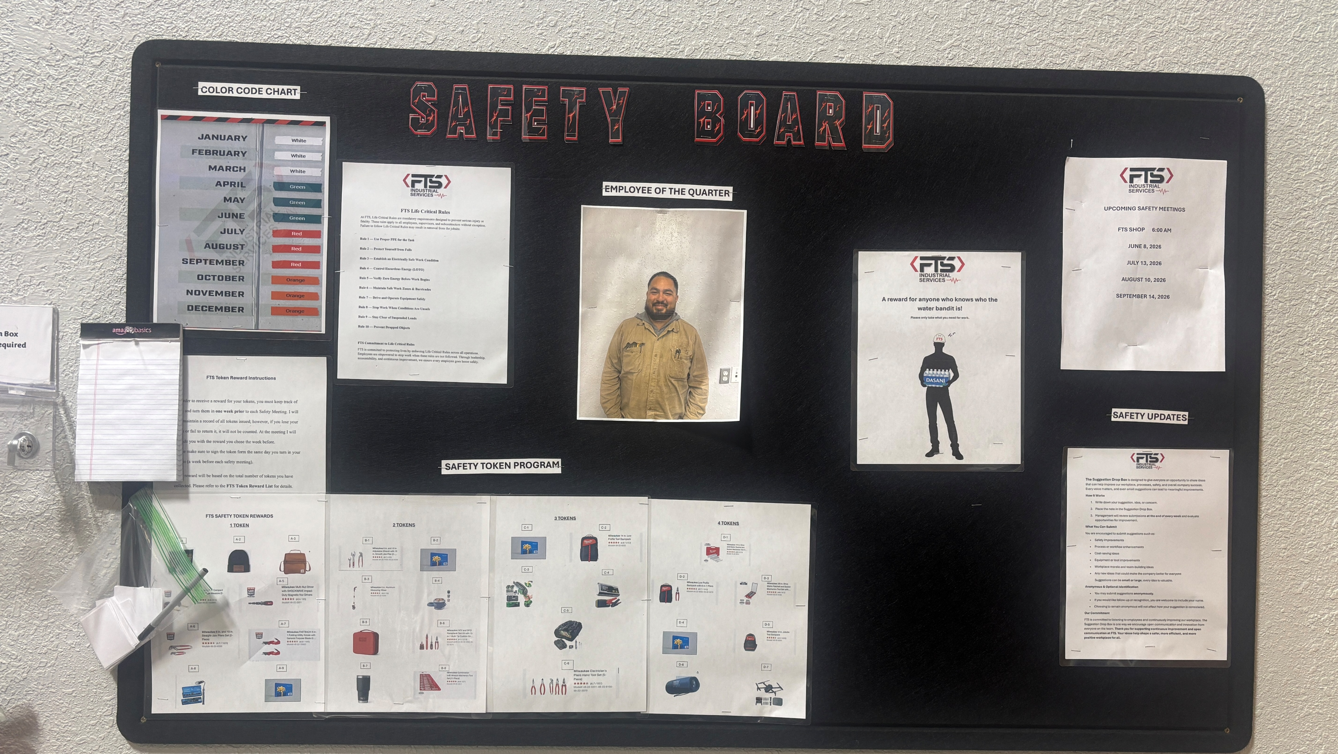
What is displayed on the FTS safety board?
2026 SAFETY EXCELLENCE AWARDS | BEST PRACTICES SEMINAR
FTS Life Critical Rules
Employee of the Quarter Recognition
Safety Token System (Reward Program and how it works)
Suggestion Box (Employee Feedback and Engagement)
Color code of the Quarter
Company Announcements
Upcoming Events and Meetings
Updates in Safety Procedures/ Documents (Changes)
Group Pictures

Slide 7
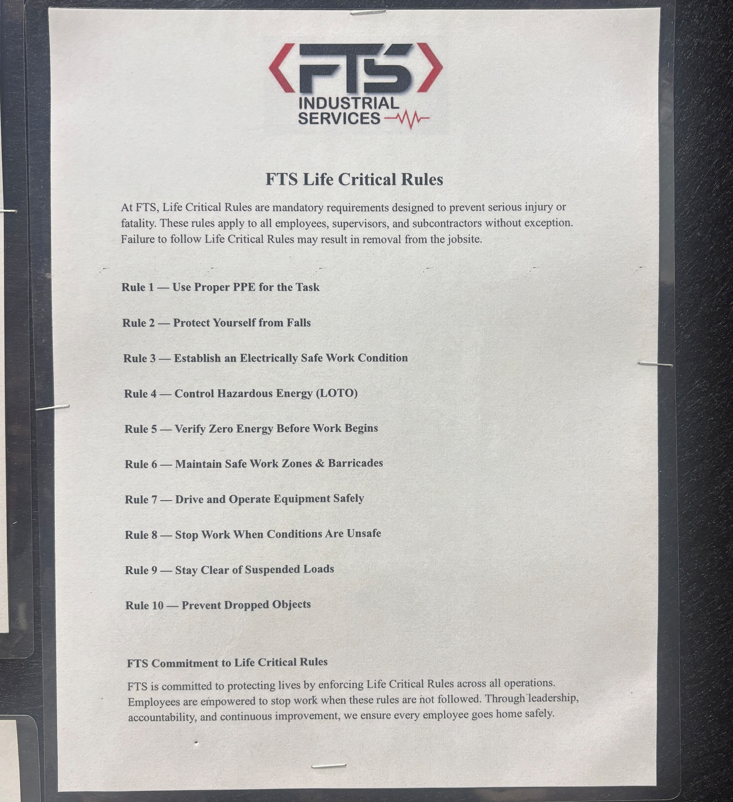
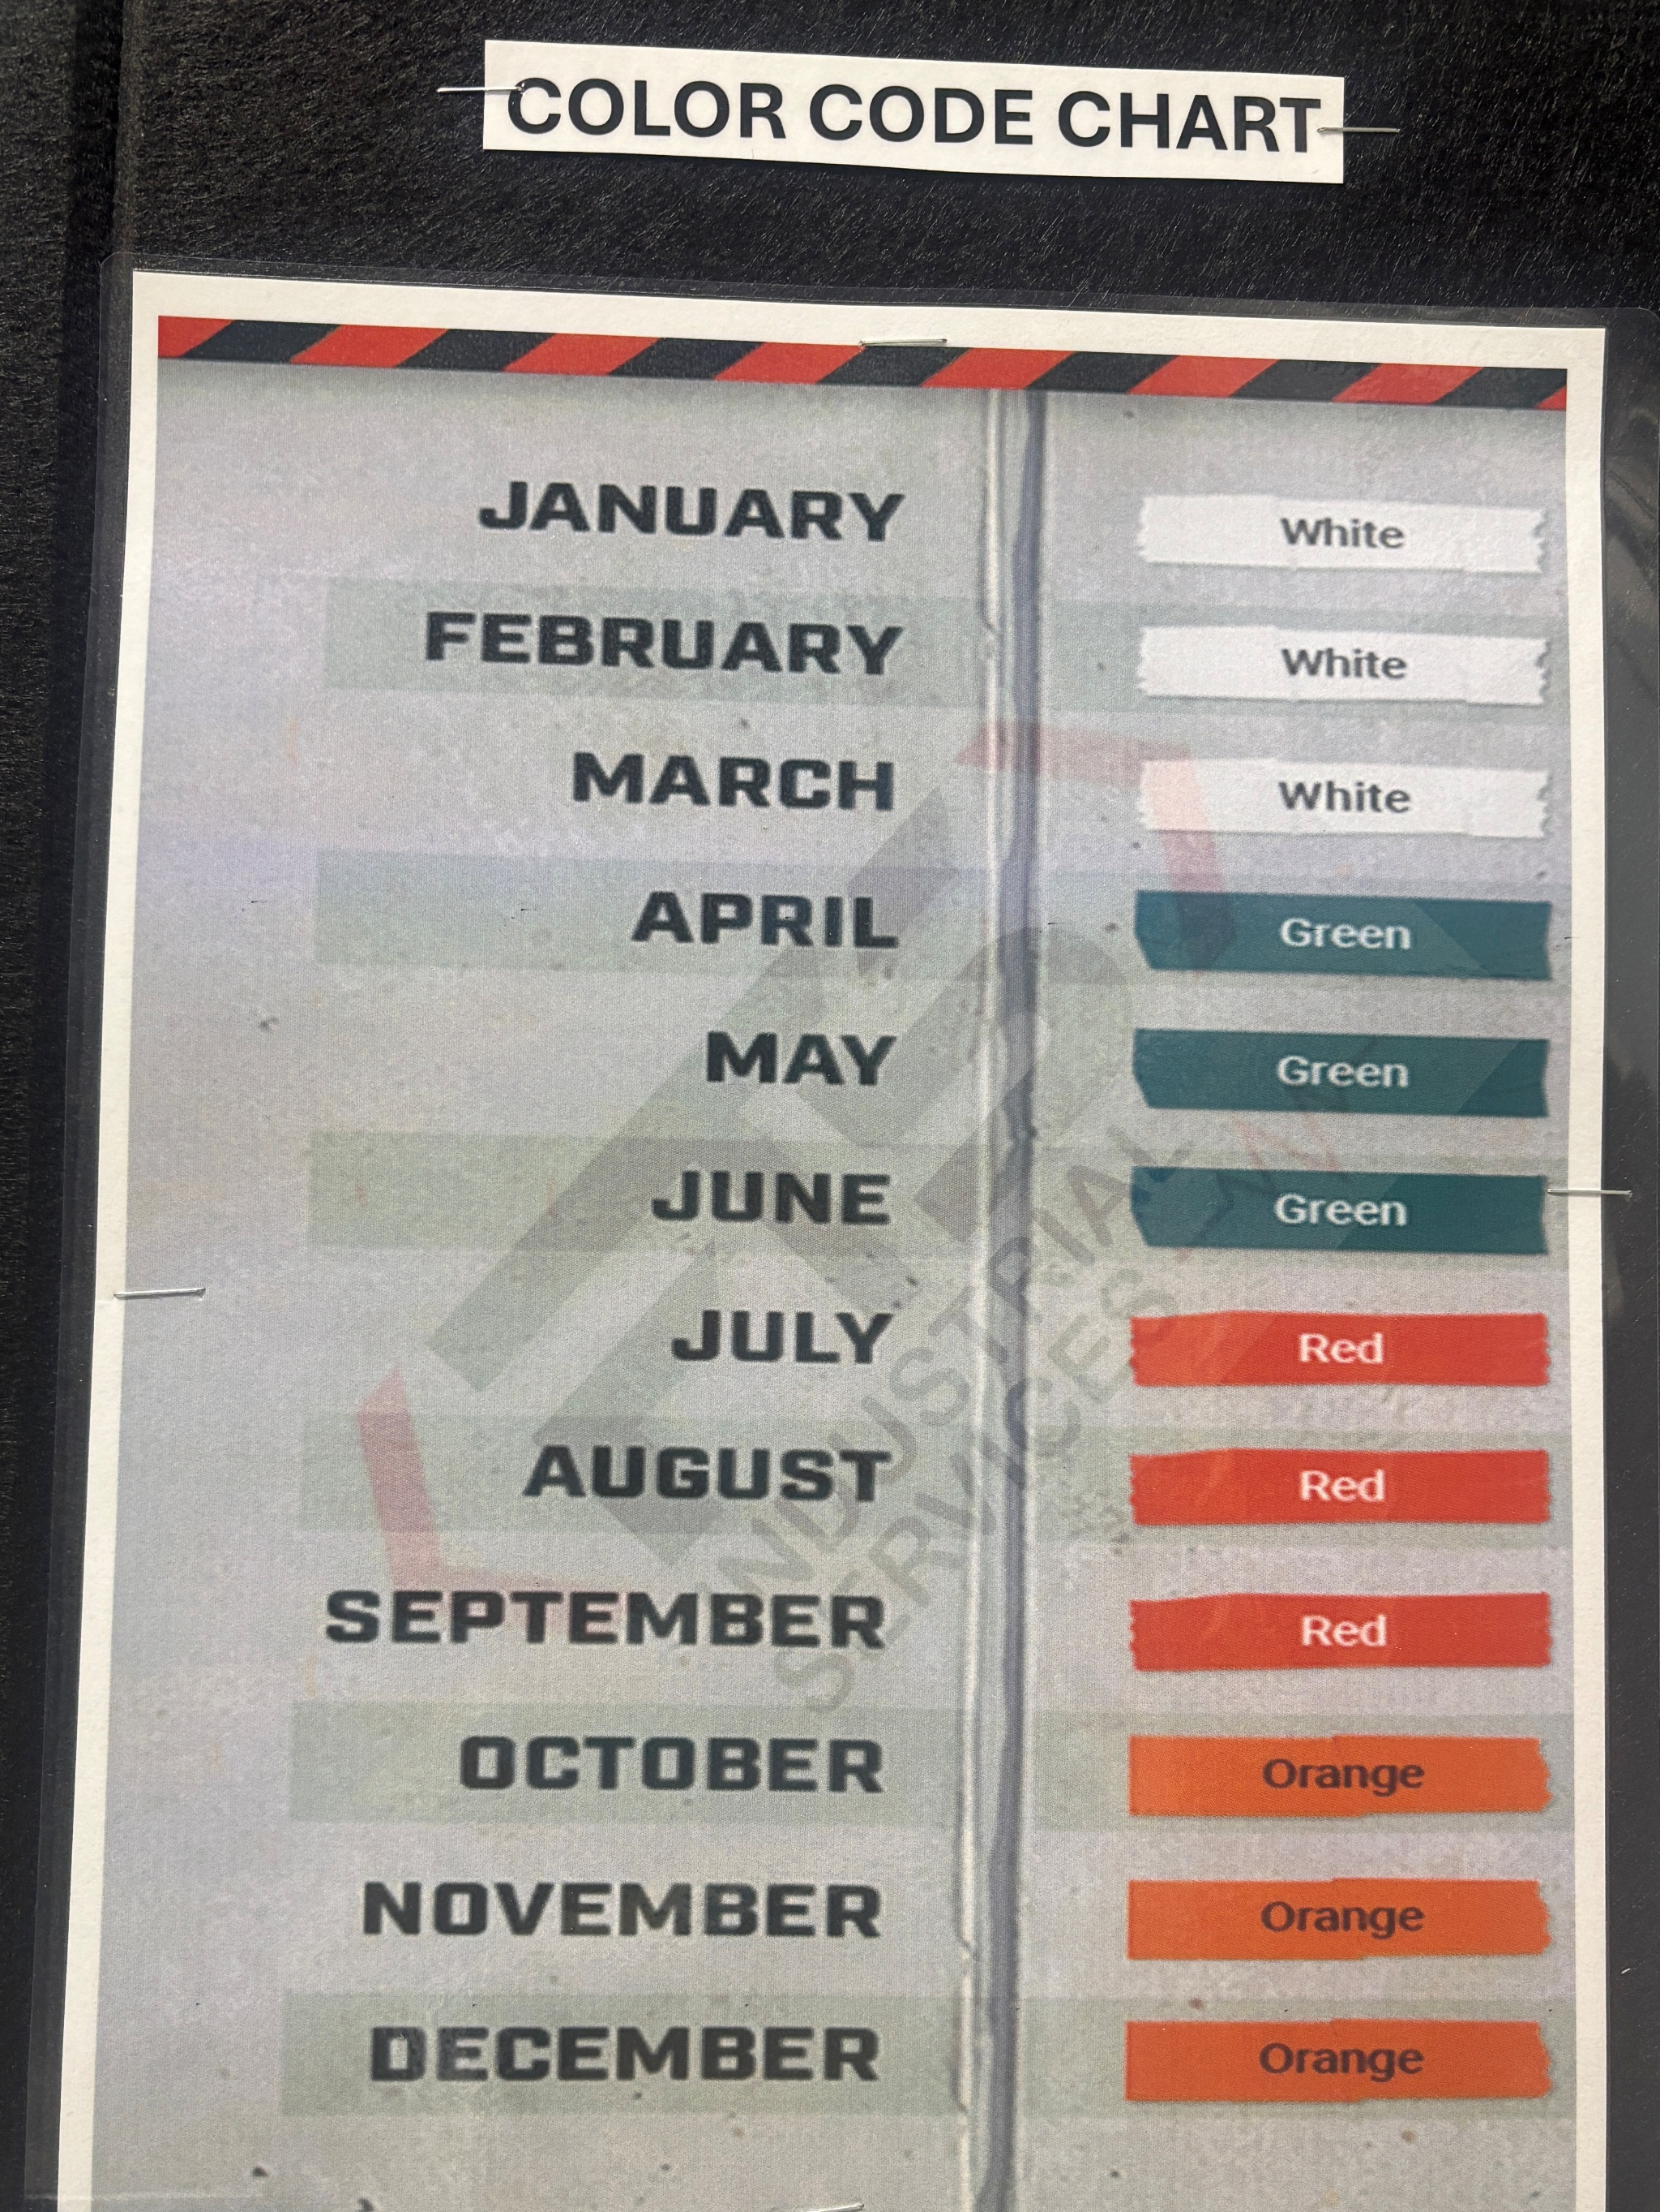
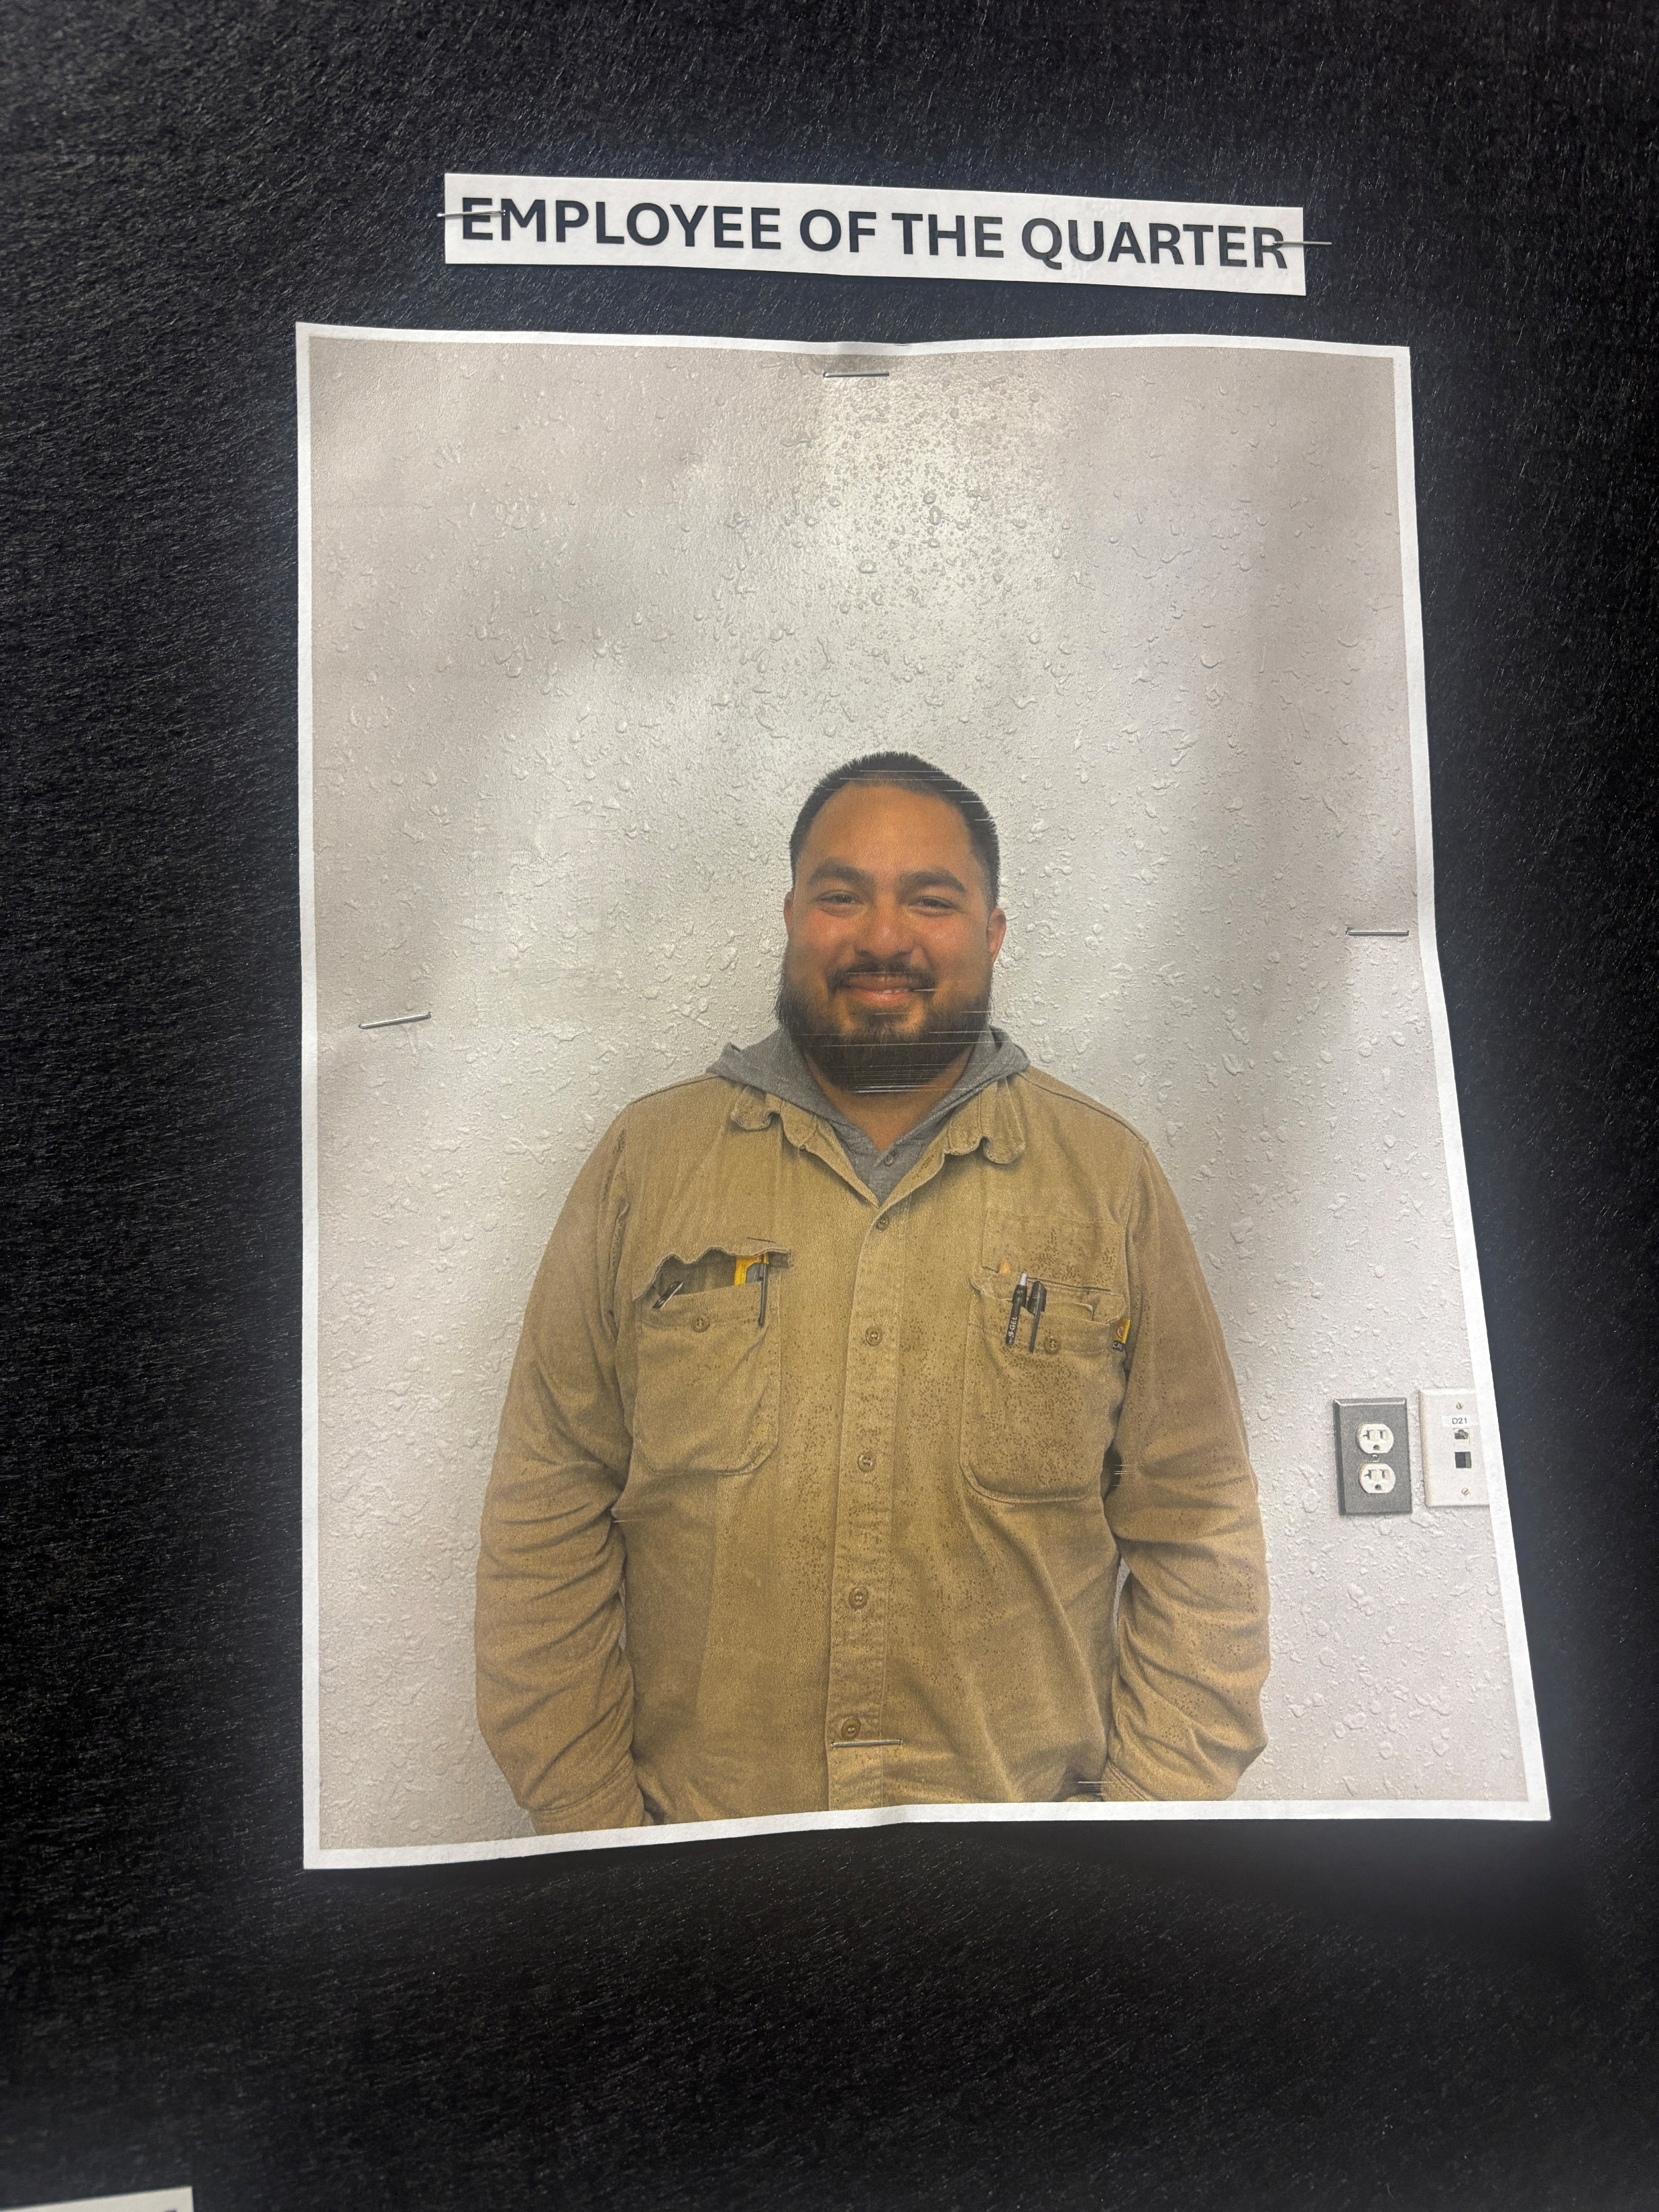
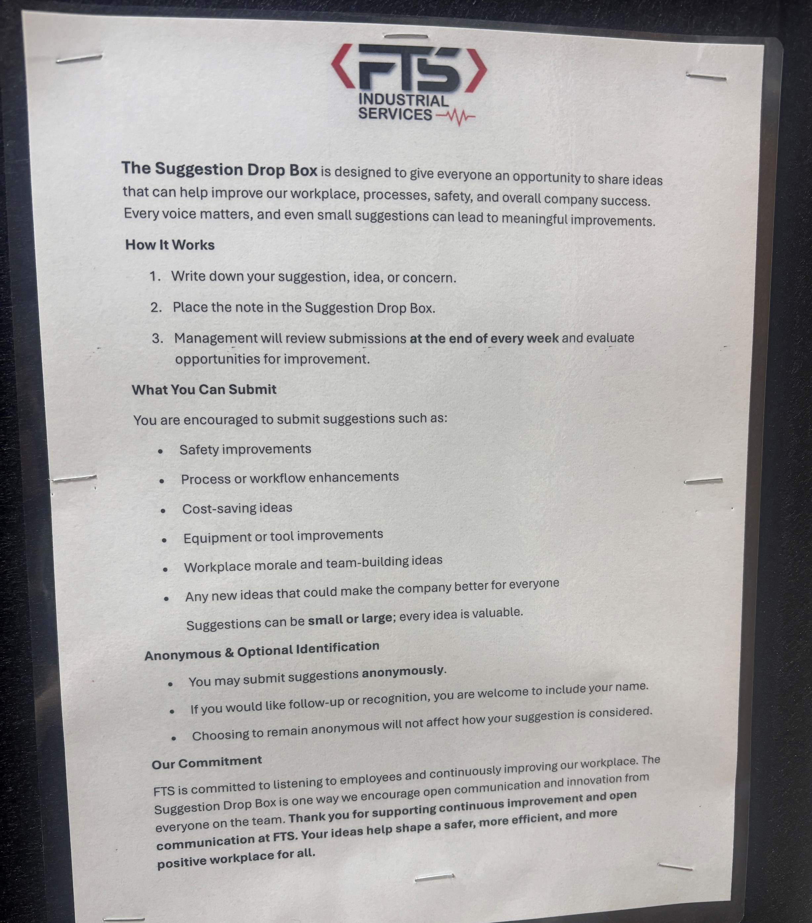
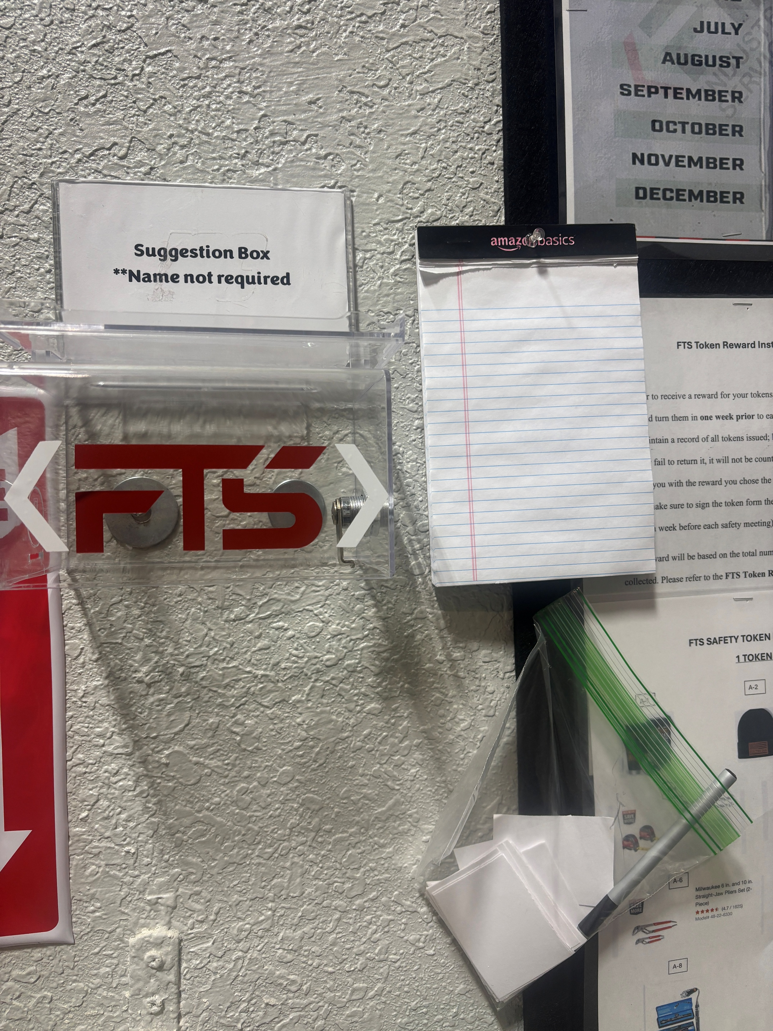
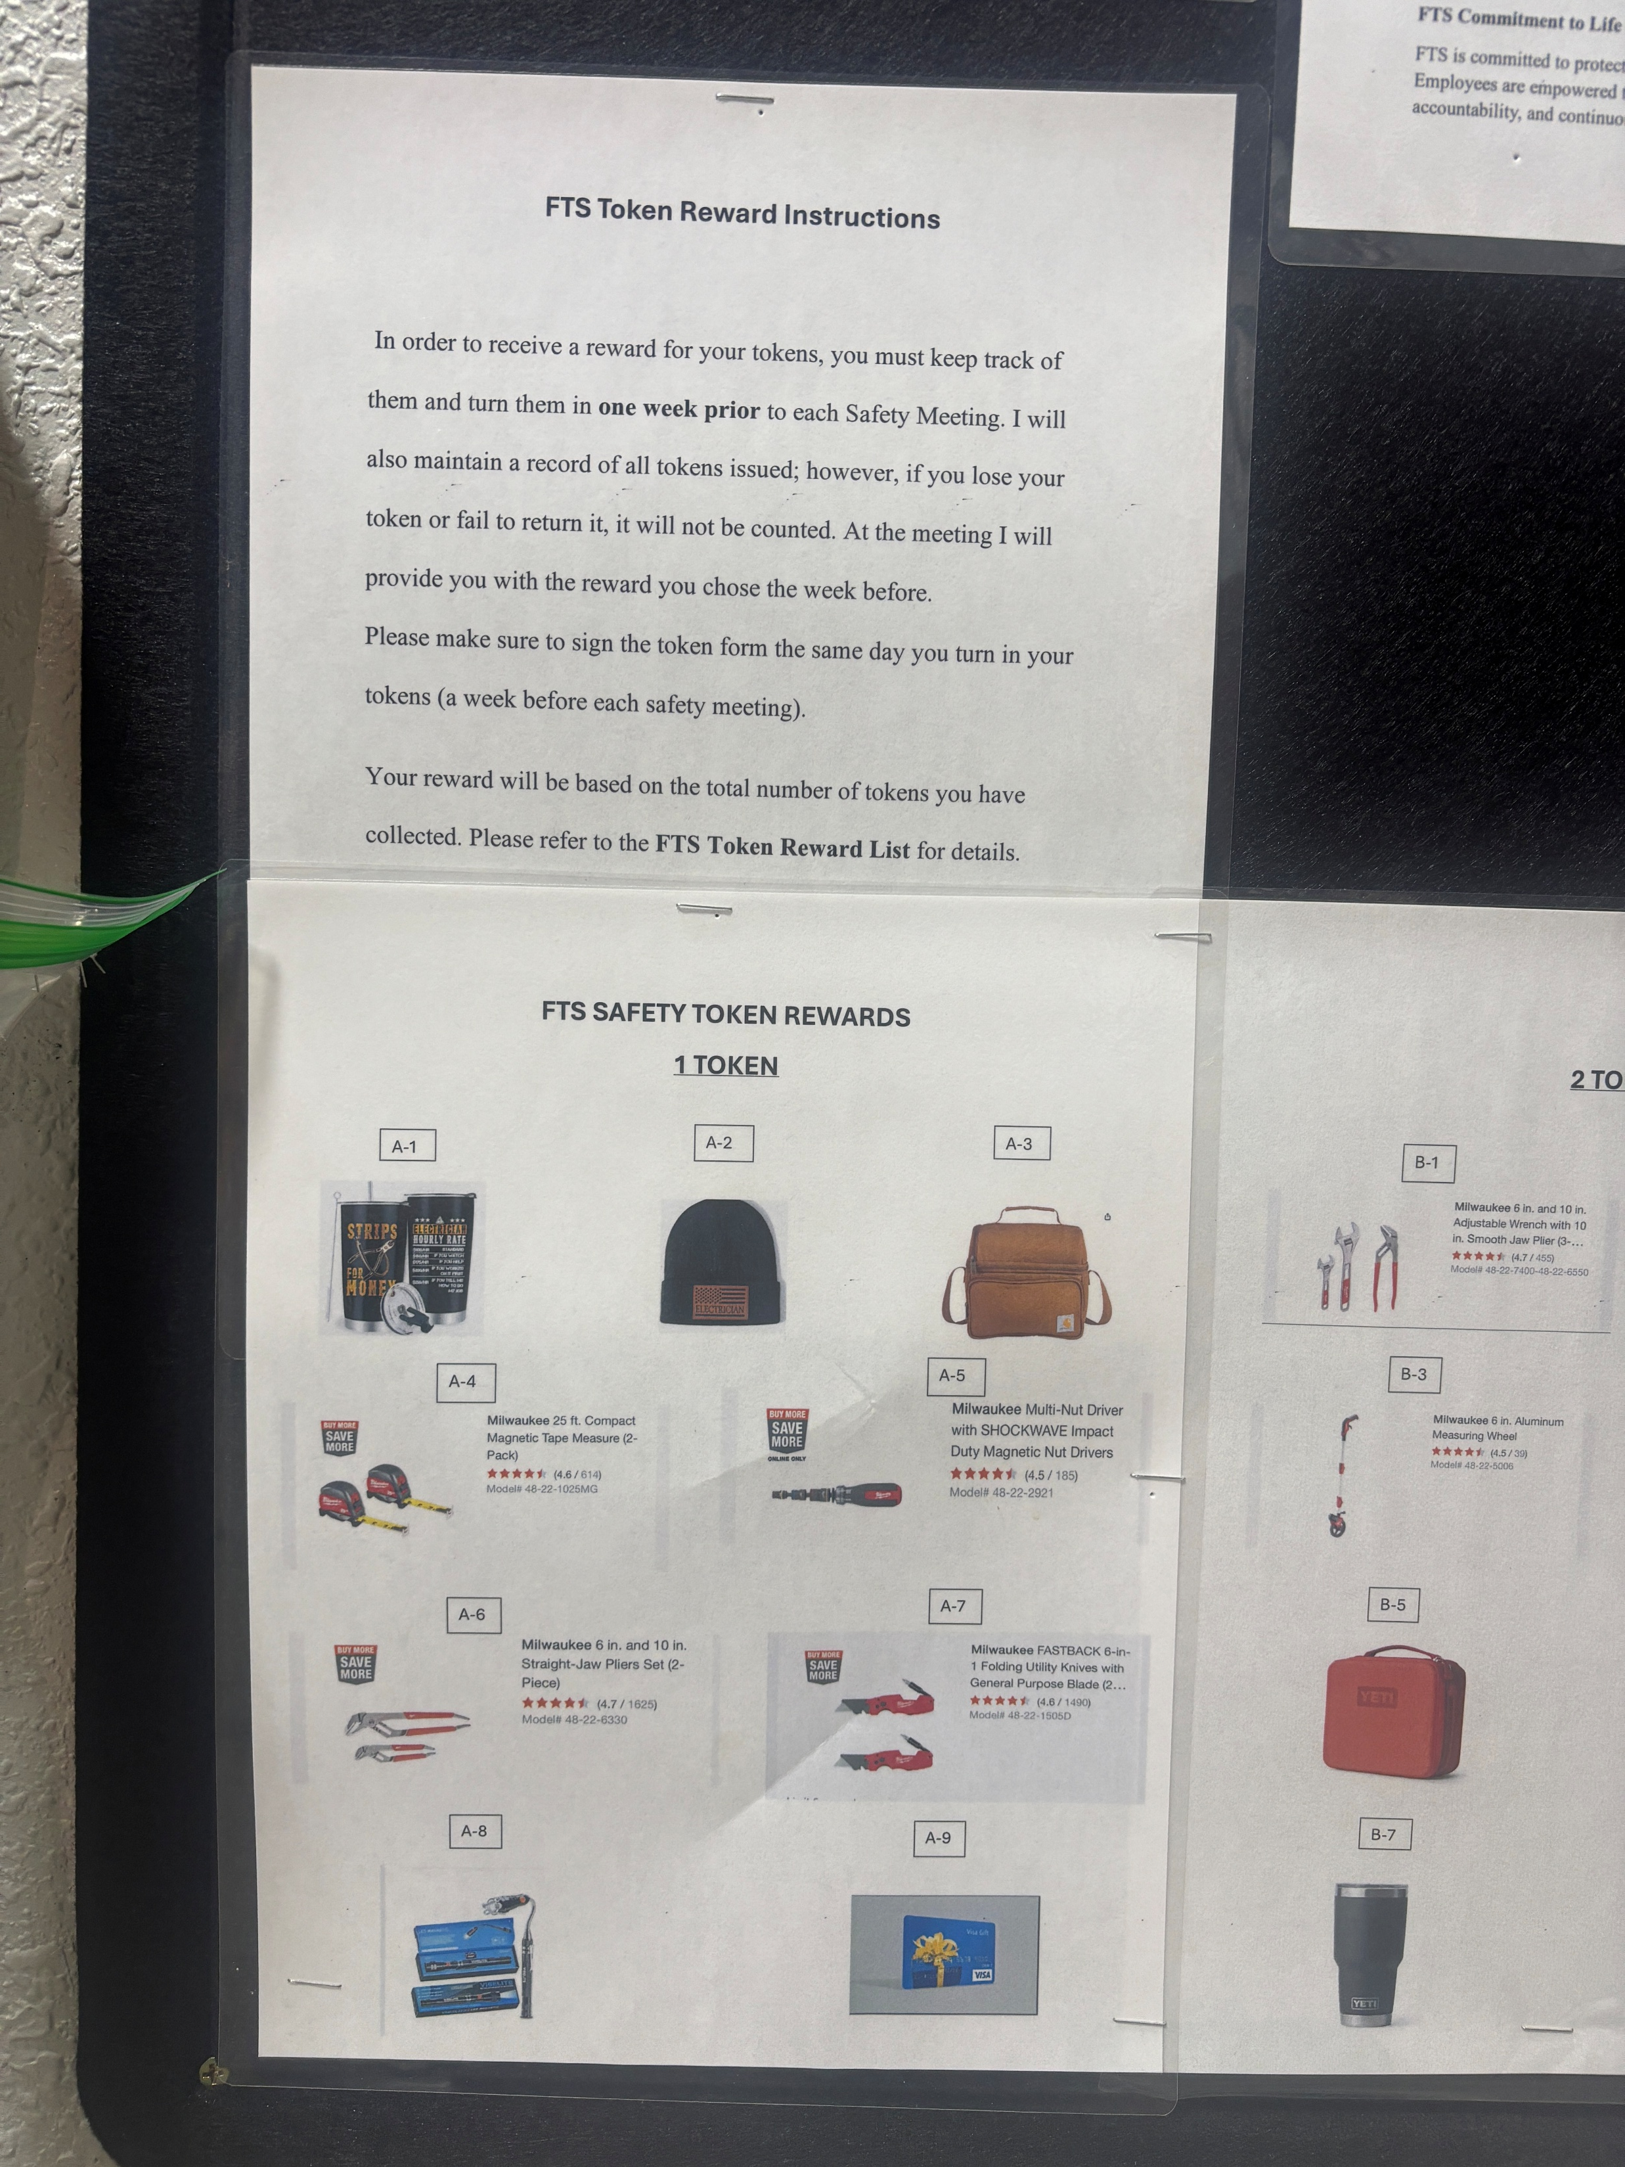
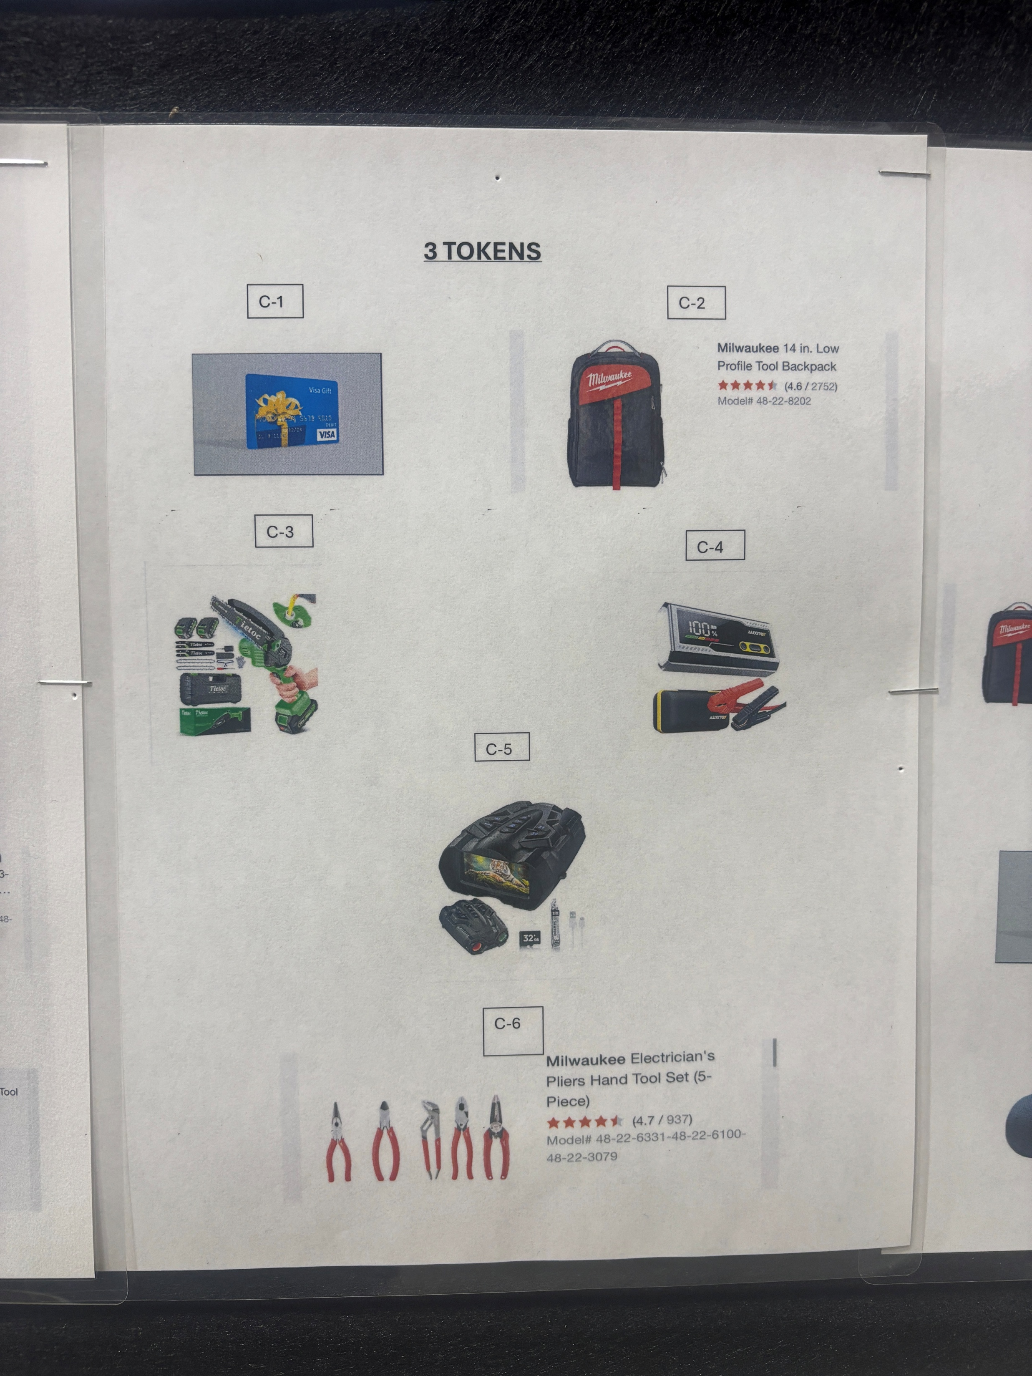
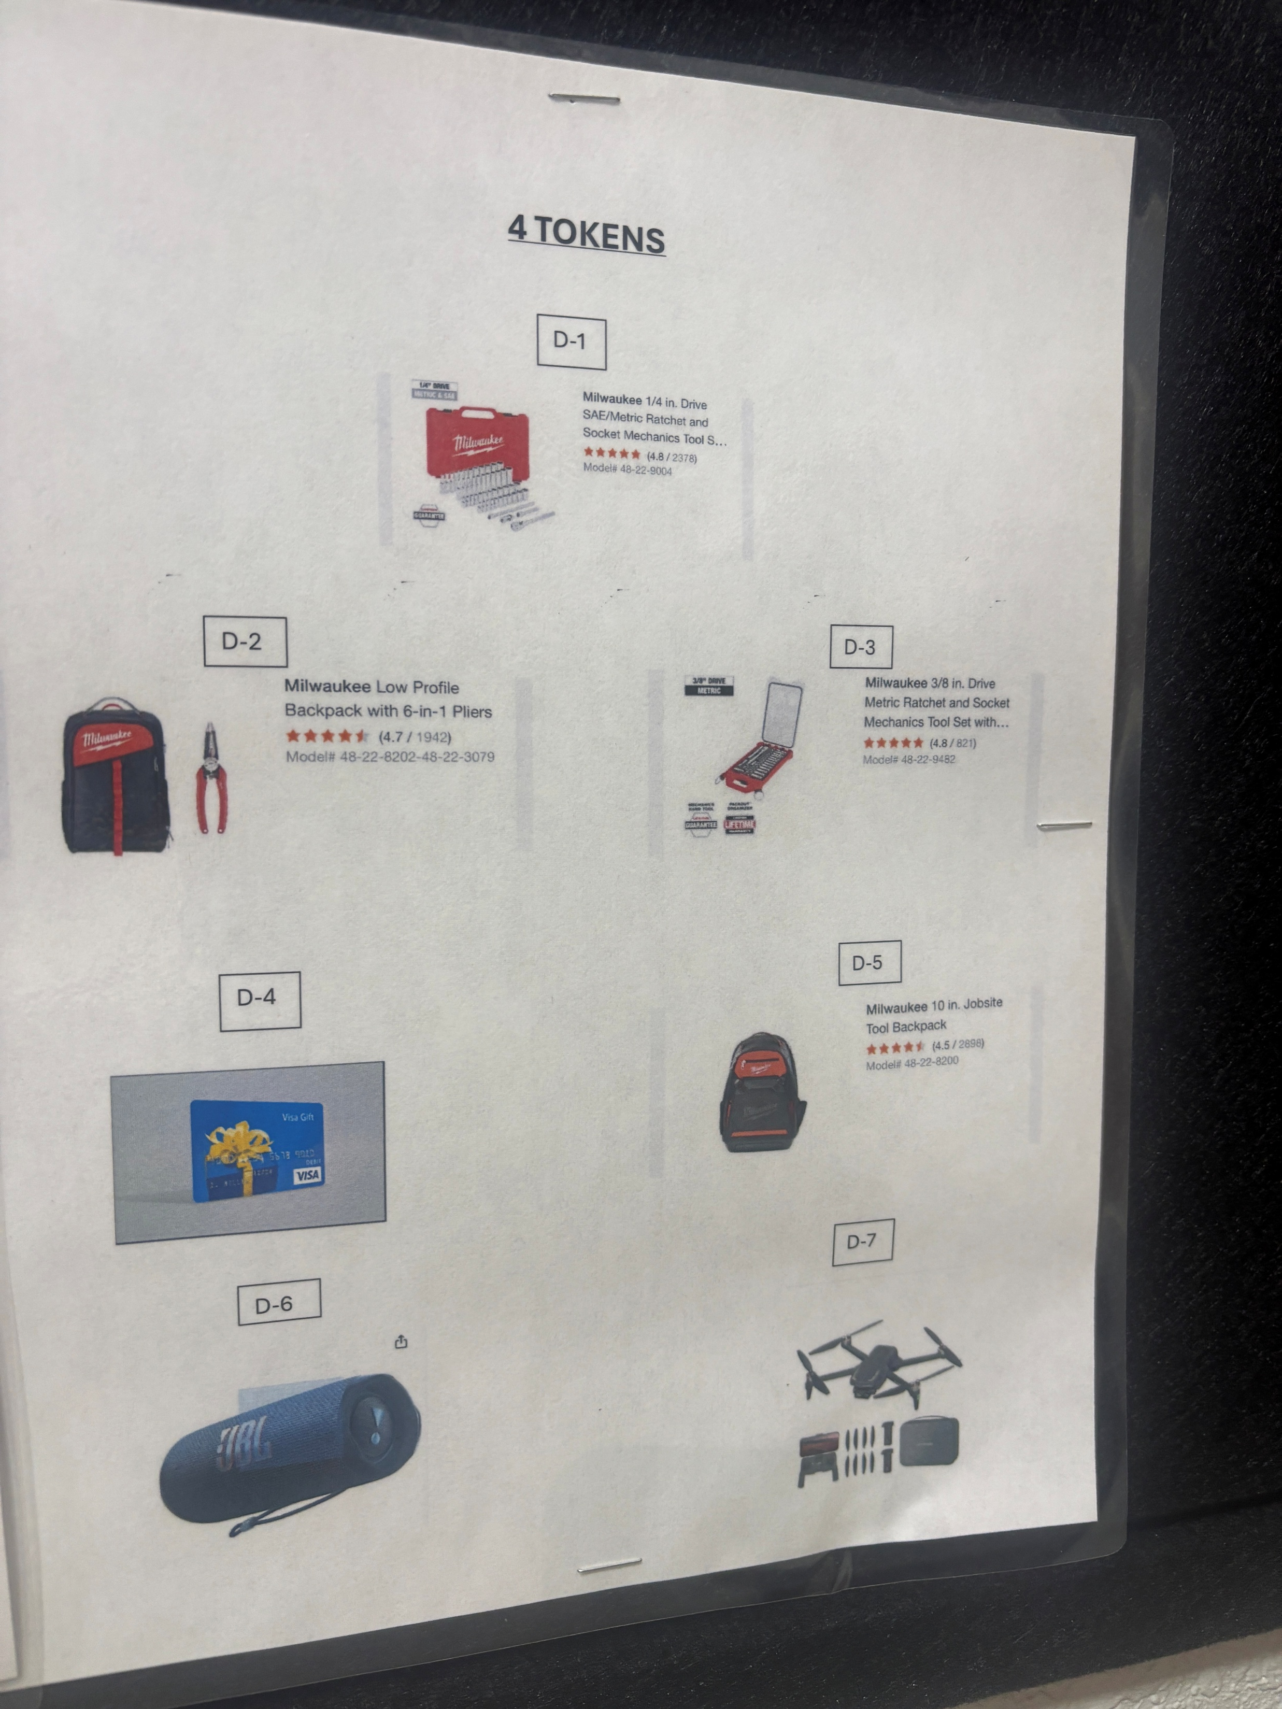
2026 SAFETY EXCELLENCE AWARDS | BEST PRACTICES SEMINAR
Employee of the Quarter is displayed
Color Code Chart
FTS Life Critical Rules
FTS Token System Program
Suggestion Box

Slide 8
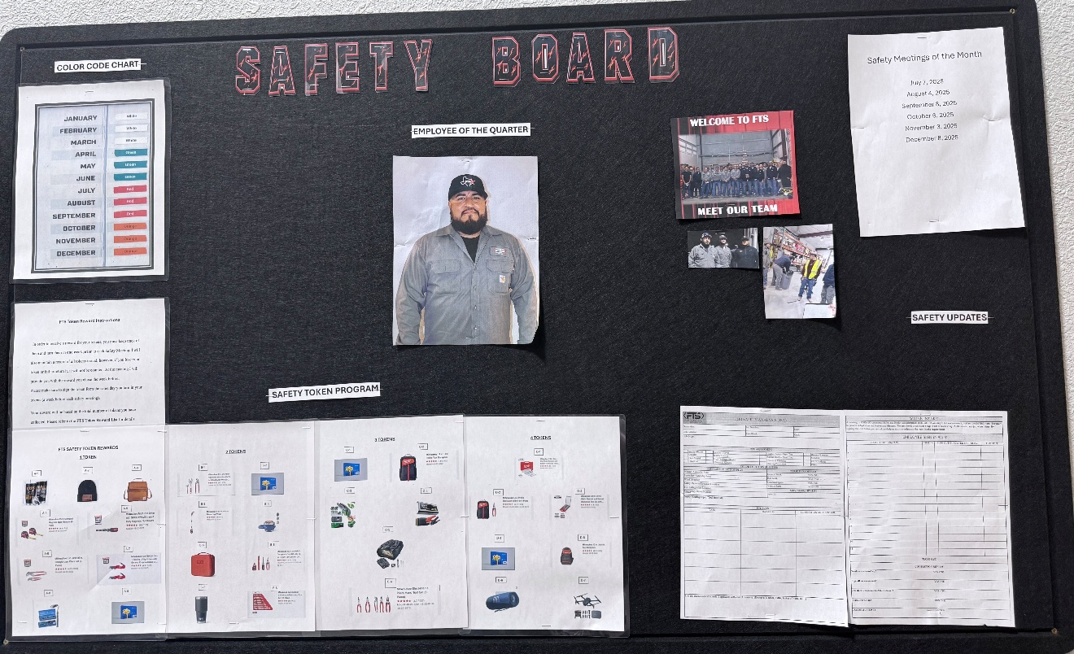
Impact On Our Safety Culture
2026 SAFETY EXCELLENCE AWARDS | BEST PRACTICES SEMINAR
Improved communication between the field and office employees
Higher employee participation
Positive reinforcement of safe behaviors
Greater awareness of company expectations

Slide 9
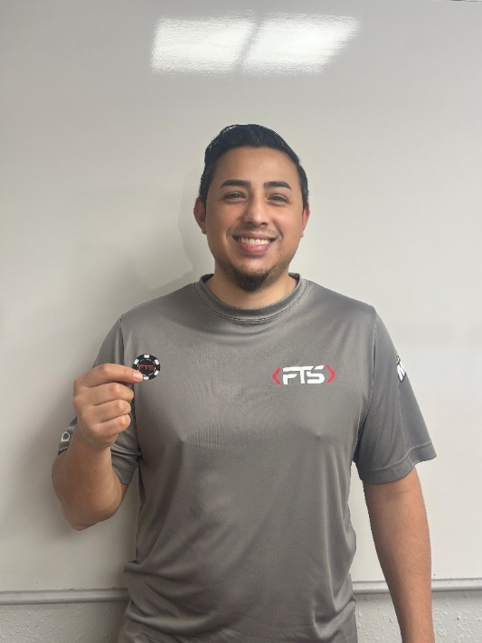
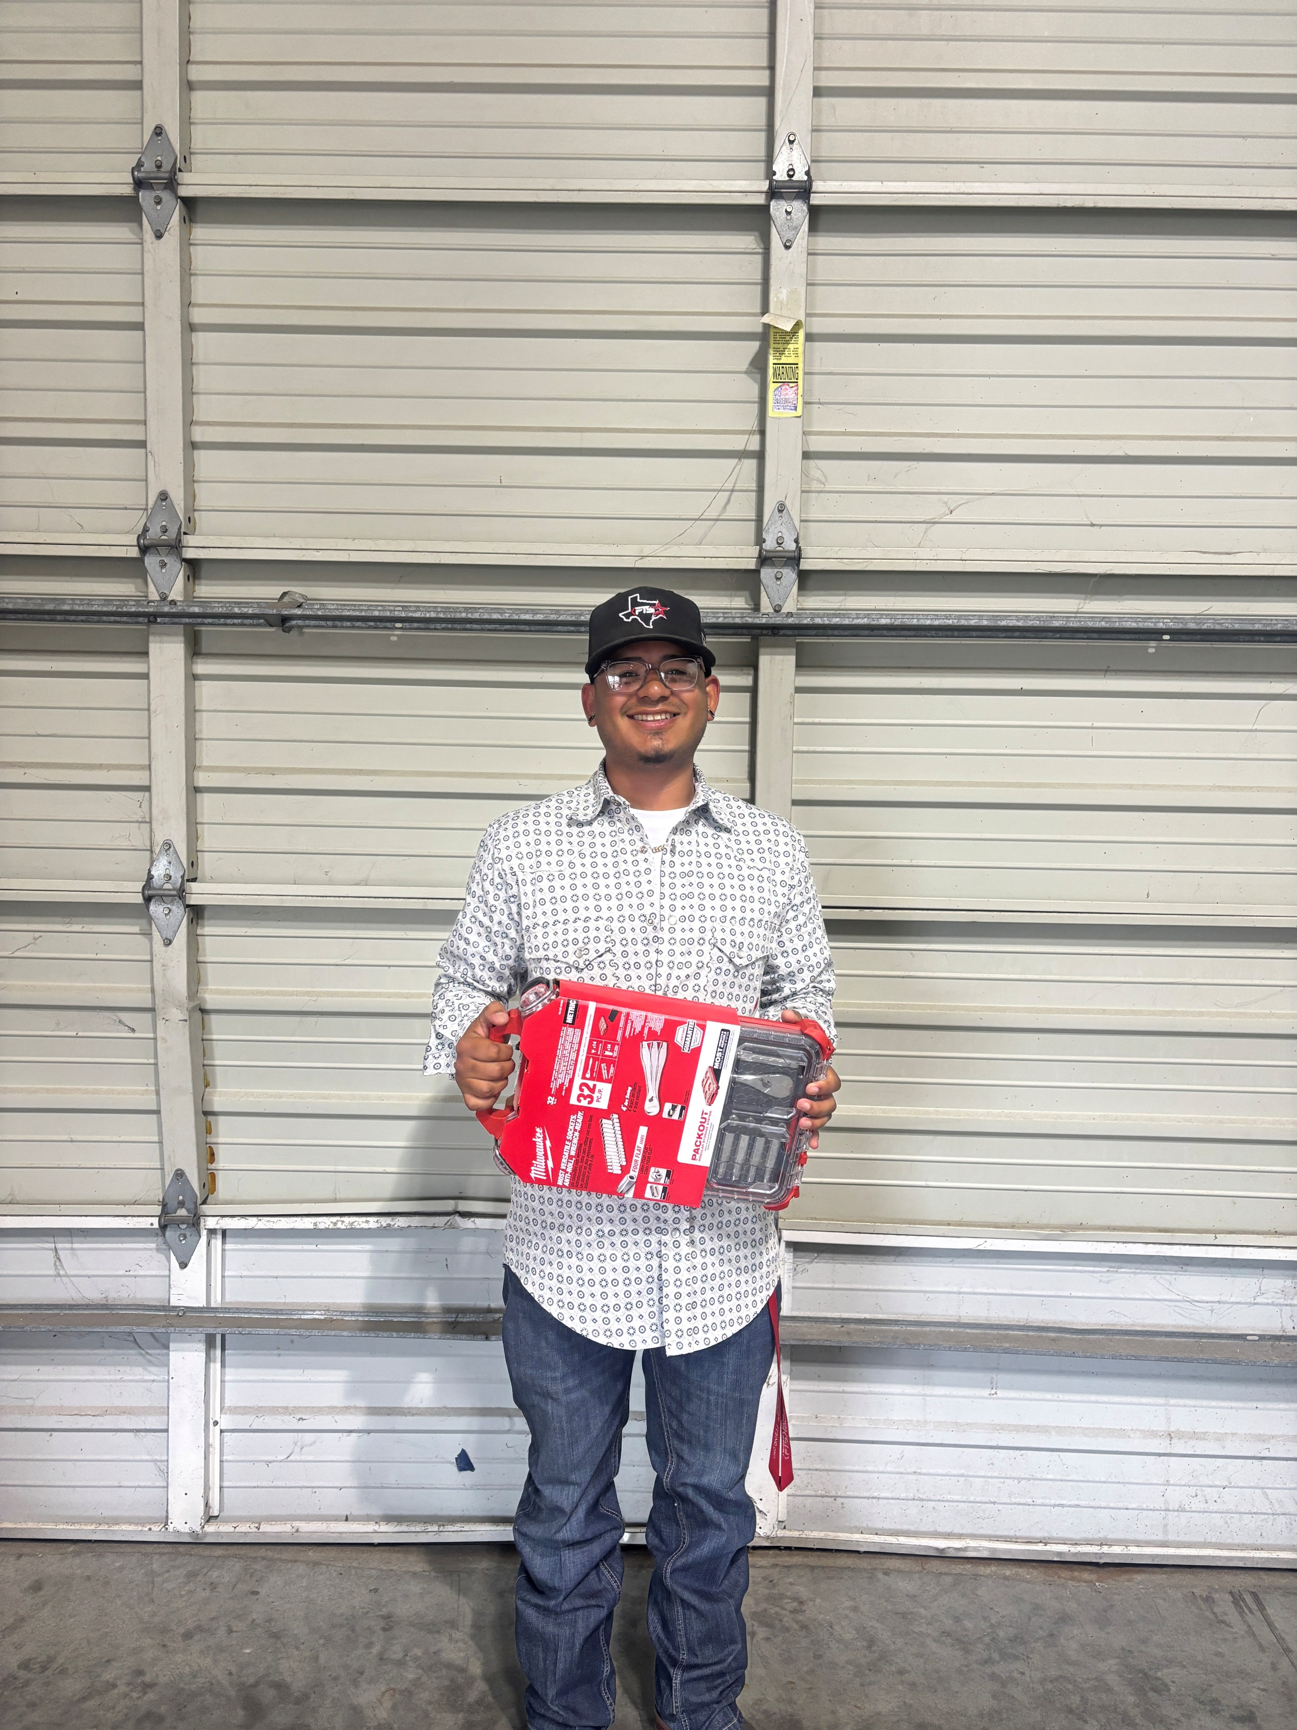
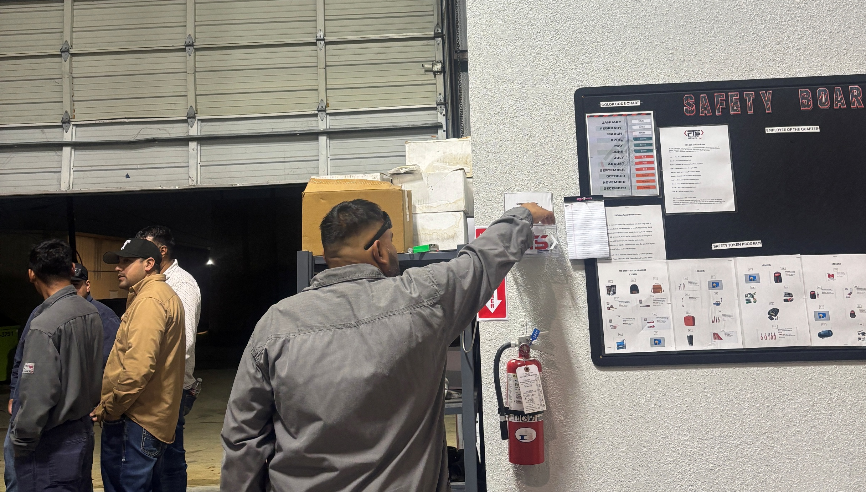
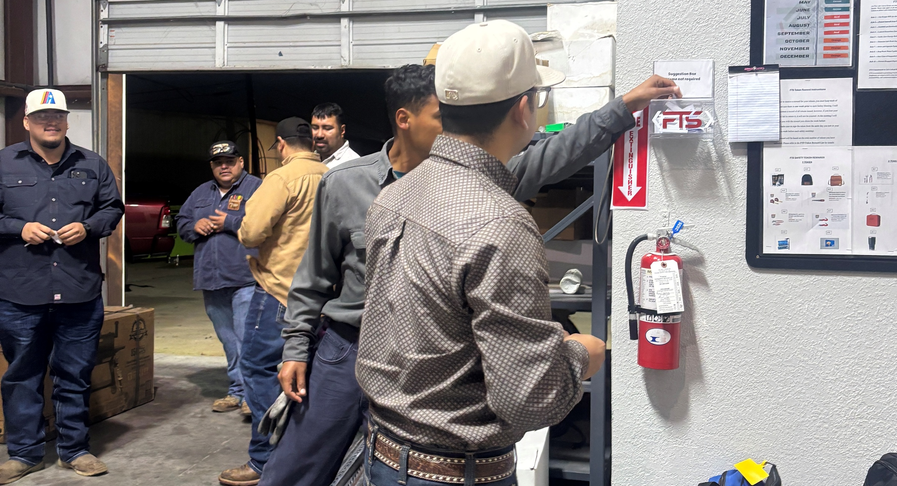
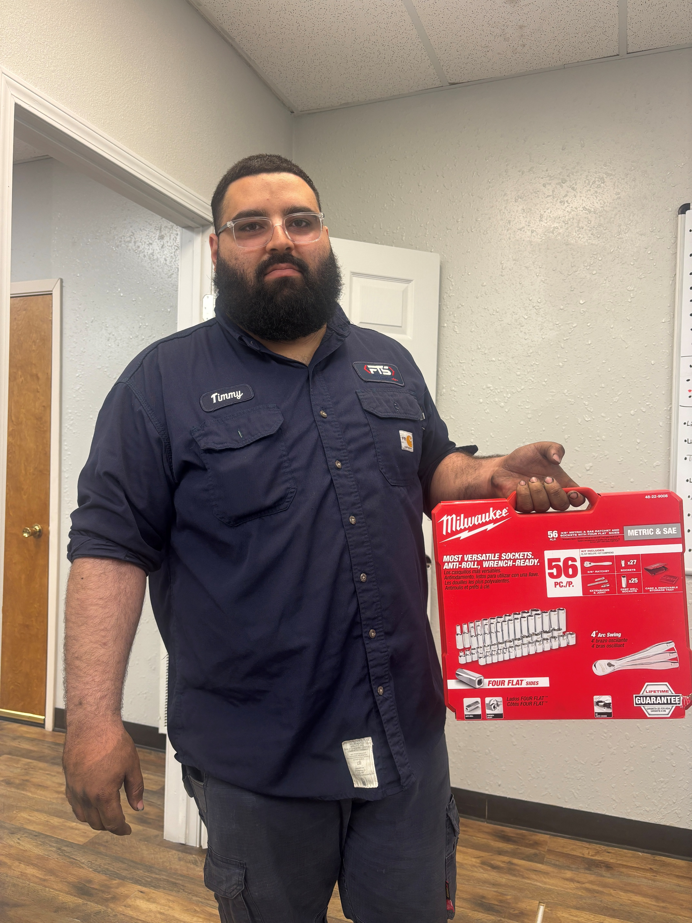
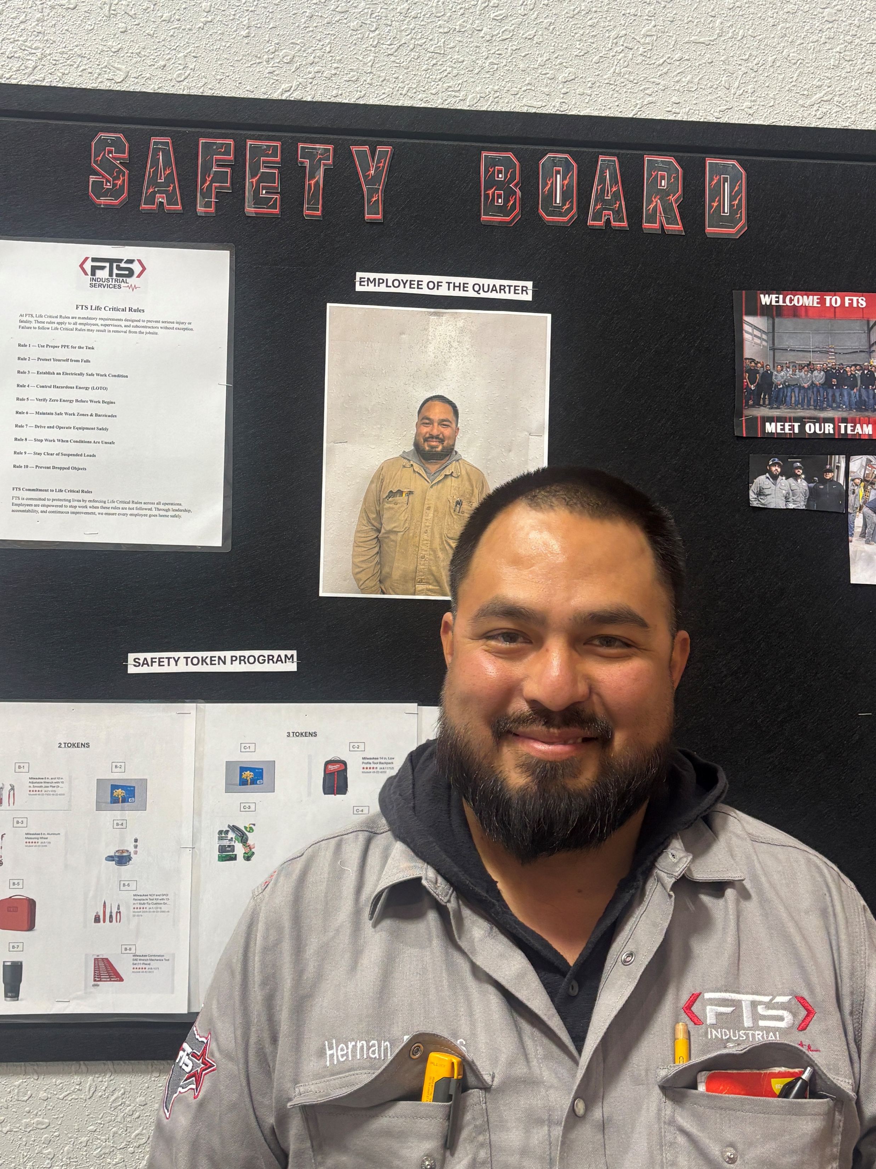
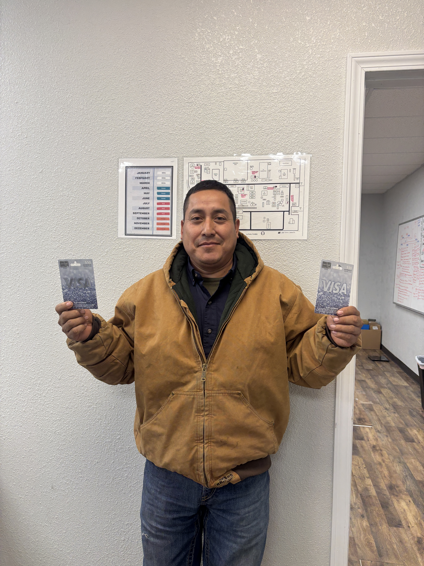
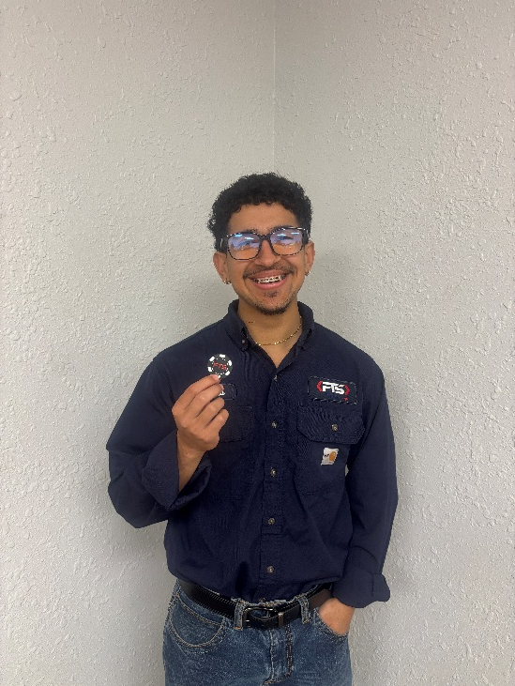
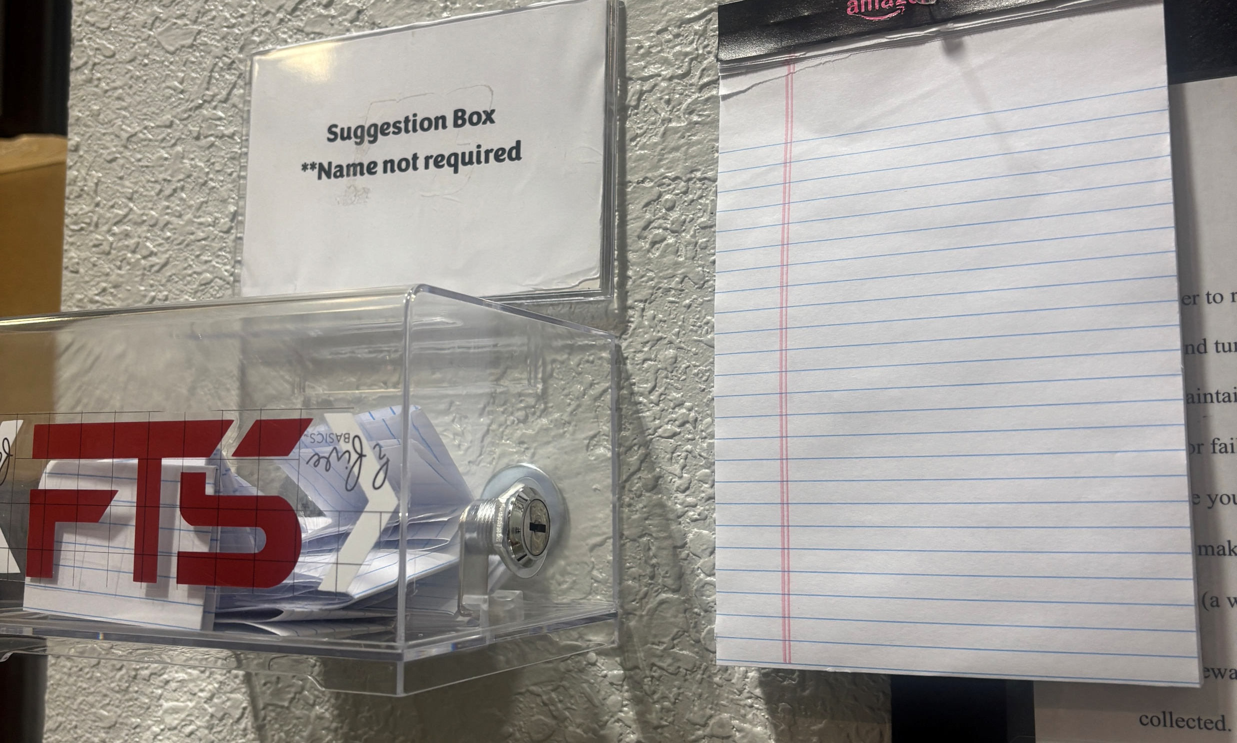
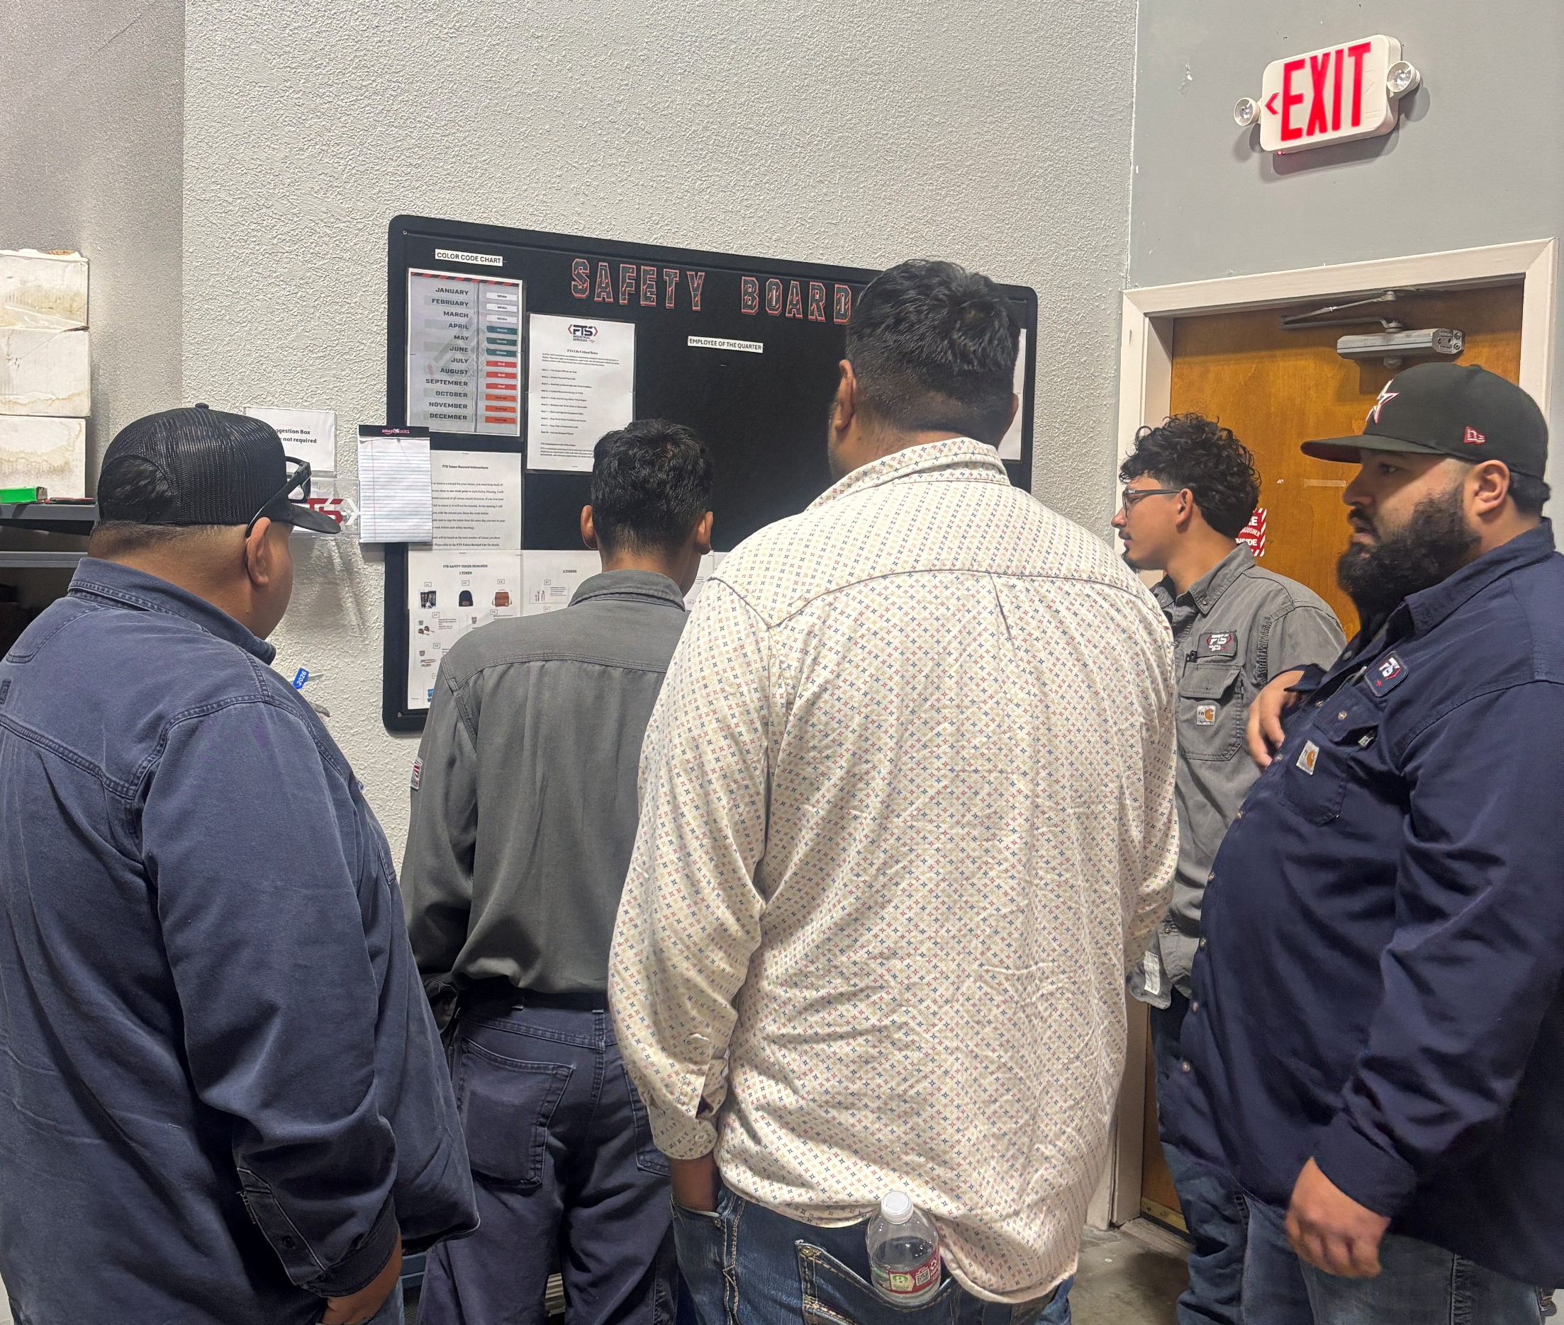
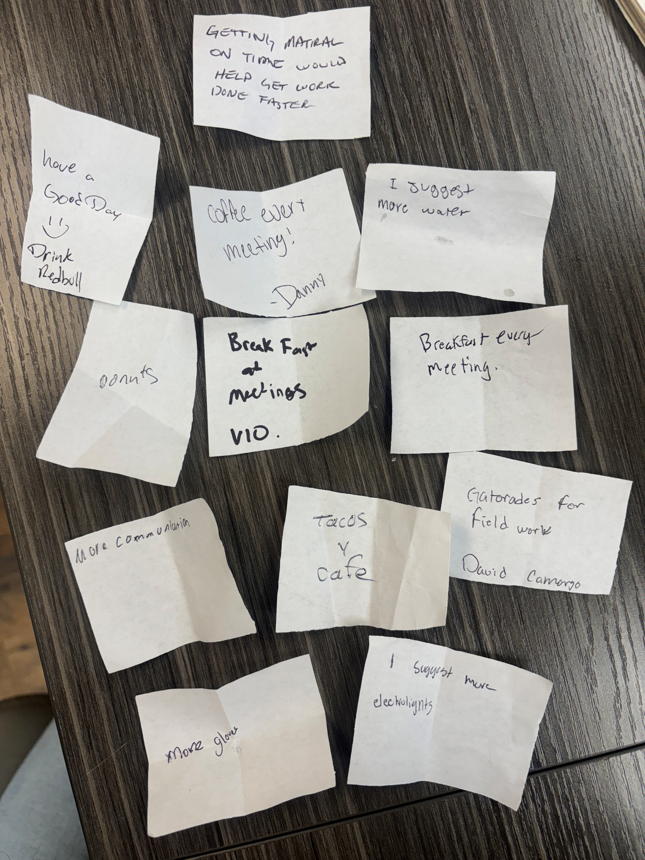
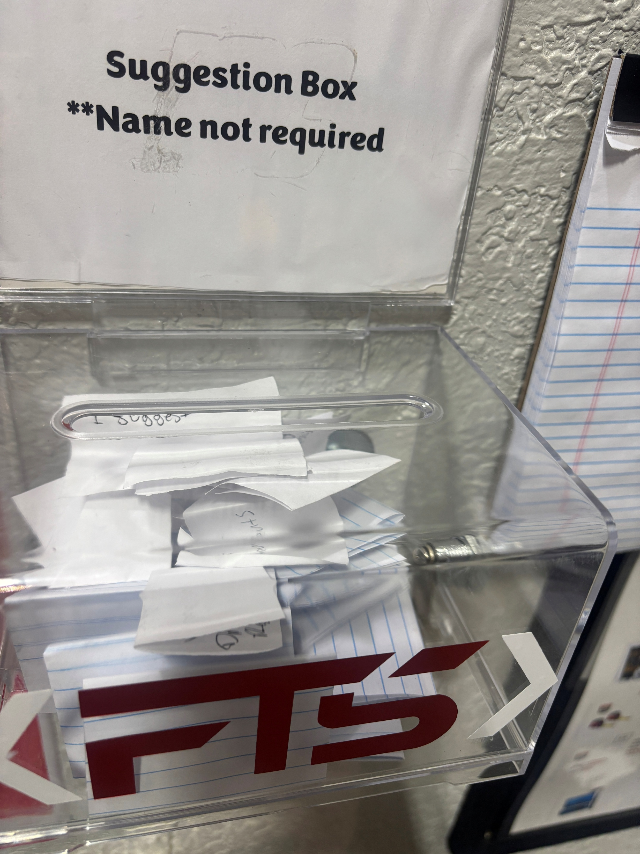
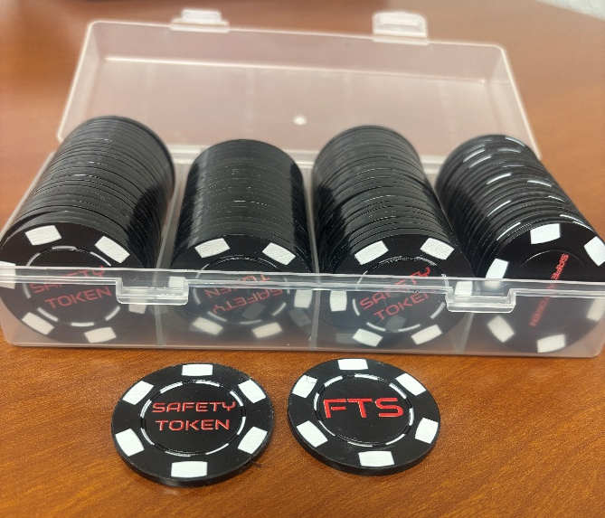
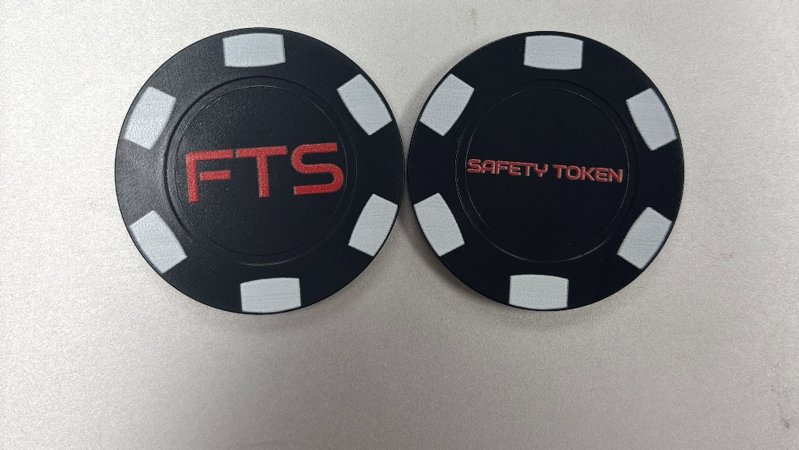
Visual Results
2026 SAFETY EXCELLENCE AWARDS | BEST PRACTICES SEMINAR

Slide 10
Bridging the Gap
2026 SAFETY EXCELLENCE AWARDS | BEST PRACTICES SEMINAR
Management
Safety Communication Board
Field Employees
Before information travelled one direction, today FTS makes sure communication flows both ways.
FTS employees understand and participate in company initiatives and management receives valuable feedback from employees.

Slide 11
Future Use and Applications
2026 SAFETY EXCELLENCE AWARDS | BEST PRACTICES SEMINAR
As FTS continues to grow, we will expand employee engagement initiatives, recognition programs, and communication tools to further strengthen the effectiveness of our safety communication board.
The safety communication board will remain a core component of our safety management system. FTS will ensure that safety information remains visible, accessible, and meaningful to everyone by continuously updating and enhancing our board based on employee feedback and company needs.

Slide 12
SUMMARY
Communication is the foundation of every successful safety culture. When employees are informed, recognized, and engaged, safety becomes everyone’s priority. At FTS, we believe our safety board serves as the foundation for achieving this goal.
2026 SAFETY EXCELLENCE AWARDS | BEST PRACTICES SEMINAR

Slide 13

QUESTIONS?

