Slide 1




2026 SAFETY EXCELLENCE AWARDS | BEST PRACTICES SEMINAR
HARD CRAFTS MEDIUM
BEST IN CLASS
Precision Machinery Contractors, LLC is a privately held company that is an industry leader in the installation, maintenance, and repair of rotating equipment with shop and field services performing work across the country and abroad. Precision is committed to being a leader in safety, quality, and efficiency by staying in front of advancements in training, technology, and tooling.

Slide 2


Slide 3
2026 SAFETY EXCELLENCE AWARDS | BEST PRACTICES SEMINAR
BEST PRACTICE
AGENDA / OUTLINE
Introduction
The iGoalZERO Platform & Our Programs
The Reports We Run
Using the Data in the Field
Examples: Hand Safety & Crew of the Month
Benefits & Results
Future Use, Summary & Q&A

Slide 4

iGoalZERO DIGITAL PLATFORM
2026 SAFETY EXCELLENCE AWARDS | BEST PRACTICES SEMINAR
What It Is
Cloud-based platform with a native mobile app — built for the field
Real-time entry at the point of work — no more paper cards and binders
Configurable forms, dashboards, and automated corrective action tracking
What We Run On It
I Care Cards (BBS): craft-driven observations of safe and at-risk behaviors — launched early 2024
Safety Audits: leadership and HSE field audits with photos, owners, and due dates
2025: 2,072 I Care Card observations and 373 audits across our job sites

Slide 5
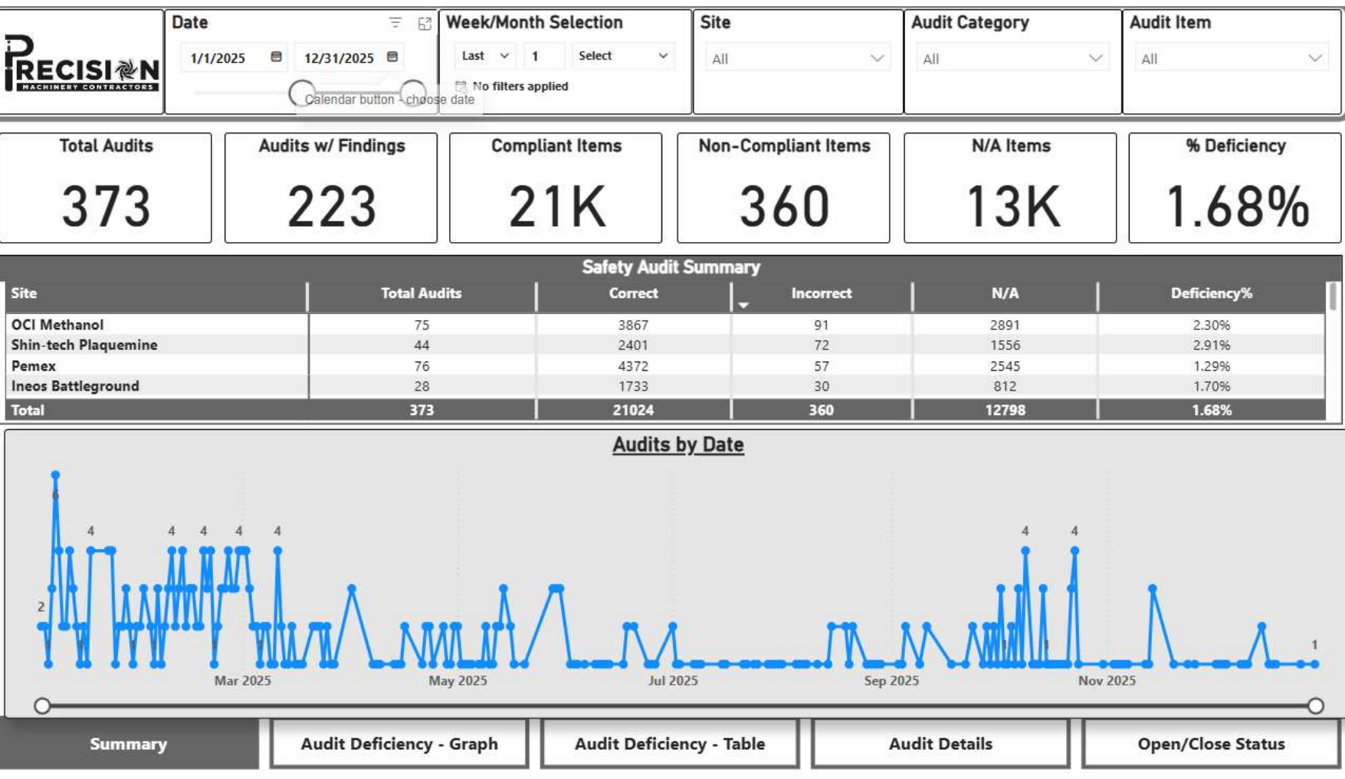
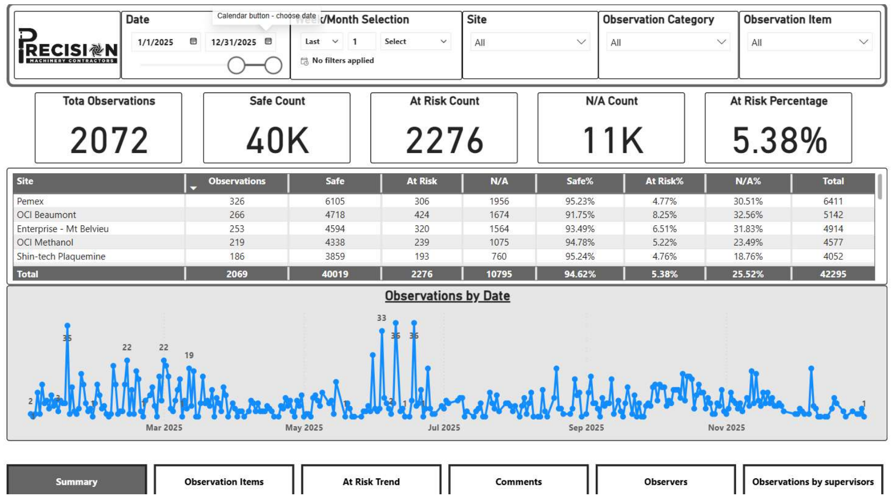
THE REPORTS WE RUN
2026 SAFETY EXCELLENCE AWARDS | BEST PRACTICES SEMINAR
These reports sparked every program you’re about to see — the best practice is what we do with them.

Slide 6
DATA BACK TO THE FIELD
2026 SAFETY EXCELLENCE AWARDS | BEST PRACTICES SEMINAR
How It Comes Back to the Craft
Daily toolbox talks built around the week’s top trending at-risk behaviors
JSA reviews target the hazards the data shows we are missing
On-the-spot coaching and recognition during observations
Platform-wide bulletins share lessons learned
Our Rhythm
Daily: HSE reviews every card and audit finding submitted
Weekly: trend summary briefed to all project managers, the CEO, and the President of Operations
Monthly: KPI review with leadership; results shared with our clients
Immediately: stand-down when a serious trend or near miss emerges

Slide 7
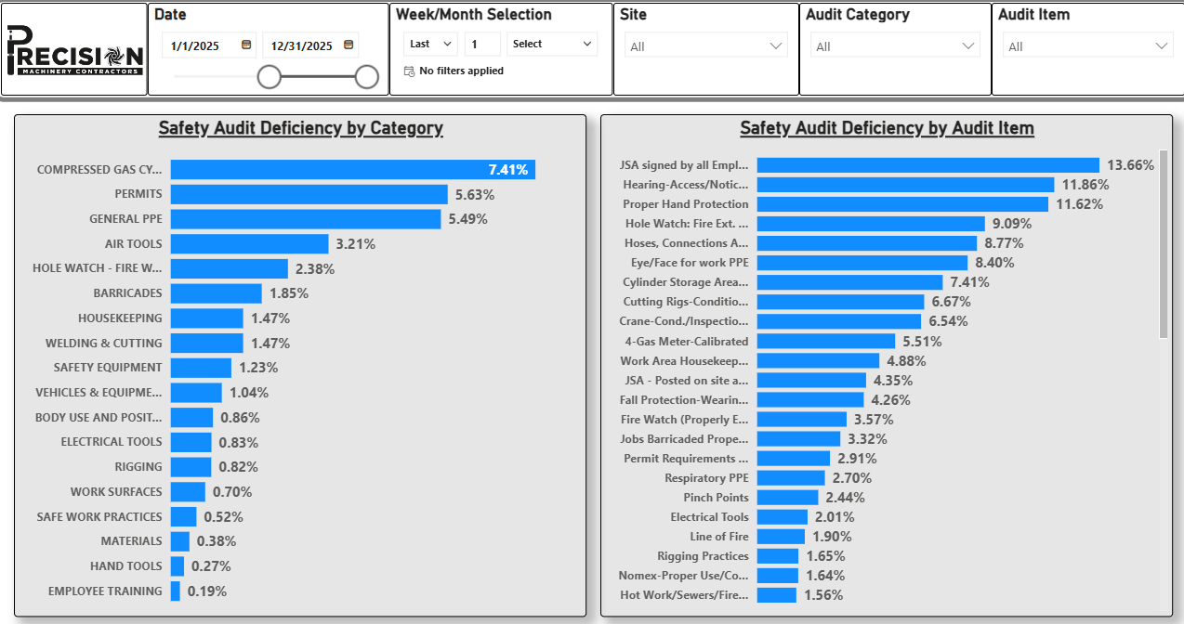
TRENDS TARGET THE WORK
2026 SAFETY EXCELLENCE AWARDS | BEST PRACTICES SEMINAR
What the Data Tells Us — and What We Do
Top at-risk behavior categories by site, crew, and task type
Focused audits and targeted refresher training where the data points
Pre-job planning informed by findings from similar past scopes
2025 audit deficiency report — Proper Hand Protection at 11.62%, our #3 audit item, jumps off the page

Slide 8
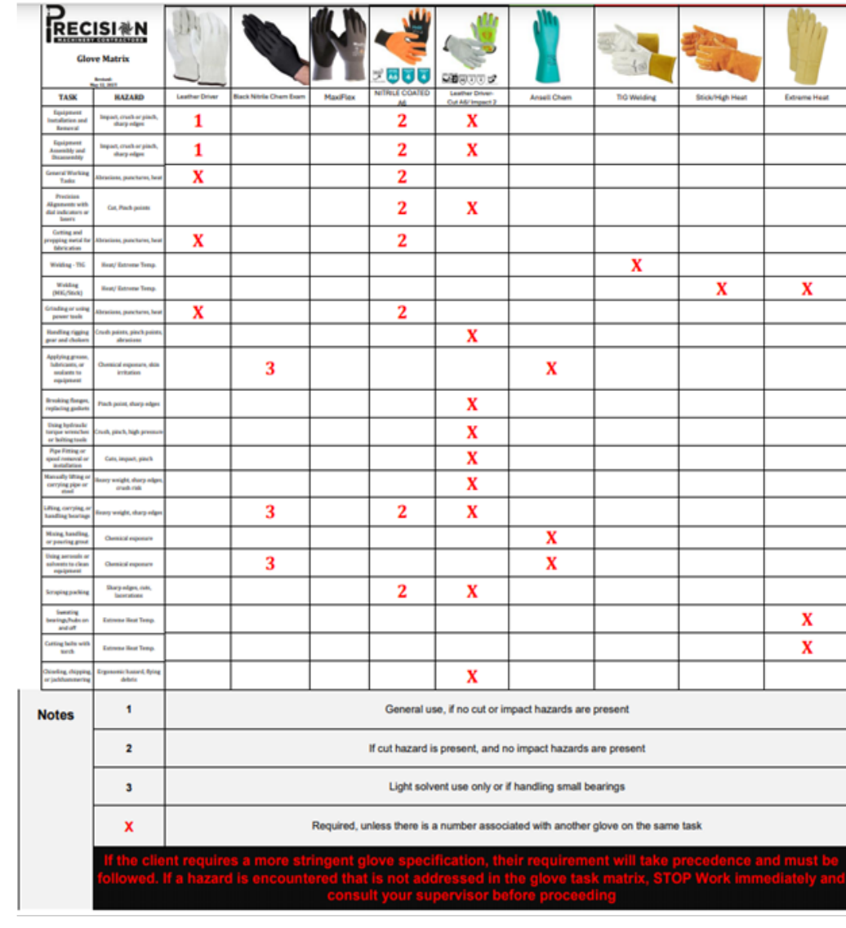

HAND SAFETY CAMPAIGN
2026 SAFETY EXCELLENCE AWARDS | BEST PRACTICES SEMINAR
Trend spotted: improper hand protection = 11.62% of 2025 audit findings — our #3 item
Response: built the Precision Glove Matrix with senior management
To the field: every hand trained and quizzed; laminated posters in trailers and the shop
Sticker contest: the craft designed our first hardhat sticker — best design won $100
Result: deficiencies cut to 1.48% since the June 1, 2025 launch — an 87% reduction
The winning design — on hardhats today

Slide 9
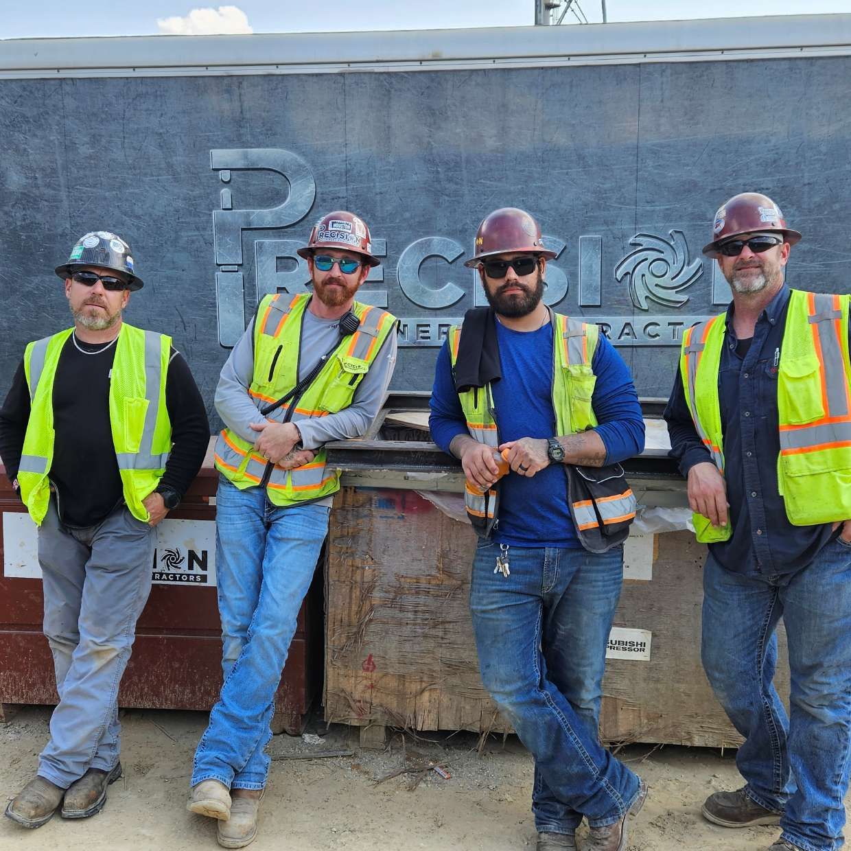
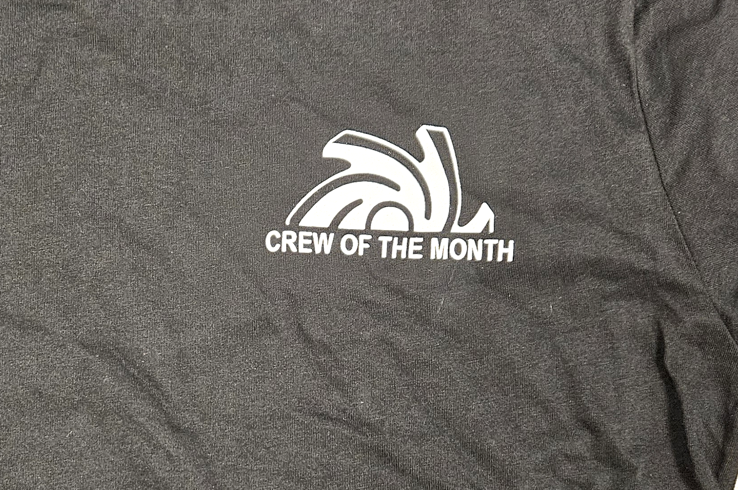
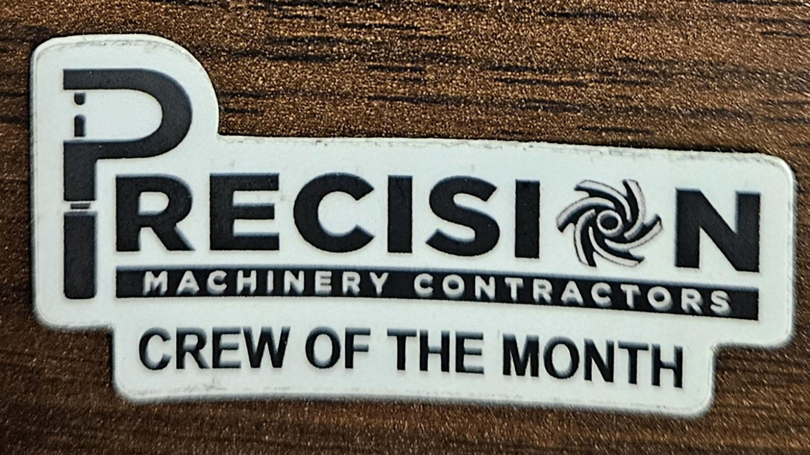
I CARE CARDS IN ACTION
2026 SAFETY EXCELLENCE AWARDS | BEST PRACTICES SEMINAR
Trend spotted: I Care Card reports showed participation below 30% after our early-2024 launch
Crew of the Month: launched November 2024 — at least 80% participation plus quality findings earns a hardhat sticker, t-shirt, and $25 Academy gift card
Steak dinner: a standout finding earns a $50 or $100 steakhouse gift card — rewarding quality, not just quantity
Result: participation sits at 91% today
July 2025 Crew of the Month

Slide 10
BENEFITS & RESULTS
2026 SAFETY EXCELLENCE AWARDS | BEST PRACTICES SEMINAR
Leading Indicators (2025)
2,072 I Care Card observations — 40,019 safe behaviors documented
373 safety audits — 21,024 items verified, 1.68% overall deficiency
I Care Card participation up from below 30% to 91%
Program Wins
Hand protection deficiencies cut from 11.62% to 1.48% after the glove matrix
Only 5.38% of observed behaviors at-risk — and we know exactly which ones to coach
2026 HASC Safety Excellence Award — Best in Class, Hard Crafts Medium

Slide 11
FUTURE USE & APPLICATIONS
2026 SAFETY EXCELLENCE AWARDS | BEST PRACTICES SEMINAR
Where We’re Headed
Just went live: creating purchase requisitions and purchase orders in iGoalZERO
In development: craft-specific trainings, weekly training alerts, and tool & equipment inspections
Predictive trending to get ahead of incidents instead of reacting to them
Advice for Other Contractors
Start simple — digitize the program you already have, then grow
Train supervisors first; the field follows their example
Return the data to the craft fast, and never let cards become punitive

Slide 12
Summary
2026 SAFETY EXCELLENCE AWARDS | BEST PRACTICES SEMINAR
Key Takeaways
Collecting safety data is easy — using it in the field is what changes outcomes
Speed matters: one-week feedback keeps crews engaged and reporting
Trend data tells you where to spend supervision, training, and audit time
What It All Comes Down To
Craft ownership plus leadership visibility builds a sustainable safety culture
The platform is the tool — the conversation at the toolbox is the practice
This award belongs to our craft professionals in the field

Slide 13

QUESTIONS?

