Slide 1




2026 SAFETY EXCELLENCE AWARDS | BEST PRACTICES SEMINAR
HARD CRAFTS LARGE
BEST IN CLASS
Superheat is advancing on-site heat treatment for the digital marketplace, delivering safe, reliable solutions for critical welding and fabrication. We specialize in weld preheating, post weld heat treatment, and advanced induction heating, supported by experienced field crews, purpose-built equipment, and proprietary digital technologies. Through real-time monitoring, data-driven reporting, and a strong safety culture, we help customers improve quality, reduce risk, and execute complex projects with confidence.

Slide 2


Slide 3
2026 SAFETY EXCELLENCE AWARDS | BEST PRACTICES SEMINAR
BEST PRACTICE
AGENDA / OUTLINE
Program Elements
Mentor Certification
Mentorship Process
Mentorship Tools
Examples
Summary & Wrap Up
Q&A

Slide 4

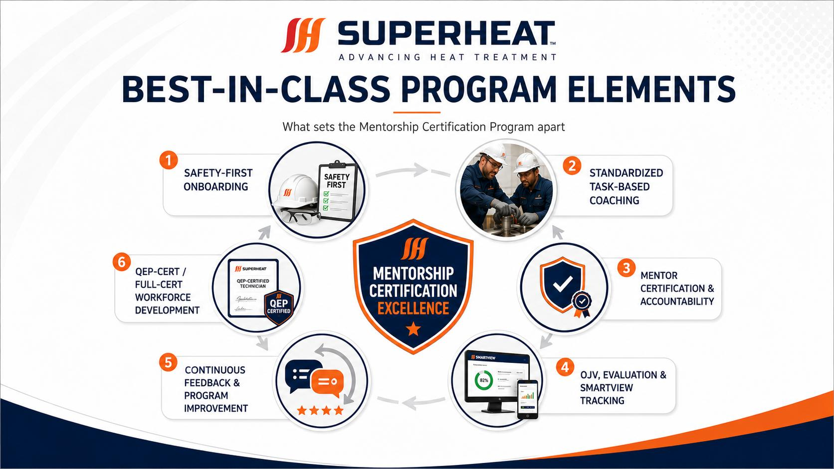
2026 SAFETY EXCELLENCE AWARDS | BEST PRACTICES SEMINAR

Slide 5
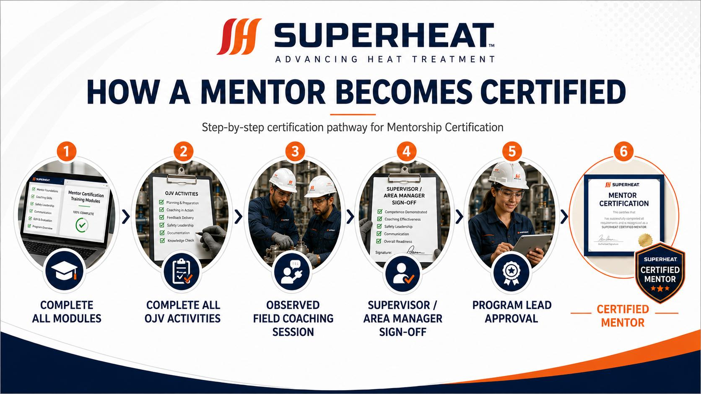
2026 SAFETY EXCELLENCE AWARDS | BEST PRACTICES SEMINAR

Slide 6
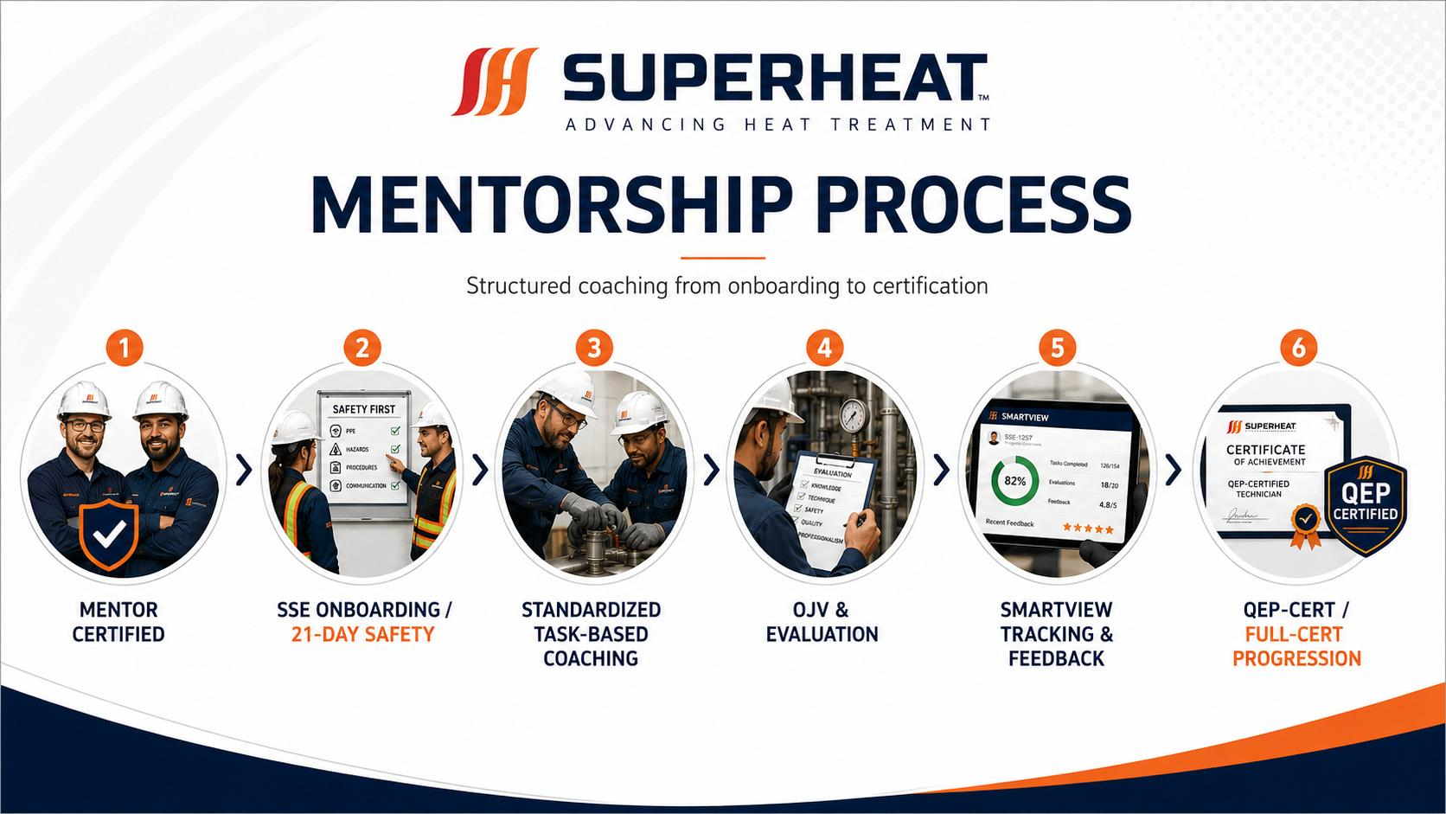
2026 SAFETY EXCELLENCE AWARDS | BEST PRACTICES SEMINAR

Slide 7
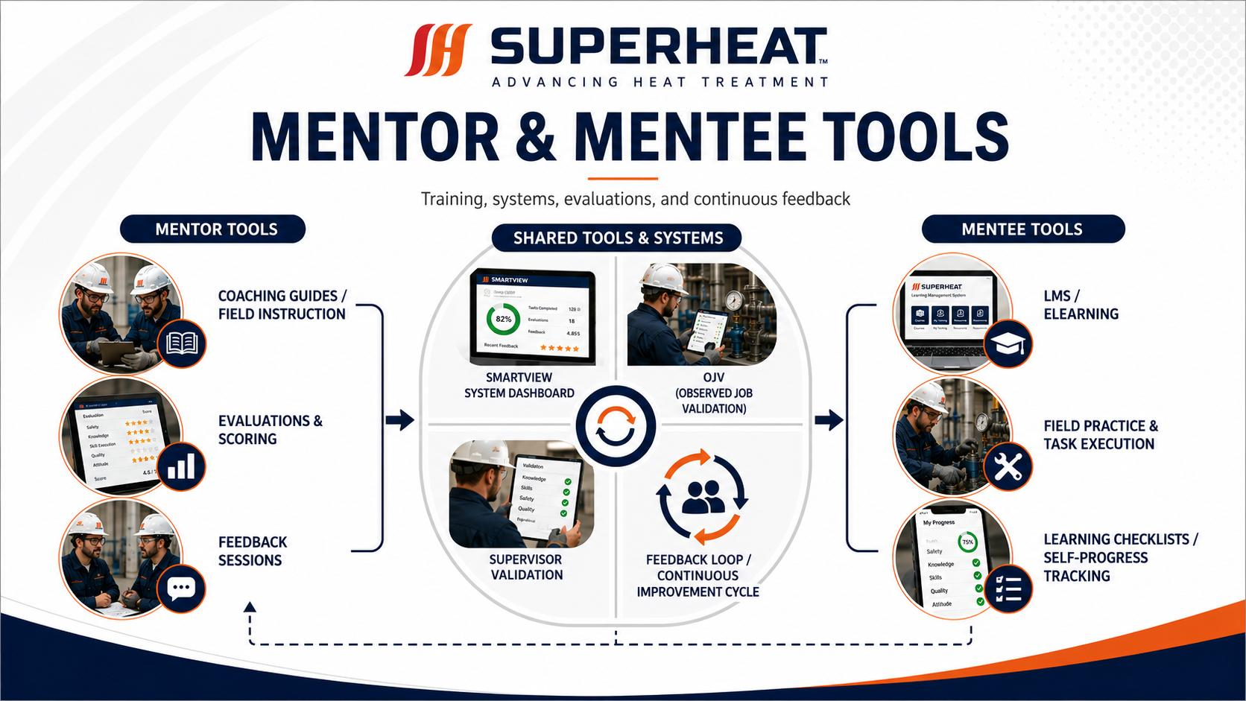
2026 SAFETY EXCELLENCE AWARDS | BEST PRACTICES SEMINAR

Slide 8
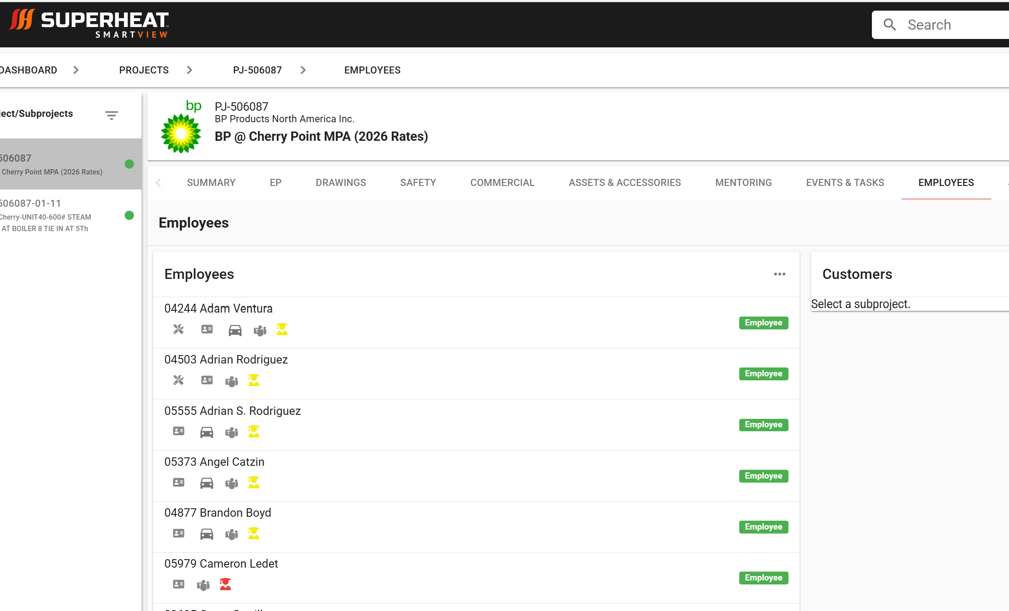
2026 SAFETY EXCELLENCE AWARDS | BEST PRACTICES SEMINAR

Slide 9
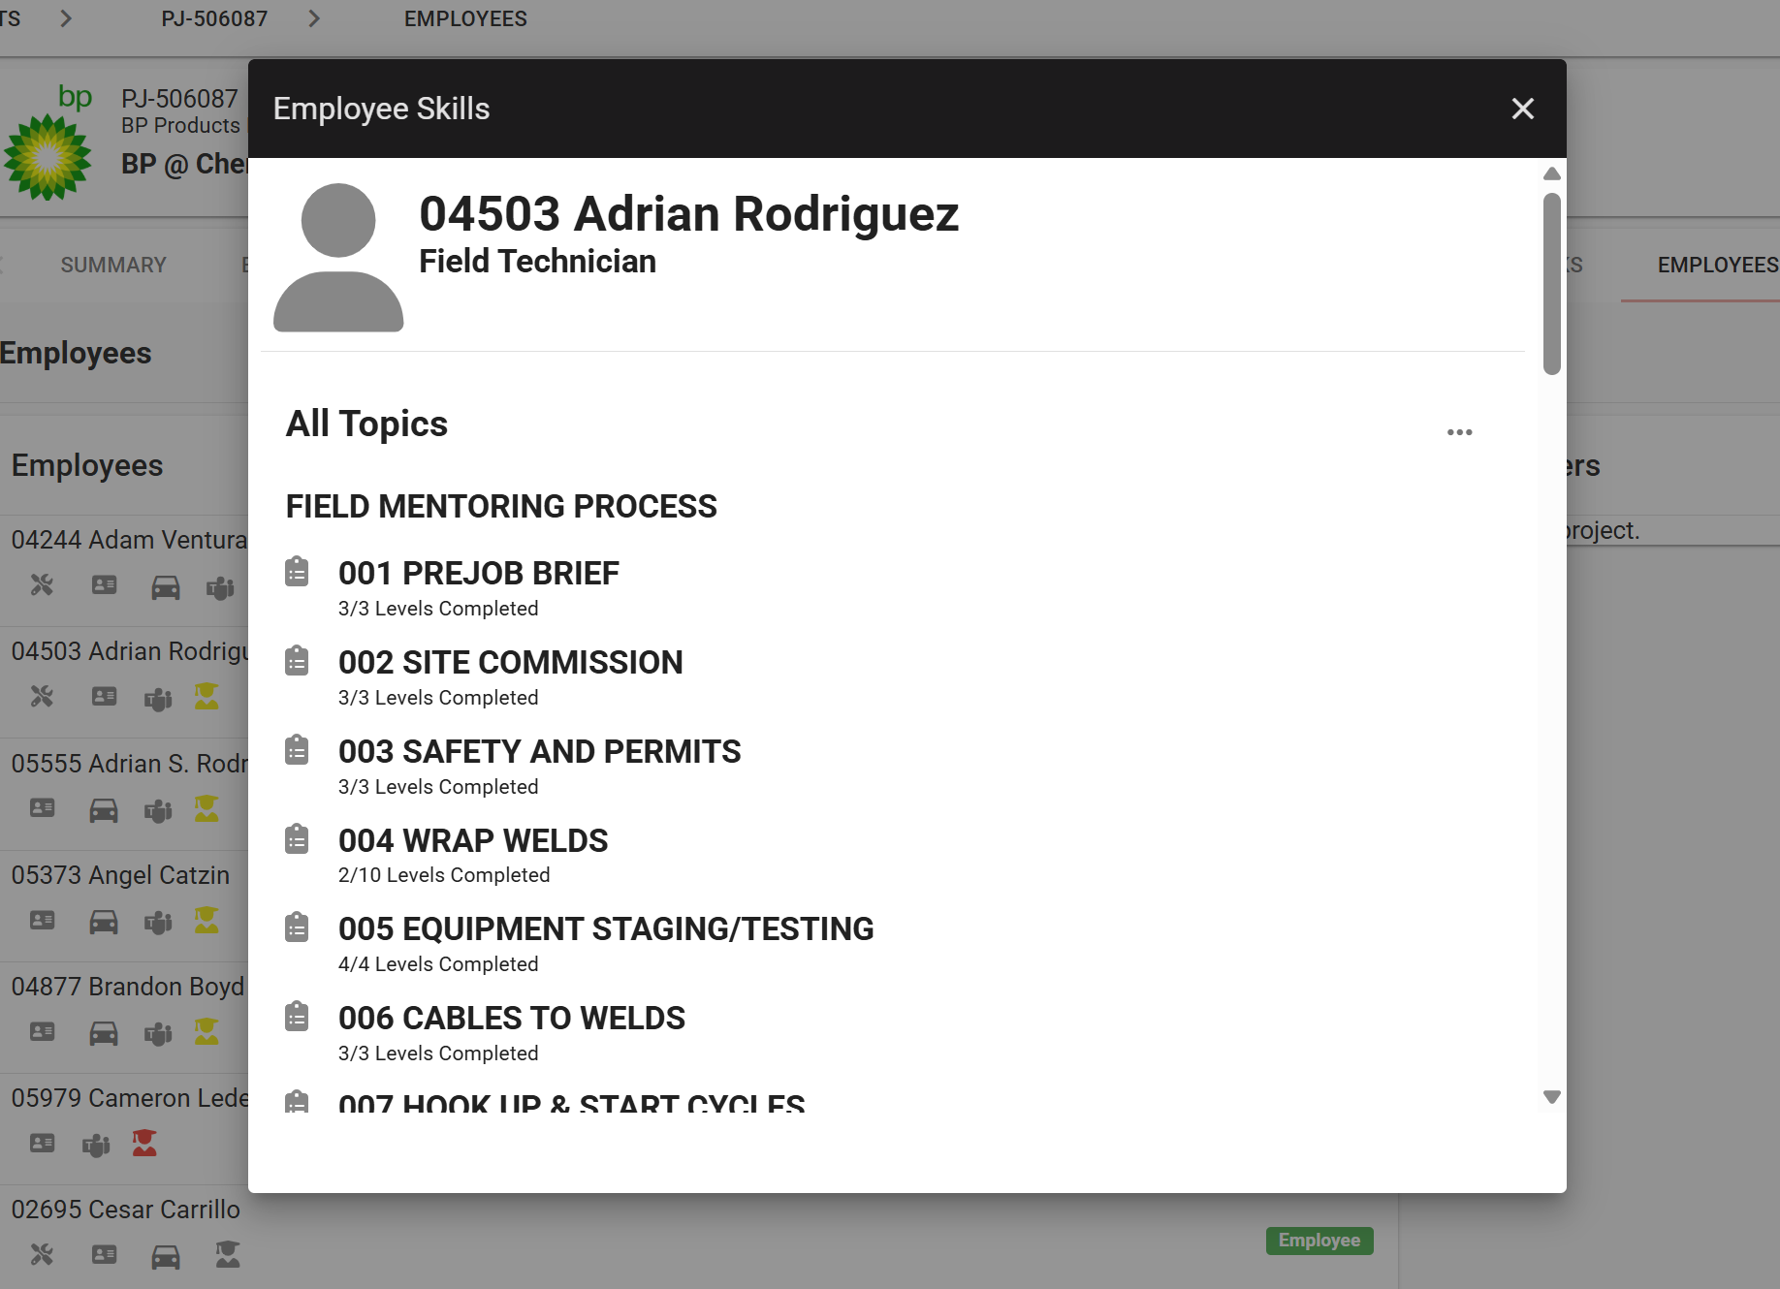
2026 SAFETY EXCELLENCE AWARDS | BEST PRACTICES SEMINAR

Slide 10
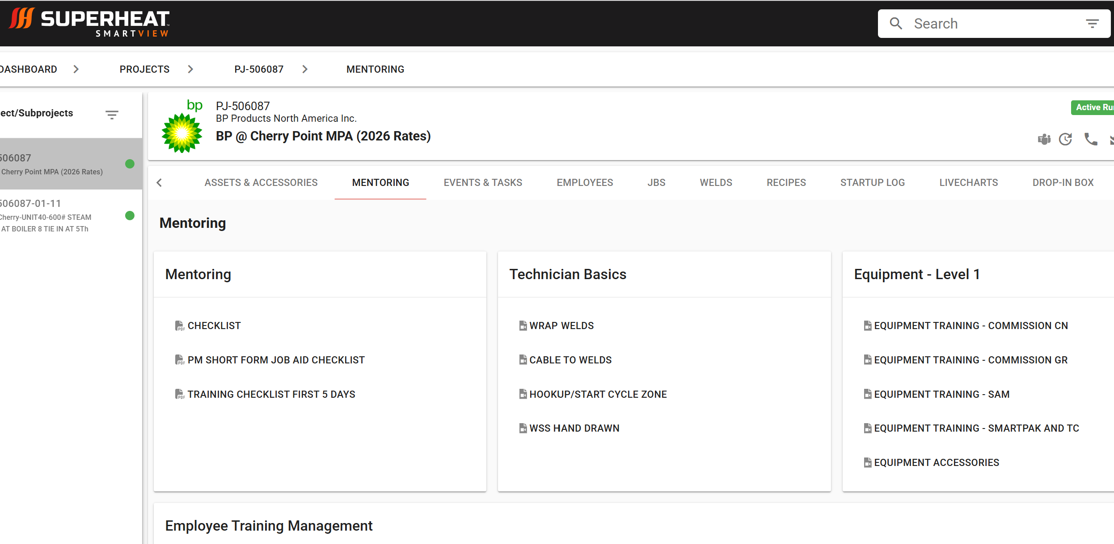
2026 SAFETY EXCELLENCE AWARDS | BEST PRACTICES SEMINAR

Slide 11
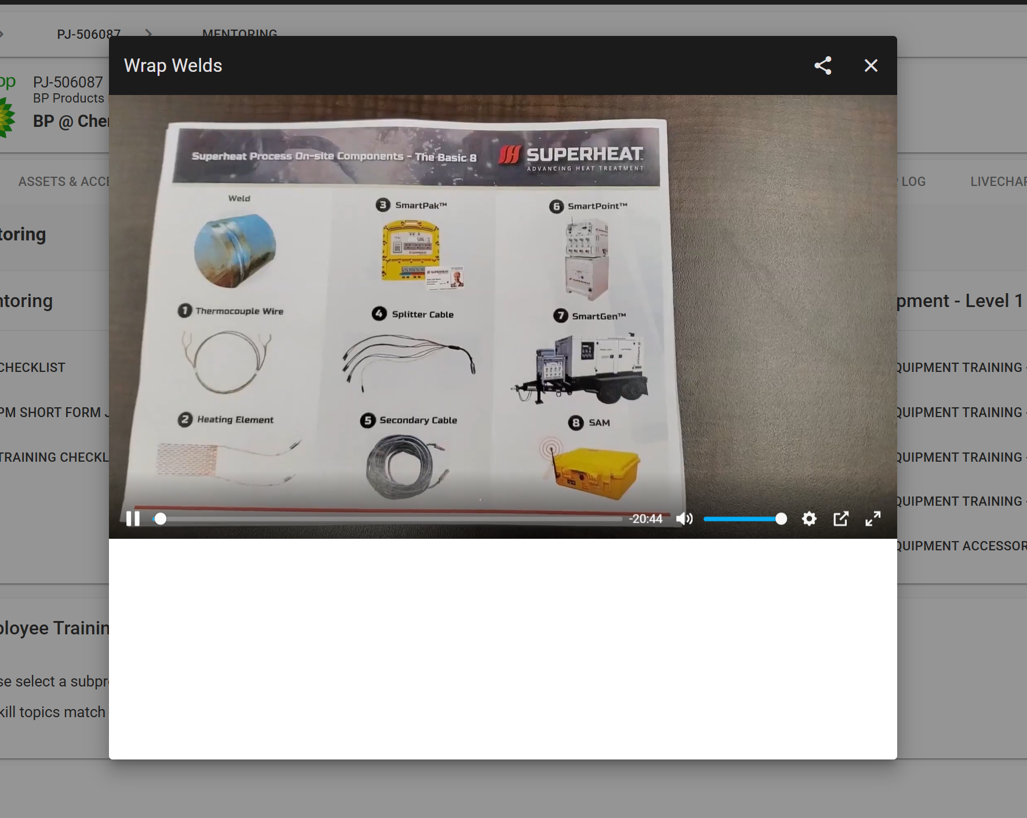
2026 SAFETY EXCELLENCE AWARDS | BEST PRACTICES SEMINAR

Slide 12

QUESTIONS?

