Slide 1
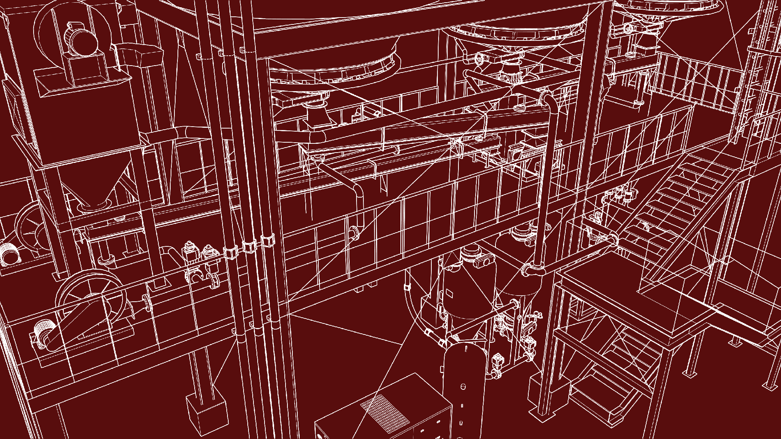



2026 SAFETY EXCELLENCE AWARDS | BEST PRACTICES SEMINAR
GENERAL CONTRACTOR X-LARGE
BEST IN CLASS
For 65 years, Turner Industries has provided turnkey industrial services and solutions to the companies that produce the energy and materials essential to modern life. Turner offers a “One Solution for Your Success” approach for heavy industrial construction, maintenance, turnaround, fabrication, equipment, and specialty services. The company employs more than 20,000 people and operates at jobsites across the United States

Slide 2


Slide 3
2026 SAFETY EXCELLENCE AWARDS | BEST PRACTICES SEMINAR
BEST PRACTICE
AGENDA / OUTLINE
Purpose
Execution & Implementation
Benefits & Results
Examples
Future Use & Applications
Summary & Wrap Up
Q&A

Slide 4

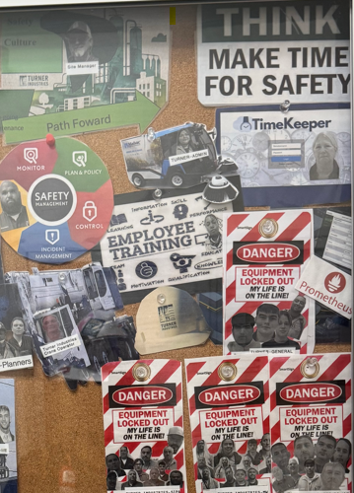
“MY LIFE IS ON THE LINE”
2026 SAFETY EXCELLENCE AWARDS | BEST PRACTICES SEMINAR

Slide 5
“MY LIFE IS ON THE LINE”
2026 SAFETY EXCELLENCE AWARDS | BEST PRACTICES SEMINAR
At Turner Industries Group, safety is a foundational value, not just a priority. We have seven life-critical rules:
Confined Space Entry Protocol
Mandatory Fall Protection
Prohibition of Working Under Live Loads
Completion of Job Safety Analysis (JSA)
Strict Adherence to the No Permit, No Work Policy
Zero Tolerance for Drugs or Alcohol
Implementation of Lock Out/Tag Out (LOTO) Procedures
Execution of Line Breaking Protocols
With commitment from our workforce and client support, we embrace the principle: "MY LIFE IS ON THE LINE."

Slide 6

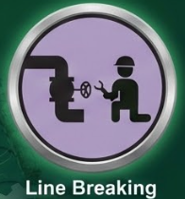


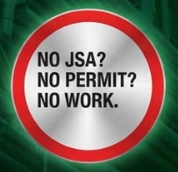


2026 SAFETY EXCELLENCE AWARDS | BEST PRACTICES SEMINAR
LIFE CRITICAL RULES

Slide 7
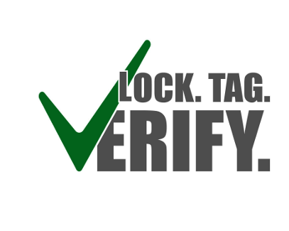
LOCK.TAG.VERIFY
2026 SAFETY EXCELLENCE AWARDS | BEST PRACTICES SEMINAR
LOTO: Verify Zero Energy
Before any job task, ensure zero energy sources are established.
LOTO (Lock-Out) is the placement of a lock-out device on an energy-isolating device per established procedure (Turner HSEP 12.02).
This prevents the equipment from being operated until the lock is removed.
Energy Sources include electrical, mechanical, hydraulic, pneumatic, chemical, thermal, or other energy.

Slide 8
Supervisor Responsibilities
2026 SAFETY EXCELLENCE AWARDS | BEST PRACTICES SEMINAR
Supervisor/Foreman and Client Verification
A company-authorized person (Supervisor/Foreman) must collaborate with the client representative.
Key actions:
  Verify all potential energy sources that are isolated or to be isolated.
  Confirm all potential energy sources are de-energized.
  Follow the verification steps in the Individual LOTO section.
The Supervisor/Foreman must also complete the Line and Equipment Opening Risk Assessment.
Adherence to this rule is non-negotiable.

Slide 9
Employees Responsibilities
2026 SAFETY EXCELLENCE AWARDS | BEST PRACTICES SEMINAR
Employee Responsibilities Under LOTO Permit
Verify correct line of work.
Verify line/equipment is tagged or marked.
Verify all bleeders are open (if applicable).
Verify flow on check valves to check for trapped product (if applicable).

Slide 10
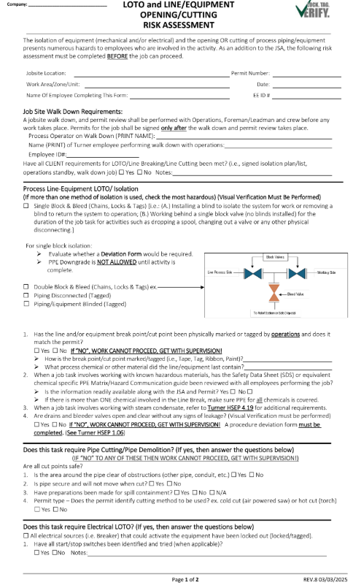
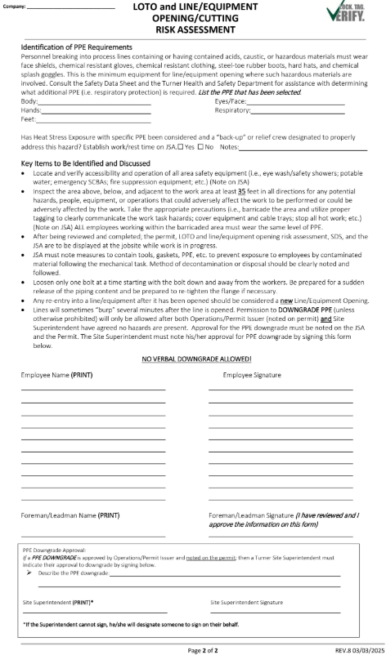
Line and Equipment Opening Risk Assessment
2026 SAFETY EXCELLENCE AWARDS | BEST PRACTICES SEMINAR

Slide 11

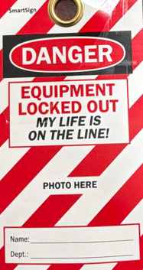
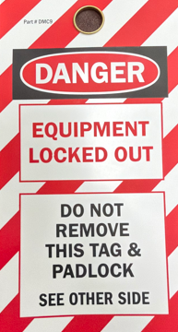
Make It Personal
2026 SAFETY EXCELLENCE AWARDS | BEST PRACTICES SEMINAR
Personal Lock/Tag Accountability
Goal: Reinforce the critical nature of LOTO and protect individual lives.
Mechanism: Personal lock tags immediately signal that a life is at risk if the lock remains.
Encouragement: Employees are encouraged to include a photo (of themselves or a loved one) on the tag.
Impact: Deepens personal accountability by turning a generic lock into a visual reminder of the person depending on its safe removal.

Slide 12
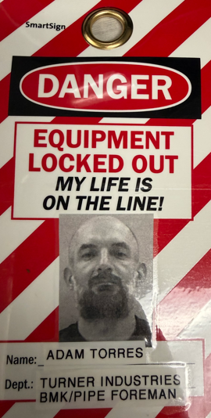
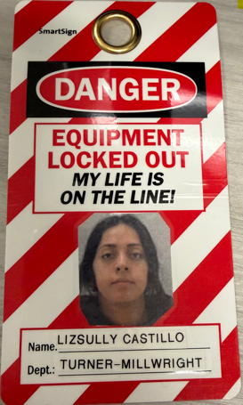
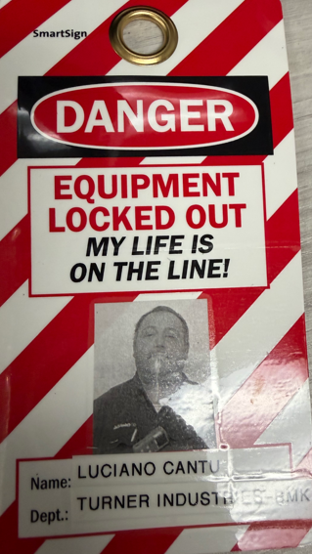
Make It Personal
2026 SAFETY EXCELLENCE AWARDS | BEST PRACTICES SEMINAR
Our biggest asset, our workforce, gave positive feedback, noting that this not only reminds them of the importance of their own life but also of the special person waiting for their safe return home.

Slide 13

QUESTIONS?

