Slide 1
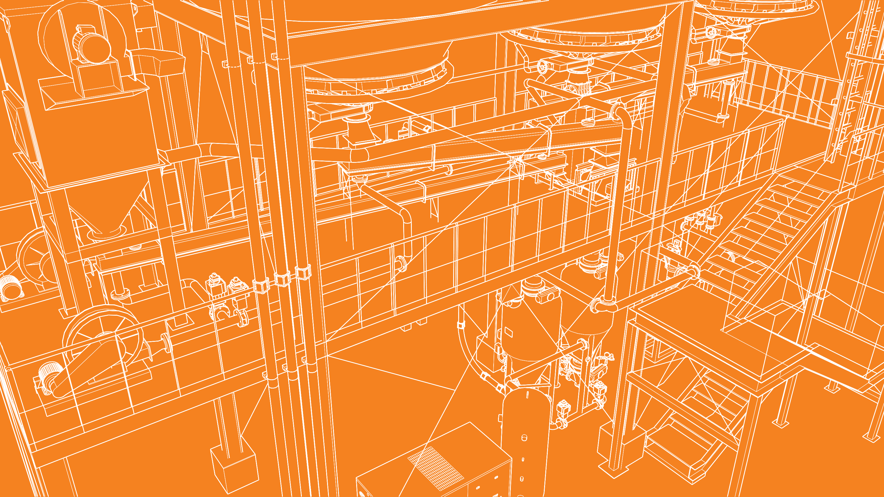

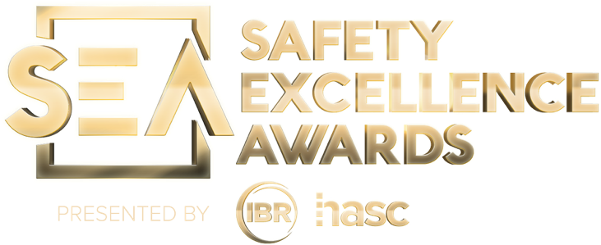

2026 SAFETY EXCELLENCE AWARDS | BEST PRACTICES SEMINAR
GENERAL CONTRACTOR SMALL
BEST IN CLASS
LWL, Inc. is a general contractor performing Civil, Pipe Fabrication, Pipe Erection, Structural Steel Fabrication, Structural Steel Erection, and Equipment Setting in the Petrochemical Industry utilizing Maintenance, New Construction, and Unit Turnaround processes. LWL has been performing Open-Shop industrial construction since 1984 to the energy industry while maintaining a stellar safety, quality, and customer service record.

Slide 2


Slide 3
2026 SAFETY EXCELLENCE AWARDS | BEST PRACTICES SEMINAR
BEST PRACTICE
AGENDA / OUTLINE
Purpose
Execution & Implementation
Benefits & Results
Examples
Future Use & Applications
Summary & Wrap Up
Q&A

Slide 4

The Why?
2026 SAFETY EXCELLENCE AWARDS | BEST PRACTICES SEMINAR
Foreman training was implemented in 3rd QTR of 2024 due to continued inadequacies and incidents occurring at field level. Over six months we experienced clusters of minor incidents:
Equipment damage
Safety infractions
Discoverable gaps in communication

Slide 5
The Why?
2026 SAFETY EXCELLENCE AWARDS | BEST PRACTICES SEMINAR
Investigative results consisted of information not being adequately relayed, field expectations not being aligned with LWL compliance expectations, supervisor to field disconnections, younger less experienced workforce, and general lacking in hazard recognition

Slide 6
The Discovery
2026 SAFETY EXCELLENCE AWARDS | BEST PRACTICES SEMINAR
These discoveries led us to believe that the root cause began with field oversight (foremen & leads). Field safety was not meeting expectations, and the overall tone was that it was field safety technicians' jobs to ensure compliance expectations were being achieved. This line of thinking is antiquated; safety is everyone’s responsibility. After a top-down review we set a baseline for change, and it began with Foreman Training.

Slide 7
The Basics of Foreman Training
2026 SAFETY EXCELLENCE AWARDS | BEST PRACTICES SEMINAR
Foreman training encompasses: Hazard assessment and risk tolerance. Effective Communication. Alignment with LWL compliance expectations. Trust, Integrity, and Transparency. Open forum for real discussions, a place to ask for help and to learn. Discoverable issues at all levels field/management/upper management. This was the baseline for the cultural change was needed at field level.

Slide 8
Expectations and Communication
2026 SAFETY EXCELLENCE AWARDS | BEST PRACTICES SEMINAR
Expectations: The expectation behind this training will be to realign focus of our leaders and crew members to the importance of hazard assessment and risk tolerance. Our leaders are to learn and understand this information and cultivate competence of these skills within our team members.
Foreman's and Leads to hold, not just 1 morning meeting but to effectively communicate job scope and expectations throughout the day via hold points. Hold points are built into the planned tasks to reassess the job, what the next steps will be and how to successfully mitigate any hazard that may arise from the next series of steps necessary to complete the job.

Slide 9
Expectations and Communication
2026 SAFETY EXCELLENCE AWARDS | BEST PRACTICES SEMINAR
Foreman's, Leads and crews to effectively communicate and address any and all issues that could arise from the planned work. Preplan the work in such a way that when it comes to execution there is no loss in time, execution or safety. How can we achieve this? By consciously being involved. Every task is planned appropriately, and every reasonable outcome or hazard is addressed and mitigated prior to action. Every tool checked for current inspection and proper operation, every barricade erected, every above base PPE or classes necessitated by job preplanned and every task or series of tasks identified.

Slide 10
Risk Tolerance – 10 Common Factors
2026 SAFETY EXCELLENCE AWARDS | BEST PRACTICES SEMINAR
Risk tolerance – the cognitive process of deciding to proceed with the task or activity, to change how we do it, or to not do it at all. Do I accept or reject the risk?
Am I or my crew…..
1. Overestimating capability or experience
2. Familiarity with the task (Habits or complacency)
3. Seriousness of the outcome
4. Voluntary actions and being in control -confirmation bias
5. Personal experience with a serious outcome
6. Cost of noncompliance - Personal cost

Slide 11
Risk Tolerance – 10 Common Factors
2026 SAFETY EXCELLENCE AWARDS | BEST PRACTICES SEMINAR
7.Overconfidence in the equipment
8. Overconfidence in personal protective equipment.
9. Profit or gain from actions
10. Role models accepting risk - LEAD BY EXAMPLE!
Which do you believe will have the most impact on your crews?

Slide 12
Focus
2026 SAFETY EXCELLENCE AWARDS | BEST PRACTICES SEMINAR
We developed Foreman forms as a type of coaching exercise for the Foreman training. These forms are filled out by Foremen, safety, or upper management when a compliance issue is identified or reinforcement for positive behaviors. The issues are discussed and awareness is brought to the group to ensure we are learning as a group. We also take this time to review incidents from other sites, CSB findings, OSHA updates, site/LWL compliance changes, safety coaching and review top field findings.

Slide 13
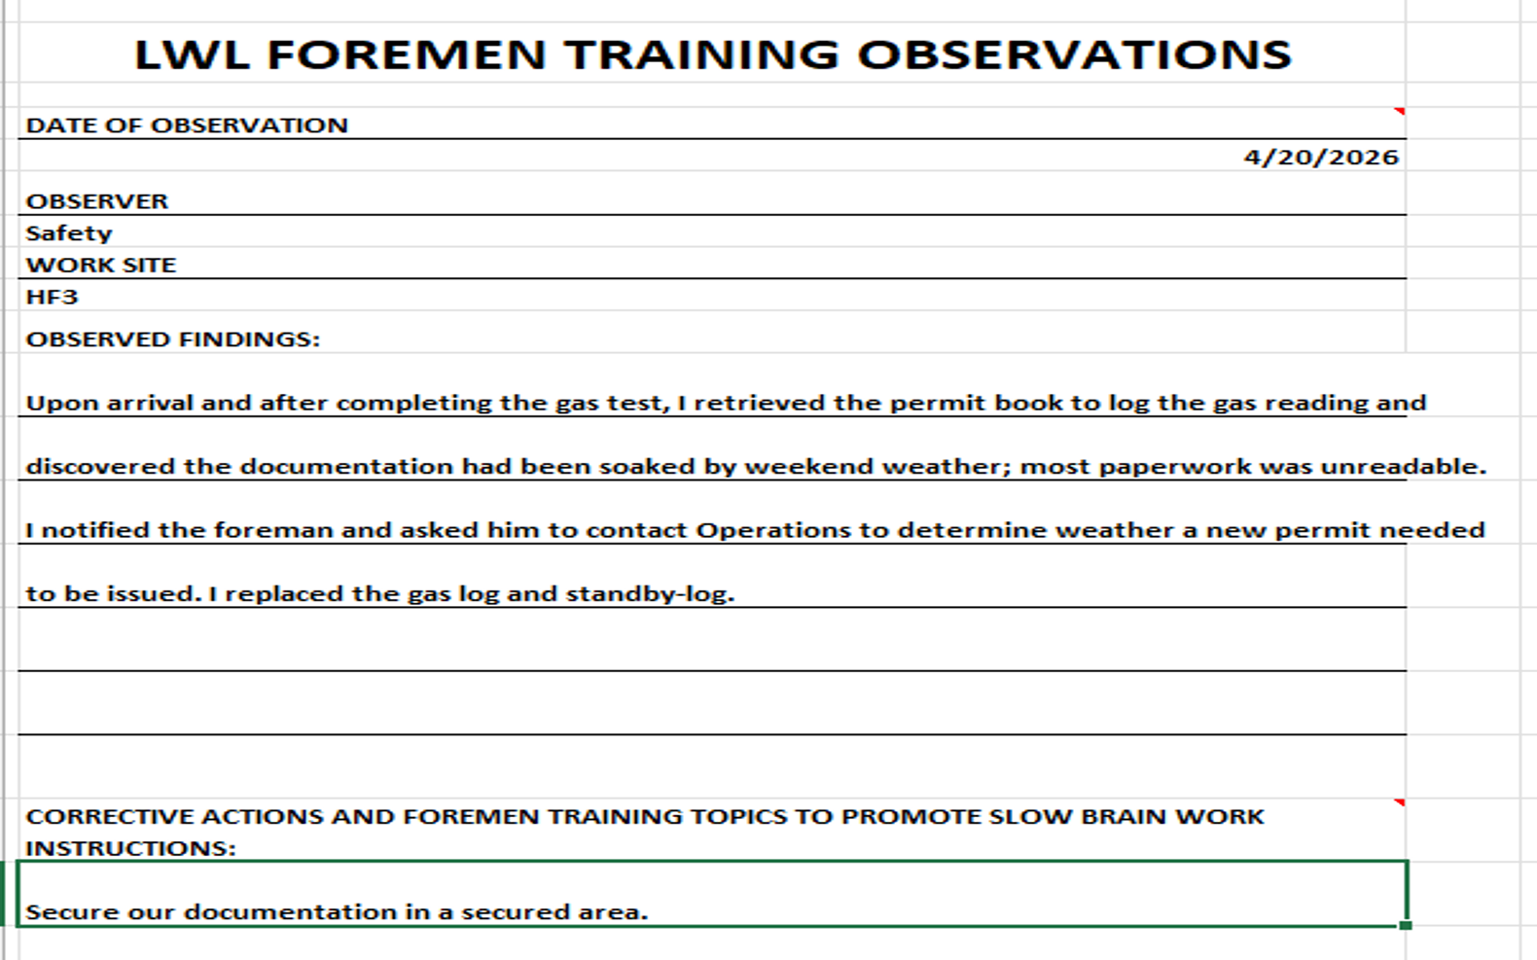
2026 SAFETY EXCELLENCE AWARDS | BEST PRACTICES SEMINAR

Slide 14
Summary
2026 SAFETY EXCELLENCE AWARDS | BEST PRACTICES SEMINAR
Since implementation of Foremen Training, we have experienced an uptick in self reporting – foremen and crews are not afraid of safety but refer to the safety team as a resource; a tool to help build safe work habits and maintain compliance. We are the first call as opposed to the last. This allows ease of compliance with all standards LWL /Client and alleviates animosity and drives compliance.
Incidents: 2024 – 14, 2025 – 4, 2026 YTD – 1.

Slide 15

QUESTIONS?

