Slide 1




2026 SAFETY EXCELLENCE AWARDS | BEST PRACTICES SEMINAR
GENERAL CONTRACTOR MEDIUM
BEST IN CLASS
Arnold Construction Company delivers full-service industrial construction for demanding projects across Texas and surrounding regions. Our integrated civil, structural, mechanical, and concrete services are designed to meet schedule, budget, safety, and performance expectations.

Slide 2


Slide 3
2026 SAFETY EXCELLENCE AWARDS | BEST PRACTICES SEMINAR
BEST PRACTICE
AGENDA / OUTLINE
Purpose
Execution & Implementation
Benefits & Results
Examples
Future Use & Applications
Summary & Wrap Up
Q&A

Slide 4


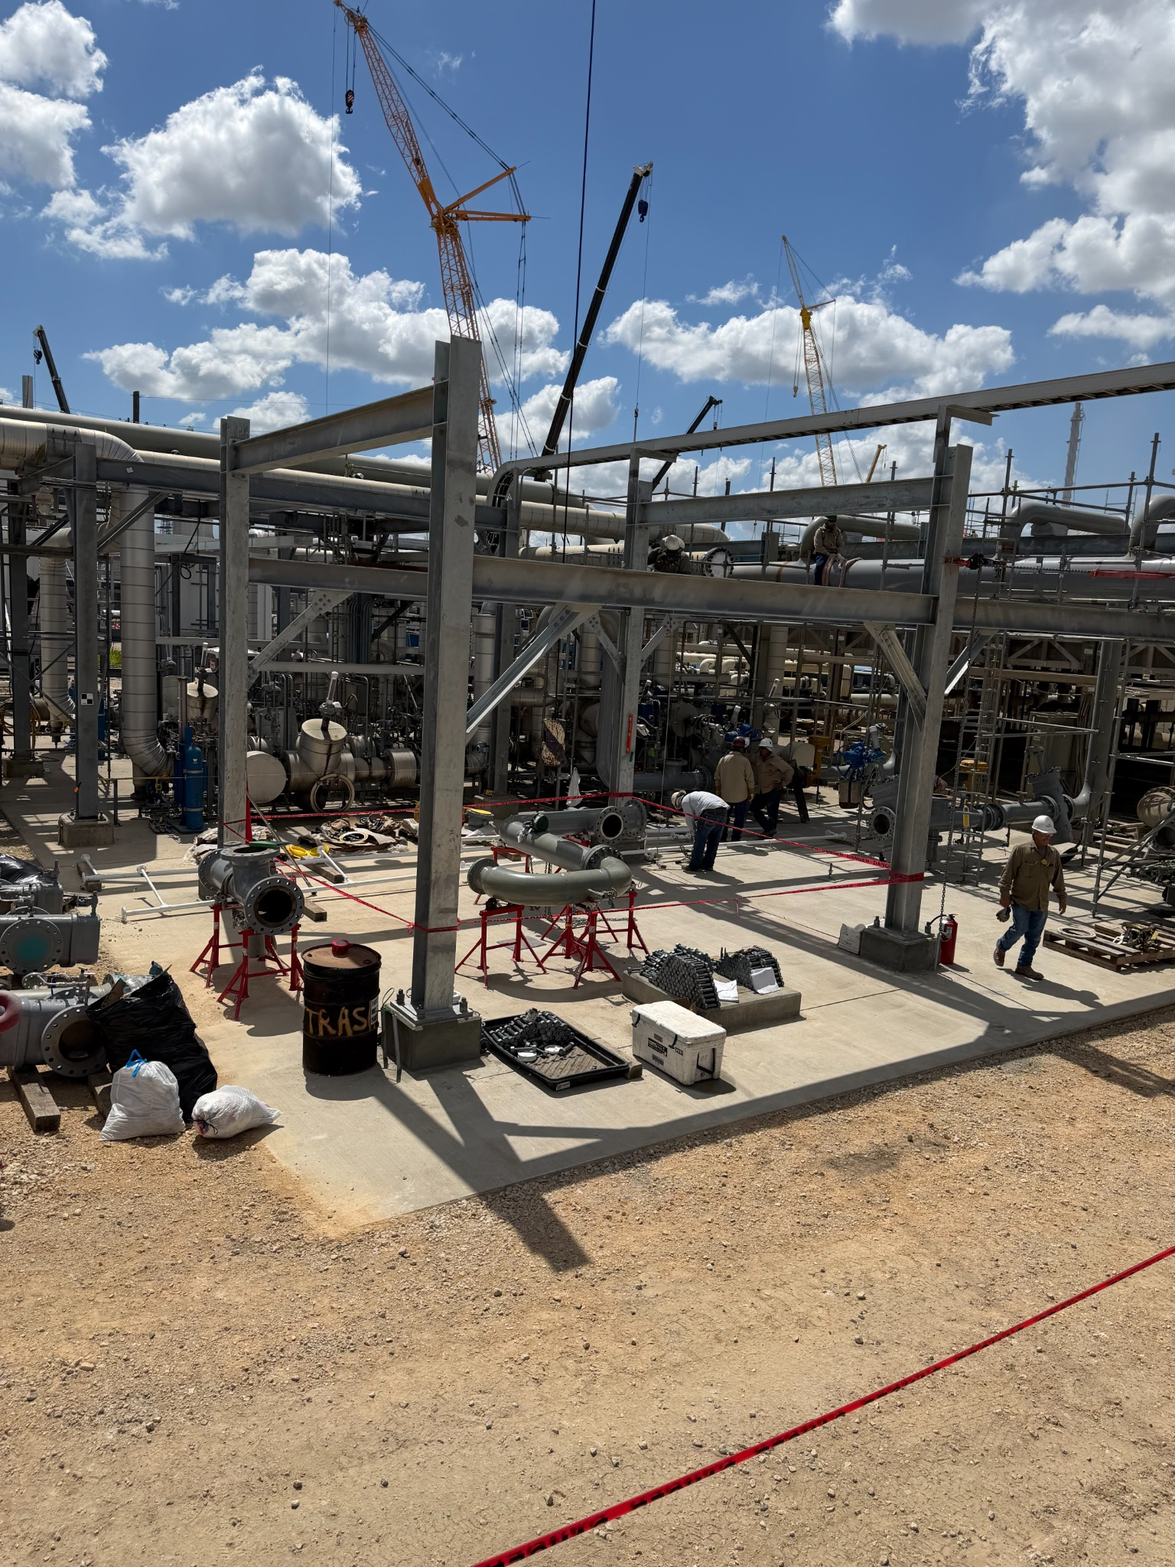

2026 SAFETY EXCELLENCE AWARDS | BEST PRACTICES SEMINAR
G.O.A.L – GET OUT AND LOOK
Create a proactive safety culture by spending time where
the work is performed. Employee engagement, hazard recognition,
leadership visibility, and real-time coaching. We integrated this into our
Spotter fleet policies as well

Slide 5
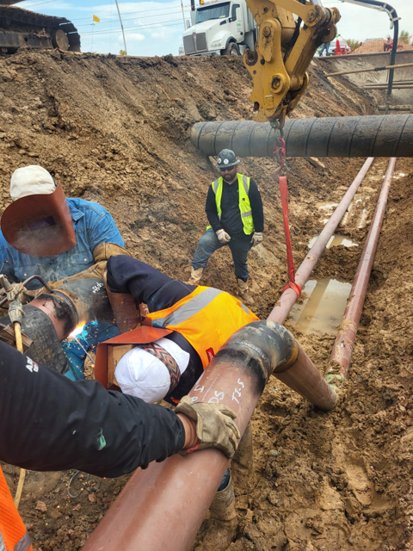
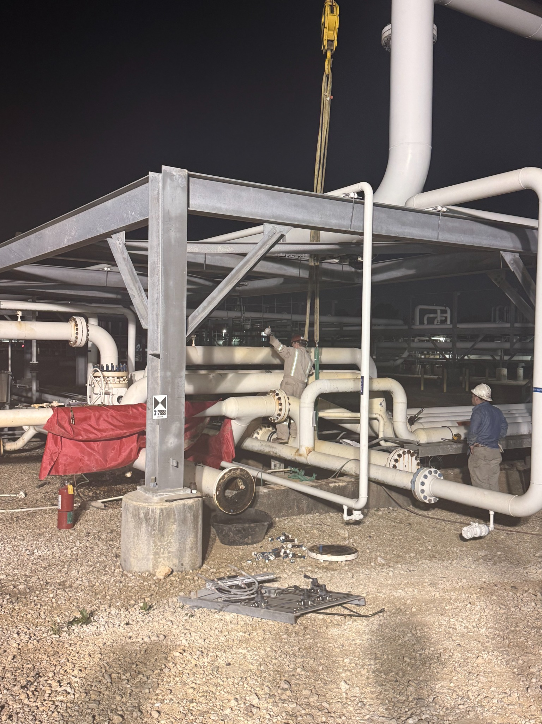
2026 SAFETY EXCELLENCE AWARDS | BEST PRACTICES SEMINAR
WHAT WE LEARNED
The workforce had the answers. Employees wanted easier access to information, supervisors needed better tools,
and paper systems were slowing us down. The work force didn’t need more rules
They need better and faster access to what we had

Slide 6
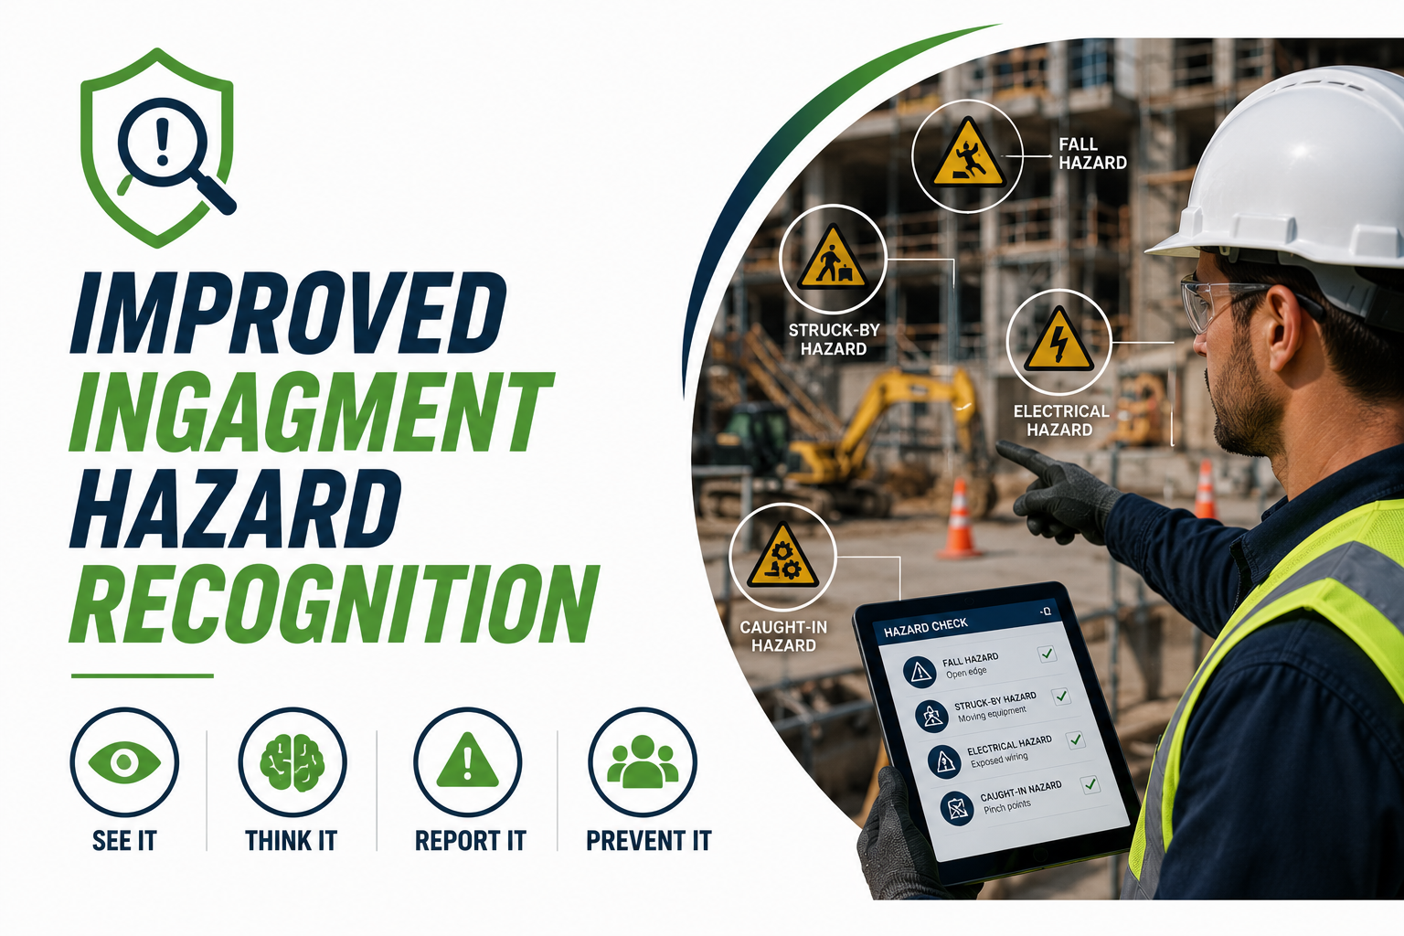
2026 SAFETY EXCELLENCE AWARDS | BEST PRACTICES SEMINAR
RESULTS OF GET OUT AND LOOK
Improved engagement, hazard recognition, accountability, documentation quality, and stronger relationships between operations and safety

Slide 7

2026 SAFETY EXCELLENCE AWARDS | BEST PRACTICES SEMINAR
BRINGING SAFETY UP TO THE SPEED OF CONSTRUCTION
Our workload and the industry evolved. Safety programs had to evolve with it

Slide 8

2026 SAFETY EXCELLENCE AWARDS | BEST PRACTICES SEMINAR
RESEARCH & INDUSTRY INPUT
Engaged leading safety platforms, industry peers, and safety professionals to gather insight, evaluate alternatives, and
validate our approach

Slide 9

2026 SAFETY EXCELLENCE AWARDS | BEST PRACTICES SEMINAR

Slide 10
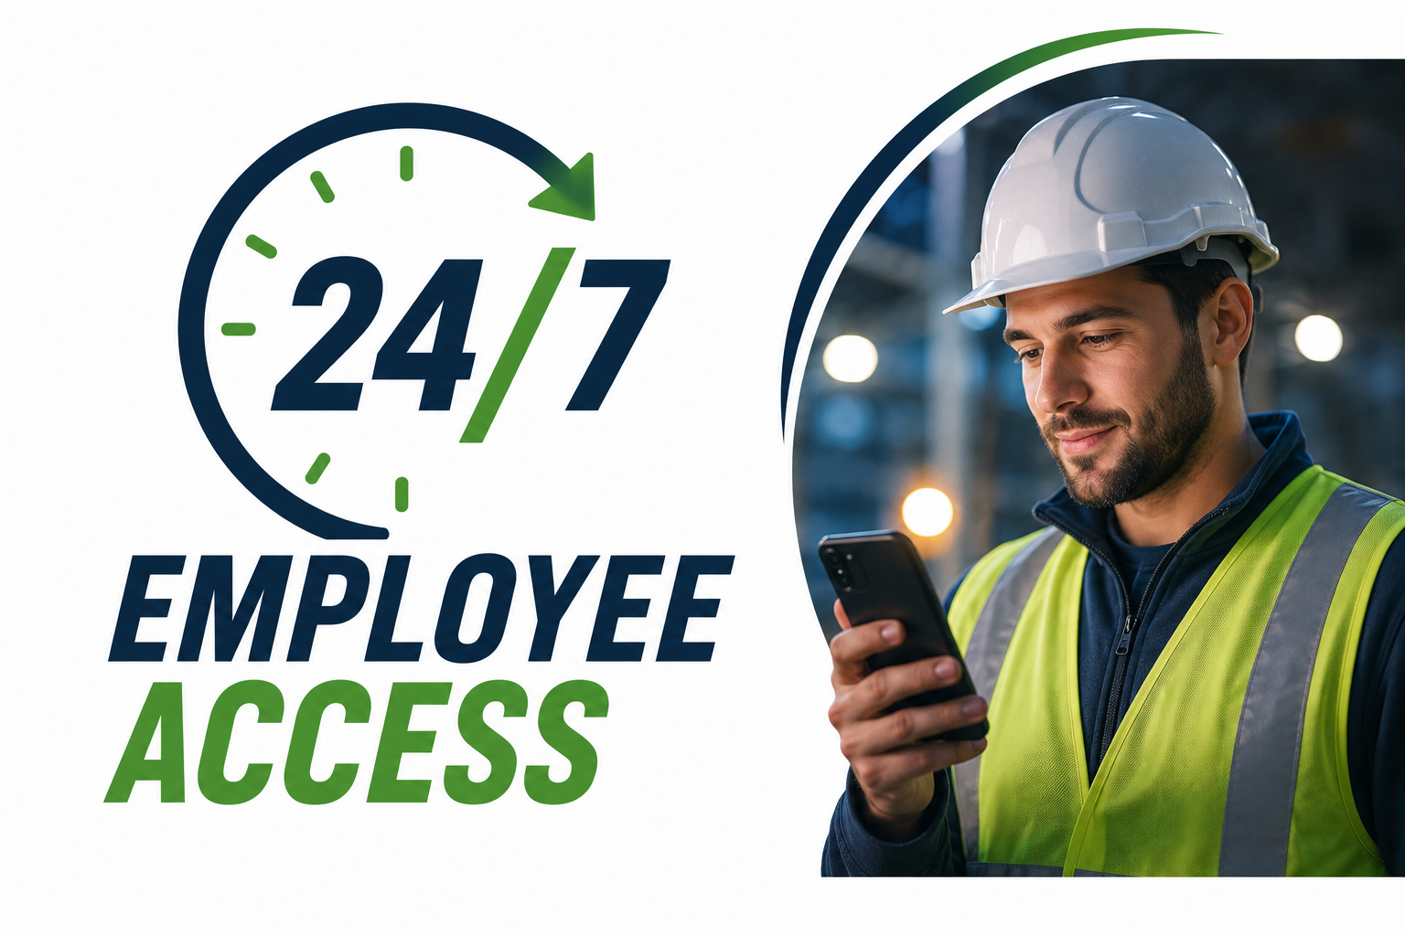
2026 SAFETY EXCELLENCE AWARDS | BEST PRACTICES SEMINAR
ACCESSIBILITY FOR EVERY EMPLOYEE at any time of the day
Every employee received resources through flash drives, digital manuals, training resources, and mobile-accessible information

Slide 11
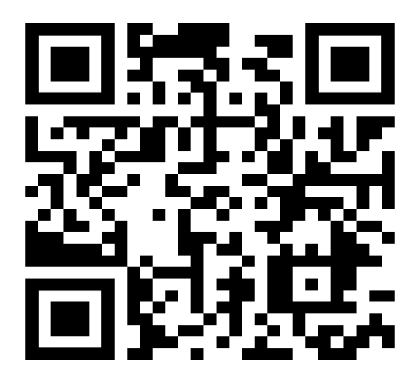
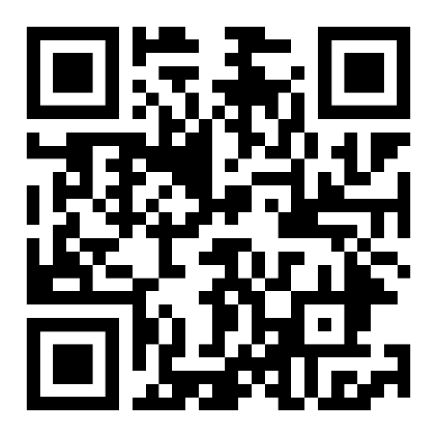
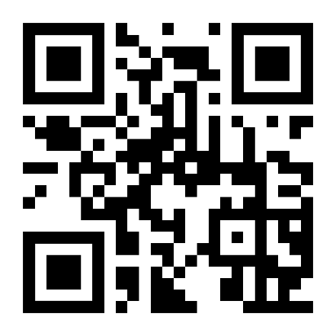
2026 SAFETY EXCELLENCE AWARDS | BEST PRACTICES SEMINAR
QR CODE PROGRAM
Instant access to Safety Manuals, SDS information, forms, toolbox talks, training resources, and emergency contacts
Master Safety &
Health
Safety Forms
Right to Know
SDS

Slide 12

Summary
2026 SAFETY EXCELLENCE AWARDS | BEST PRACTICES SEMINAR
TECHNOLOGY INTEGRATION
Integrated Safety Manual, SDS Program, Forms, Training Resources, Toolbox Talks, and Emergency Information into one connected system

Slide 13

QUESTIONS?

