Slide 1
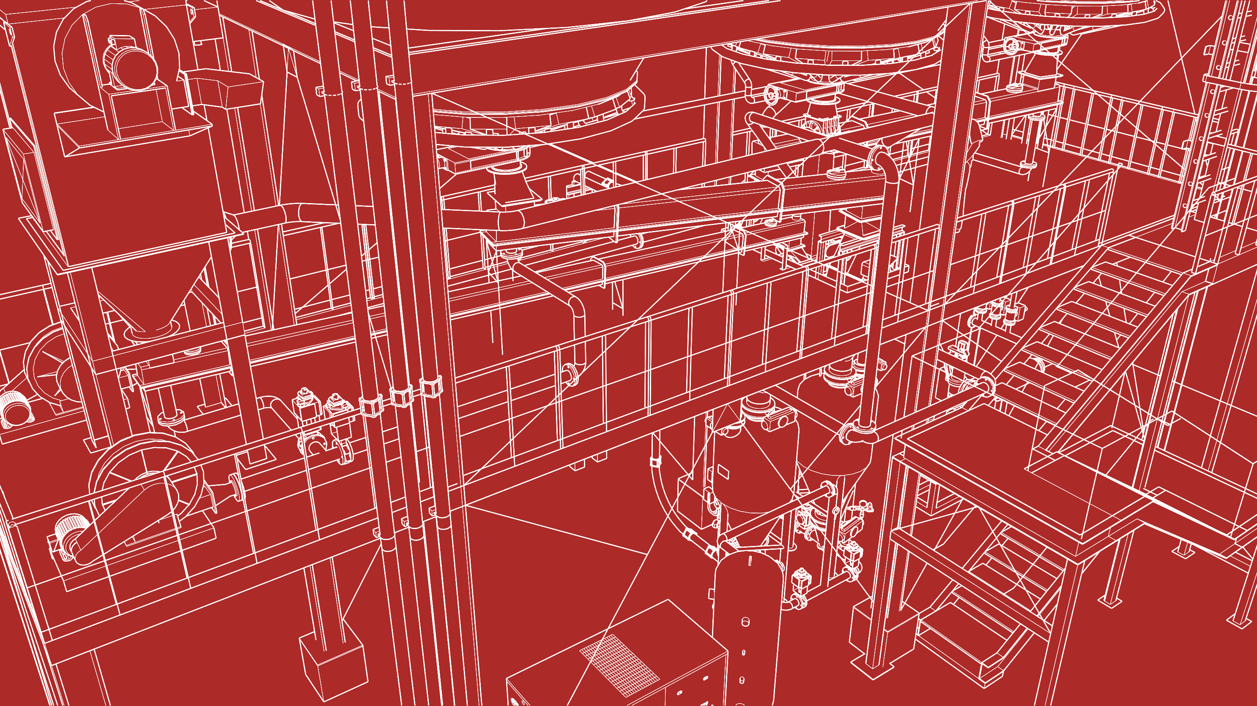


2026 SAFETY EXCELLENCE AWARDS | BEST PRACTICES SEMINAR
GENERAL CONTRACTOR LARGE
BEST IN CLASS
Founded in 1983, Starcon is a national, full service contractor offering comprehensive industrial and mechanical services to a wide variety of process industry clients. Starcon provides expertise in turnarounds, maintenance, capital construction, and facility support. Our success is built on a strong safety culture, quality execution, and a commitment to delivering best in class results for our clients. Starcon is proud to be 100% employee owned.

Slide 2


Slide 3
2026 SAFETY EXCELLENCE AWARDS | BEST PRACTICES SEMINAR
BEST PRACTICE
AGENDA / OUTLINE
Purpose
Execution & Implementation
Benefits & Results
Examples
Future Use & Applications
Summary & Wrap Up
Q&A

Slide 4

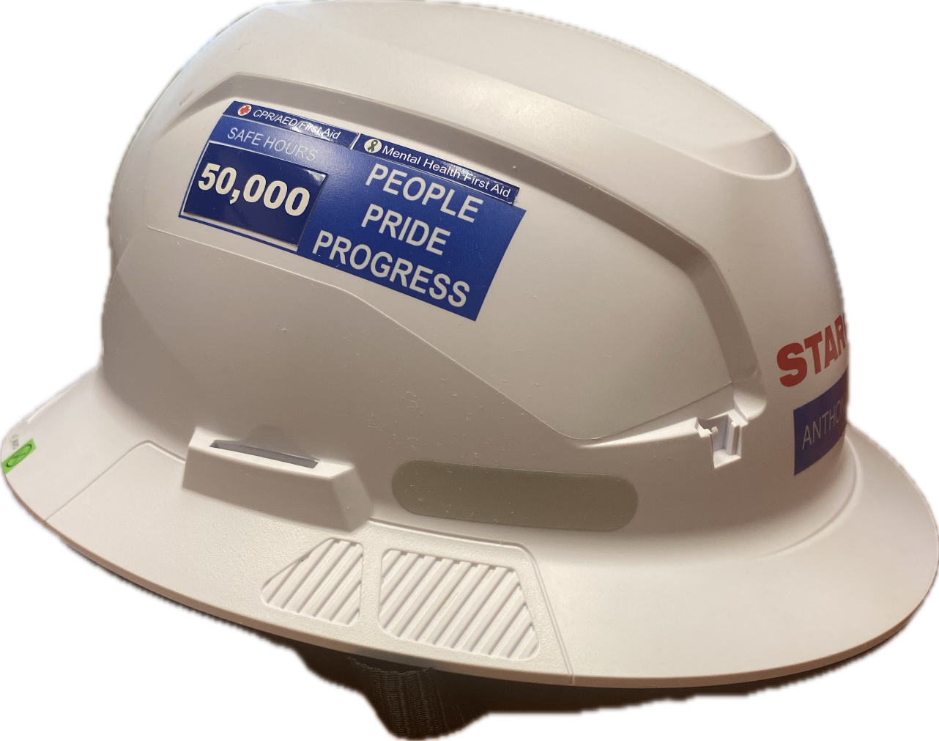
Purpose
2026 SAFETY EXCELLENCE AWARDS | BEST PRACTICES SEMINAR
The purpose of this initiative was to improve head protection across all operations and reduce the risk of traumatic brain injuries(TBI). TBIs are a global public health problem and is a leading cause of injury-related death and disability. In order to better protect our team members, we have identified safety helmets provide industry leading protection for head impacts.
Traditional hard hats primarily protect against top impacts, but they do not address side or off-angle impacts.
To address this gap, we implemented a company-wide transition to Type II helmets.
The Cianbro Companies - Type 2 Safety Helmet Launch

Slide 5

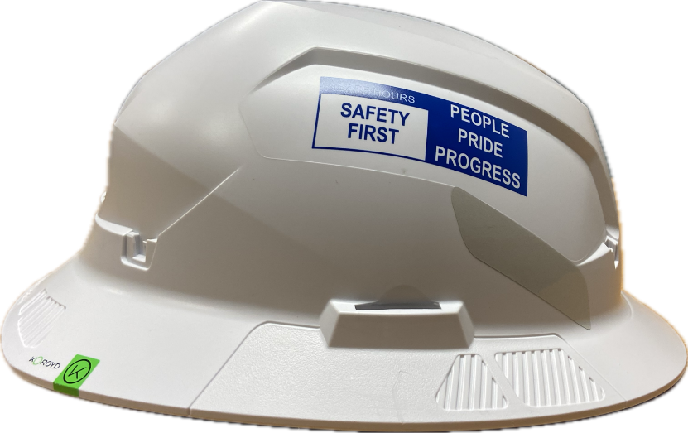
Execution & Development
2026 SAFETY EXCELLENCE AWARDS | BEST PRACTICES SEMINAR
We began by conducting industry research and evaluating multiple helmet options.
The Type II full-brim helmet was selected due to its ability to provide multi-directional impact protection, electrical rating, and compatibility with integrated accessories.
We also piloted the program and gathered workforce feedback to ensure usability and acceptance prior to full implementation.

Slide 6
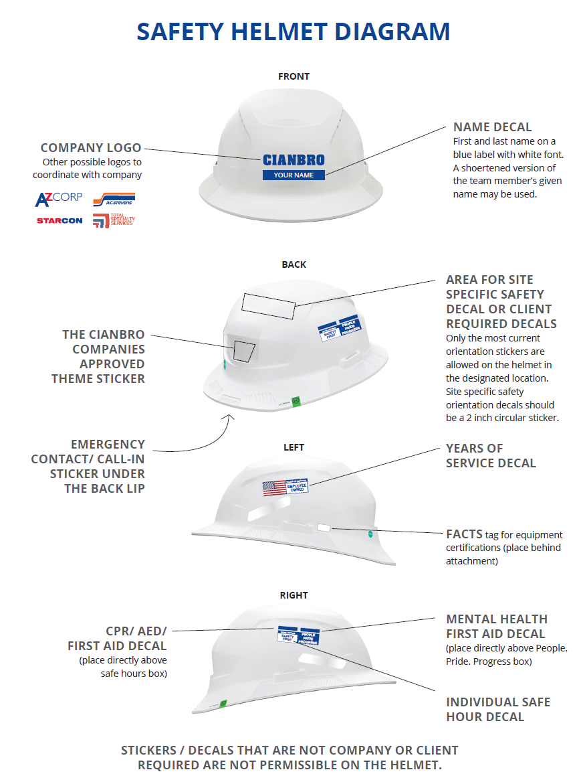

Operational Integration
2026 SAFETY EXCELLENCE AWARDS | BEST PRACTICES SEMINAR
Following implementation, the program was integrated into daily operations.
This included JSA development, pre-task planning, and field safety observations.
We also standardized helmet configurations, including labeling and decal placement, to ensure consistency across the workforce.
Unauthorized modifications were restricted to maintain compliance and visibility.

Slide 7
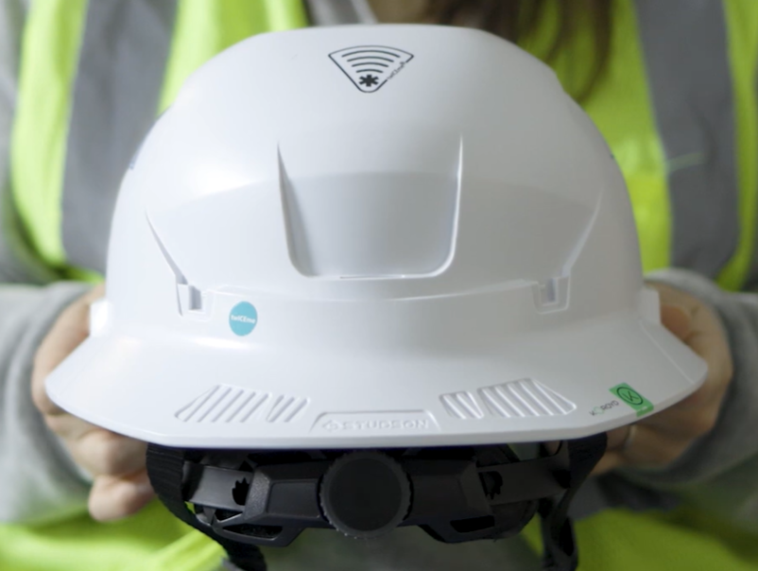
Benefits & Results
2026 SAFETY EXCELLENCE AWARDS | BEST PRACTICES SEMINAR
The transition to Type II helmets provides improved protection from front, rear, and side impacts, which were not addressed by traditional hard hats.
The use of chin straps helps ensure the helmet remains in place during slips, trips, and falls.
In addition, standardization has improved overall PPE compliance and enhanced our ability to identify personnel and qualifications in the field.

Slide 8
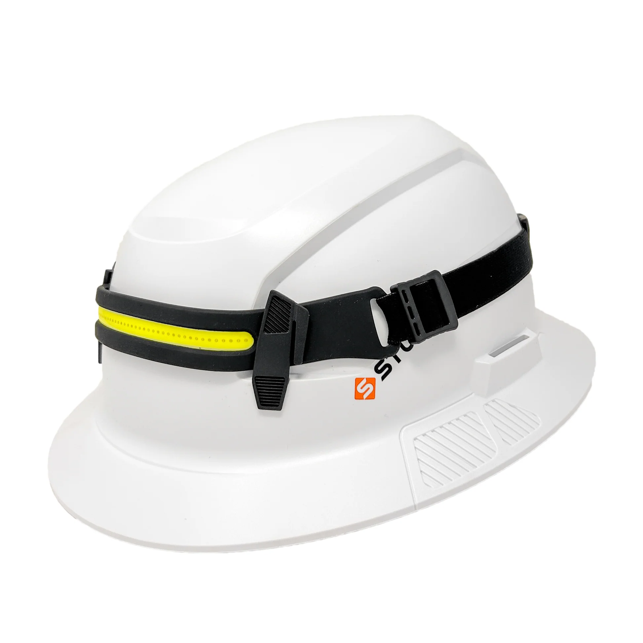
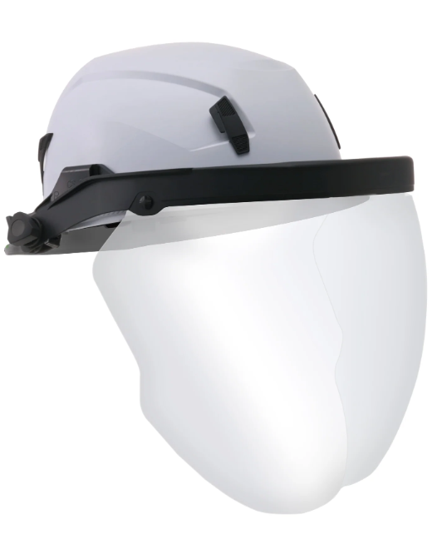
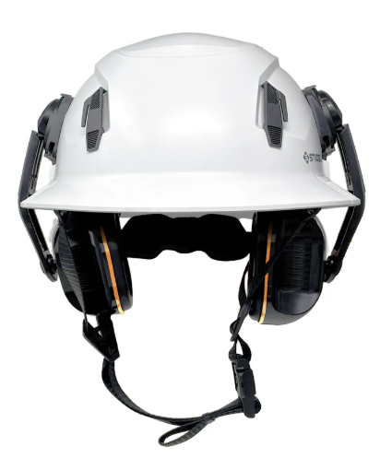
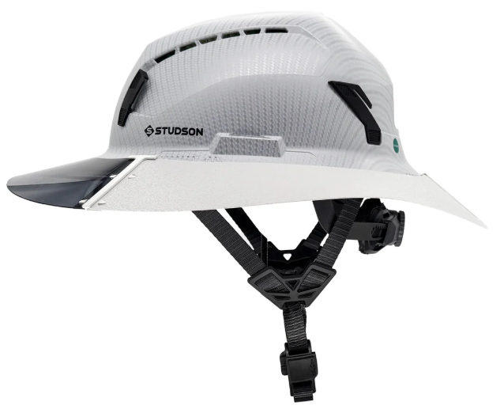
Attachments
2026 SAFETY EXCELLENCE AWARDS | BEST PRACTICES SEMINAR
Specialty Protection Sun Shield
Face shields
Double Hearing Protection
Head Lamp

Slide 9
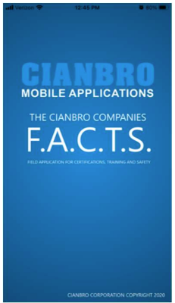
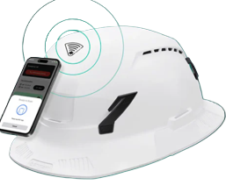
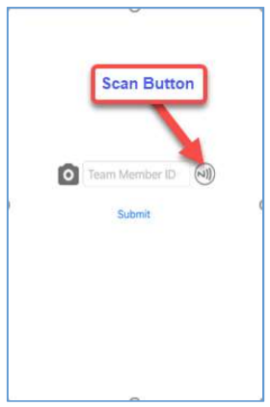
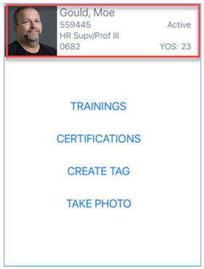
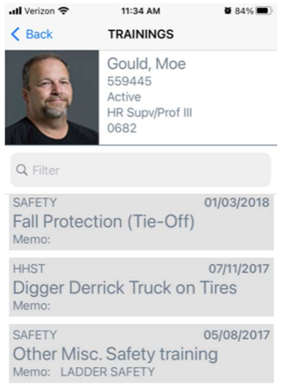
Technology
2026 SAFETY EXCELLENCE AWARDS | BEST PRACTICES SEMINAR
Utilizing helmet’s built-in NFC feature to link team members with their company records for prompt retrieval with mobile device
F.A.C.T.S. (Field Application for Certifications, Training and Safety)
Scan NFC tag or enter team member ID

Slide 10
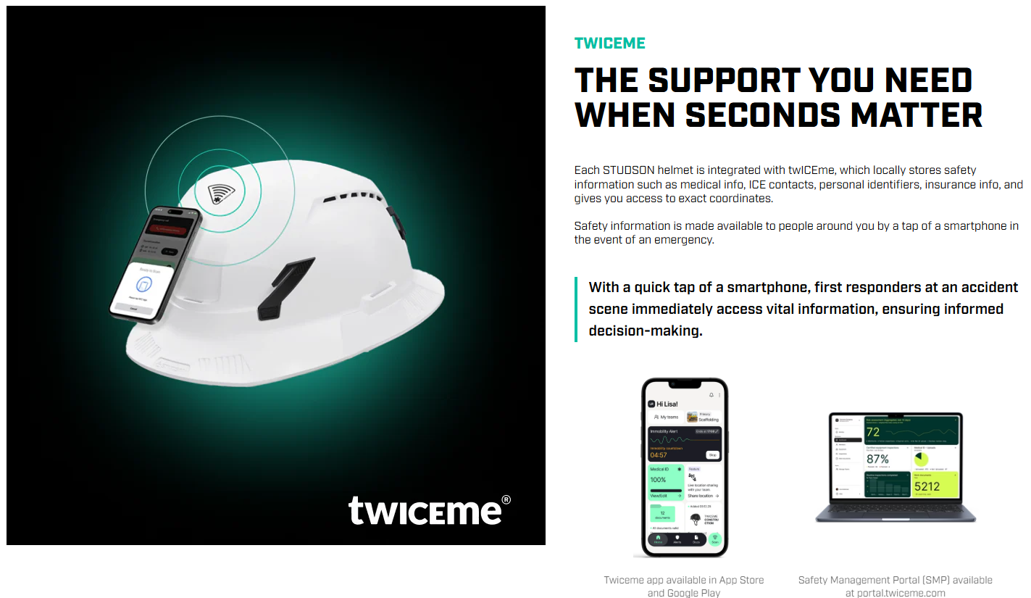
Future Applications
2026 SAFETY EXCELLENCE AWARDS | BEST PRACTICES SEMINAR
Expand to subcontractors
Enhance PPE systems
Leverage technology
Apply to high-risk activities
Locally stores safety information such as medical information.

Slide 11

Summary
2026 SAFETY EXCELLENCE AWARDS | BEST PRACTICES SEMINAR
Type II helmets improve protection
Integration enhances effectiveness
Standardization drives compliance
Supports strong safety culture

Slide 12

QUESTIONS?

