Slide 1




2026 SAFETY EXCELLENCE AWARDS | BEST PRACTICES SEMINAR
CRANE & RIGGING SUPPORT
BEST IN CLASS
Barnhart Crane & Rigging is a leading North American provider of heavy lift, rigging, and transport solutions, specializing in complex industrial projects. With a nationwide network, advanced engineering expertise, and a problem-solving approach. Barnhart delivers innovative, safe, and cost-effective solutions that minimize downtime and reduce total project costs for clients across diverse industries.

Slide 2


Slide 3
2026 SAFETY EXCELLENCE AWARDS | BEST PRACTICES SEMINAR
BEST PRACTICE
AGENDA / OUTLINE
Purpose & Need
Implementation
Benefits & Results
Summary & Wrap Up
Q&A

Slide 4



The Challenge
With a mobile workforce, completing paper versions of inspections, JHAs, and job observations can be challenging. Additionally, returning the paper versions to operations team for entry into database and capturing corrective actions can be difficult.
2026 SAFETY EXCELLENCE AWARDS | BEST PRACTICES SEMINAR

Slide 5
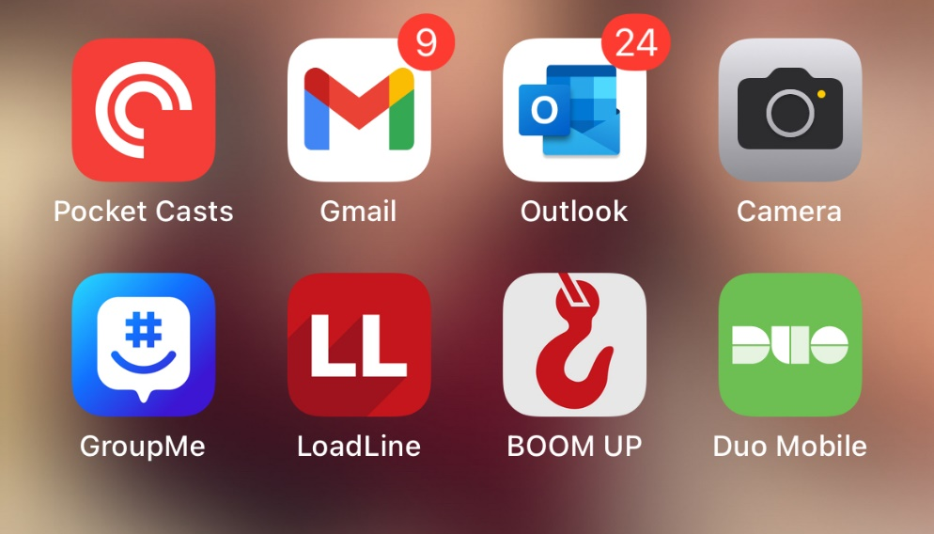
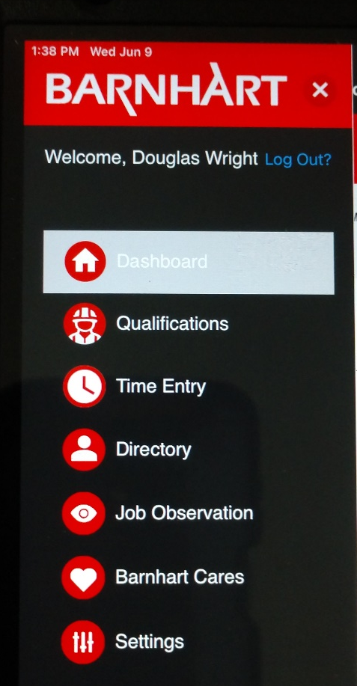
The Solution
2026 SAFETY EXCELLENCE AWARDS | BEST PRACTICES SEMINAR
Mobile App that can be added to employee phone or iPad for access to jobs, inspections, observations, and time entry.
Boom Up home page showing Dashboard
Boom Up App

Slide 6

Boom Up Overview
2026 SAFETY EXCELLENCE AWARDS | BEST PRACTICES SEMINAR

Slide 7

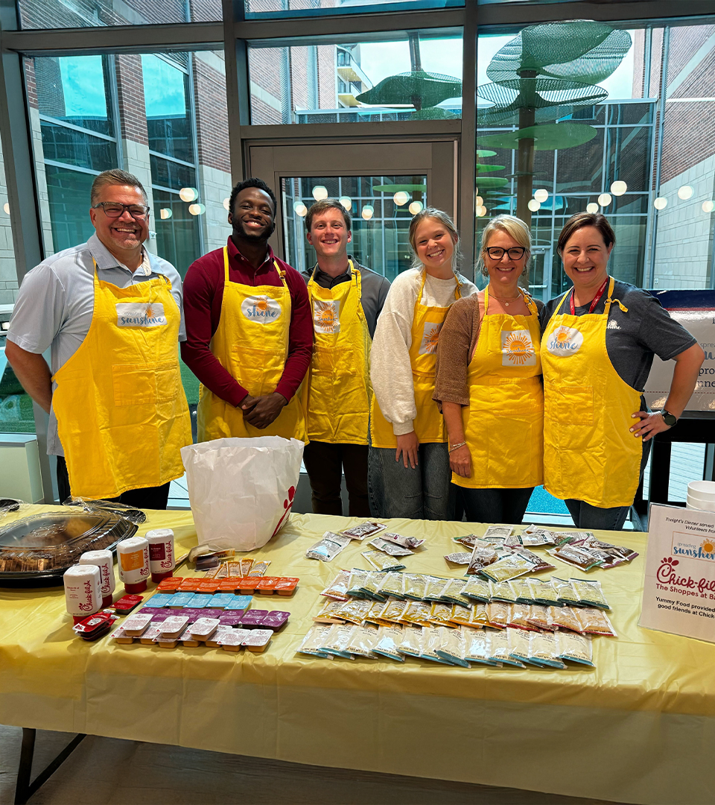
2026 SAFETY EXCELLENCE AWARDS | BEST PRACTICES SEMINAR
Barnhart believes
in developing and empowering employees for meaningful work, personal growth,
and eternal impact.

Slide 8
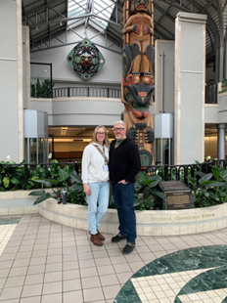



Employee Care
2026 SAFETY EXCELLENCE AWARDS | BEST PRACTICES SEMINAR
Marriage
Finances
Ready to Wed
Weekend to Remember
Hope Restored
Financial Peace University
MKL Financial Budgeting Services
Crown Financial
Relational Care
Cares Resources
Chaplain Care
Counseling
JH Outback
RightNow Media
OneTeam Scholarships
Barnhart Trade School Scholarship
Employee Benevolent Fund

Slide 9

2026 SAFETY EXCELLENCE AWARDS | BEST PRACTICES SEMINAR
Community Care
Our focus shifts outwardly through programs designed to encourage engagement and investment in our local communities.

Slide 10

Summary
2026 SAFETY EXCELLENCE AWARDS | BEST PRACTICES SEMINAR
The Boom Up app enables our mobile workforce to fulfill requirements as well as have key documentation at their fingertips without the need to handle paper.
Through our Cares programs, we provide benefits to the employee and family outside of work, as well as create opportunities to give back and support our communities.

Slide 11

QUESTIONS?

