Slide 1
2025 SAFETY EXCELLENCE AWARDS | BEST PRACTICES SEMINAR
HARD CRAFTS SMALL
BEST IN CLASS
Tray-Tec is a specialty services contractor that provides shutdown service to refineries, petrochemical plants, gas plants, and fabrication shops. Their success has earned them a reputation for performing safe, quality work while meeting or exceeding deadlines and budgets expectations. Tray-Tec services include towers inspections and installations, catalyst change outs including inert entry, mechanical services, and specialty welding. NBIC and ASME code work.

Slide 3
BEST PRACTICE
AGENDA / OUTLINE
Purpose
Execution & Implementation
Benefits & Results
Examples
Future Use & Applications
Summary & Wrap Up
Q&A

Slide 4
Purpose: Evolve with the Changing Workforce
2025 SAFETY EXCELLENCE AWARDS | BEST PRACTICES SEMINAR
Our Best Practice to address talent shortage, high turnover, and knowledge retention . . .
Workforce Development with Hands-on Training at TTI University

Slide 5
Execution & Implementation – Safety Committee
2025 SAFETY EXCELLENCE AWARDS | BEST PRACTICES SEMINAR
Putting the plan in action
SEA Auditors - 2024
Founding TTI University
Create new Workforce Development Plans
Carrying out the plan
Writing new policies
Creating Training &
Videos & QR Codes
Measuring Successes

Slide 6
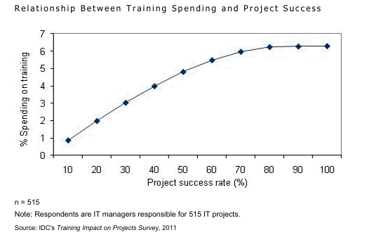
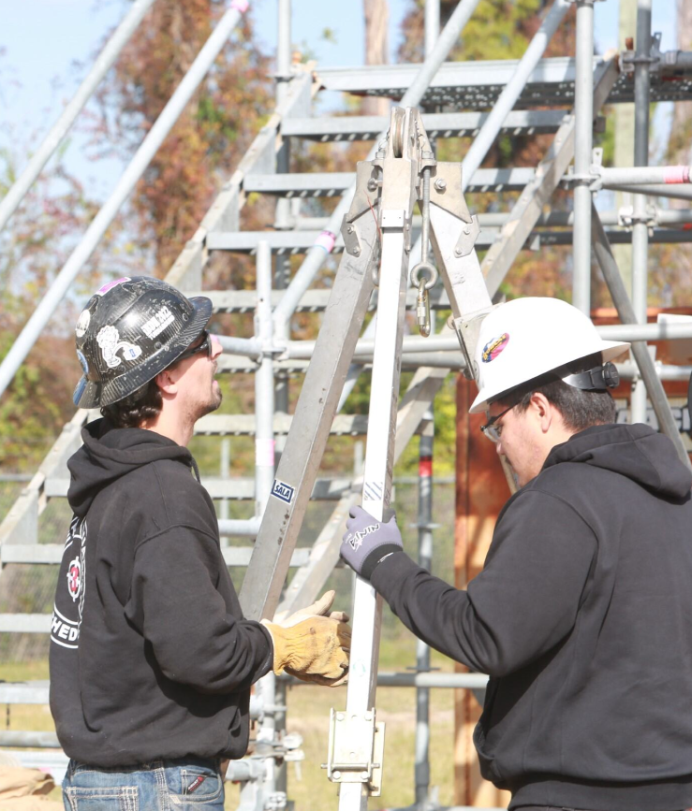
Benefits & Results
2025 SAFETY EXCELLENCE AWARDS | BEST PRACTICES SEMINAR
ROI?

Slide 7
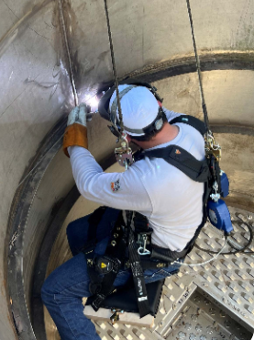
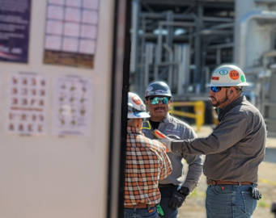
Workforce Development - Onboarding
2025 SAFETY EXCELLENCE AWARDS | BEST PRACTICES SEMINAR
Hands-on Workers Remain in Demand
Partner with Health & Safety Council (HASC) for New Hire Orientation & Skills Assessments
80 Hands-on / 20 Classroom Training at TTIU in Humble, TX

Slide 8
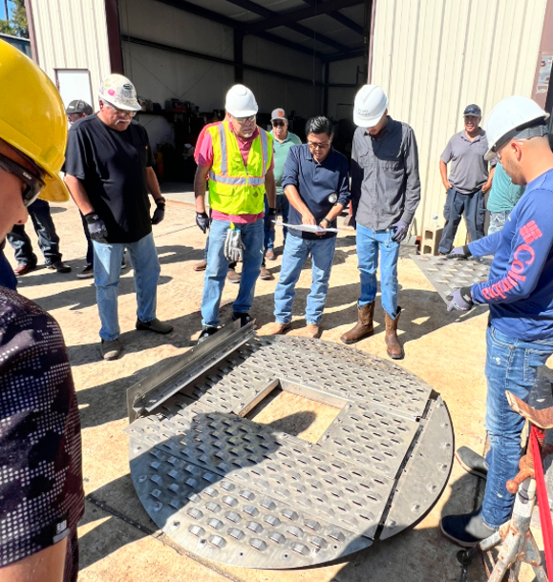
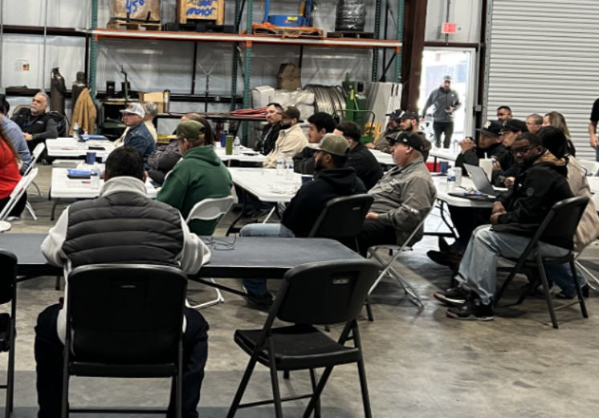
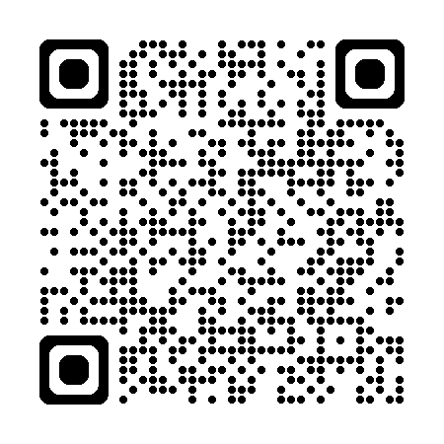
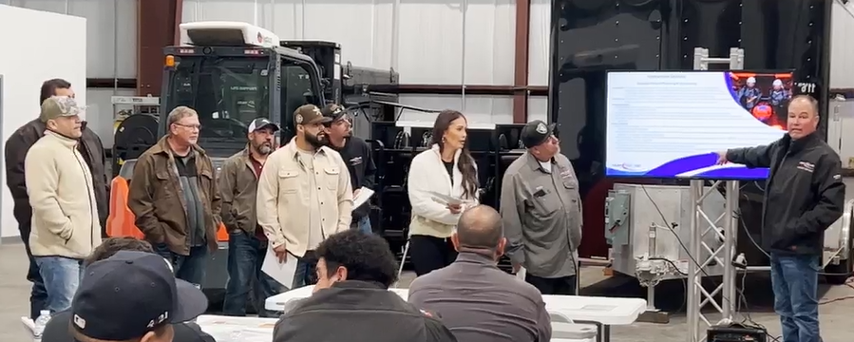
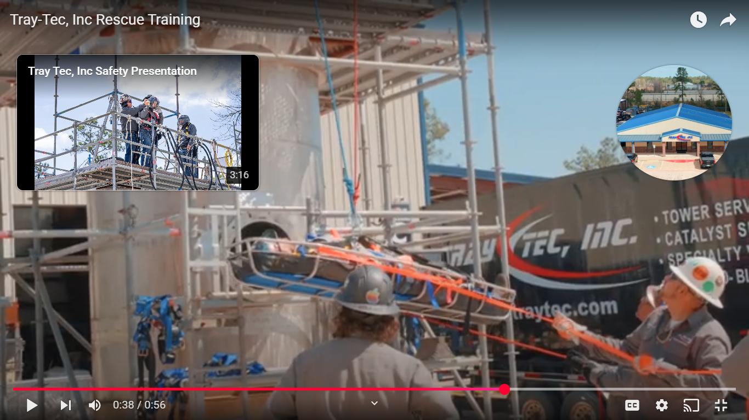
Workforce Development – Theory to Application
2025 SAFETY EXCELLENCE AWARDS | BEST PRACTICES SEMINAR
TTI University
Tray-Tec, Inc Rescue Training

Slide 9
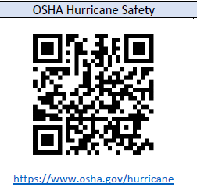
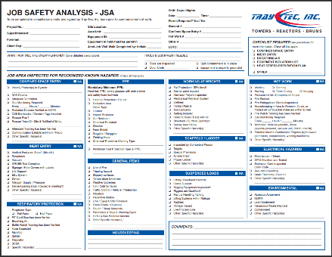
Workforce Development – Continuous Improvement
2025 SAFETY EXCELLENCE AWARDS | BEST PRACTICES SEMINAR
HSE Meetings
Short Service Worker
Employee Observation Program
JSA/Field Audits
All Employees
One per week
Crew Leads, HSEQ, Supervisors
15+ Min. Weekly Meeting
All New Employees
2023 Employee Participation: 58%
2024 Employee Participation: 85%

Slide 10
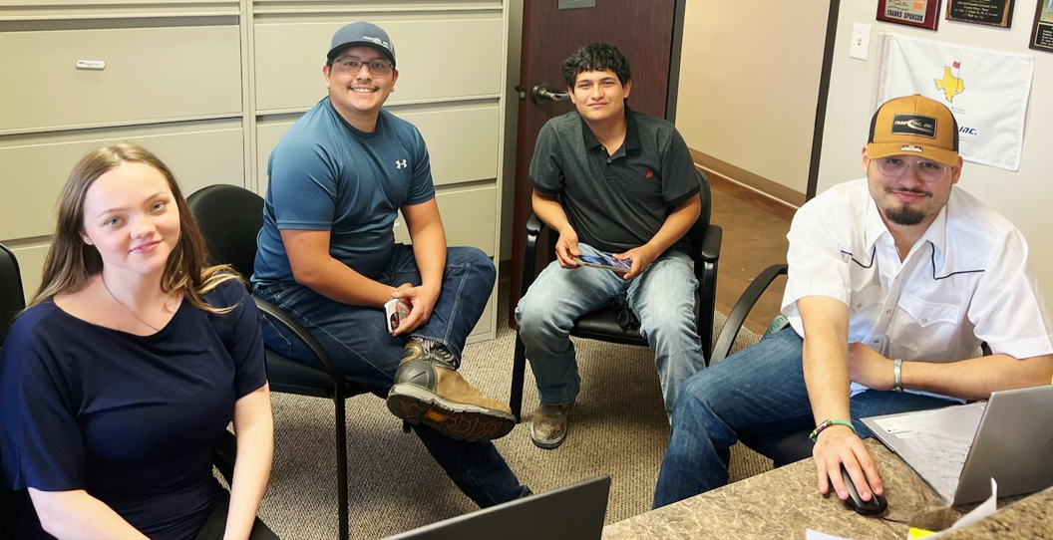
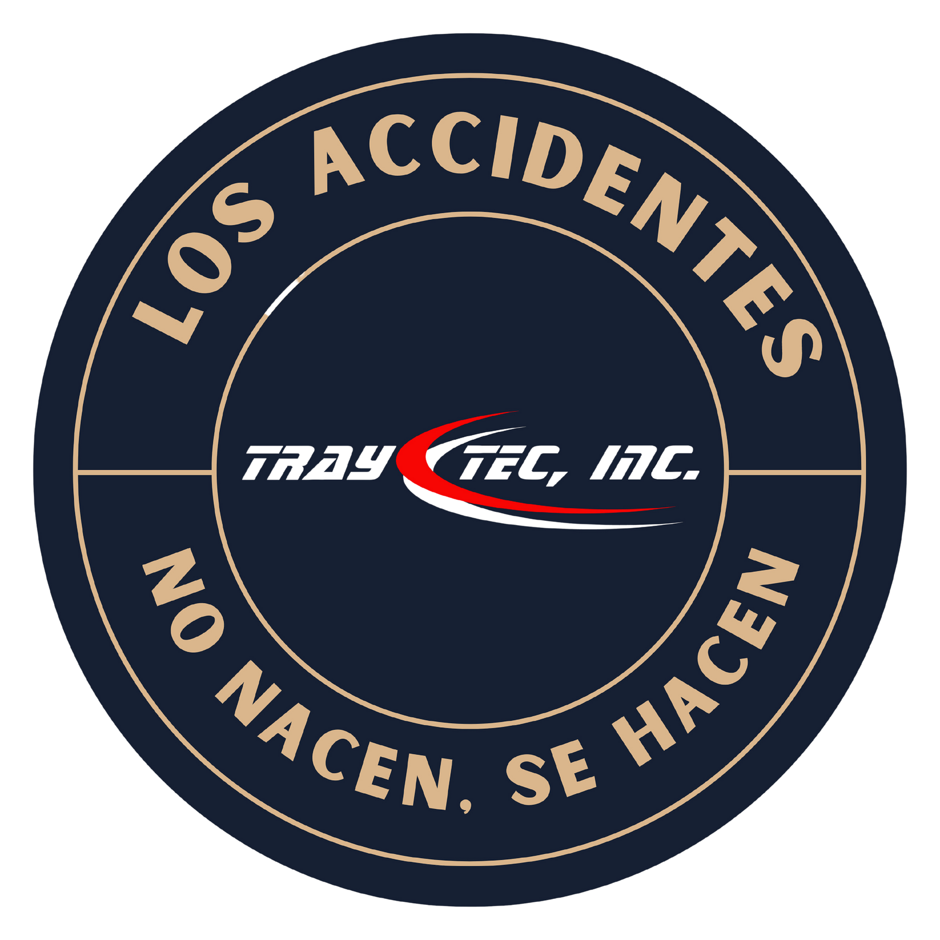
Future Uses & Applications
2025 SAFETY EXCELLENCE AWARDS | BEST PRACTICES SEMINAR

Slide 11
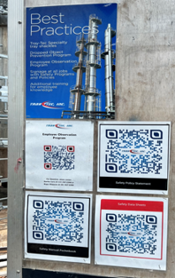
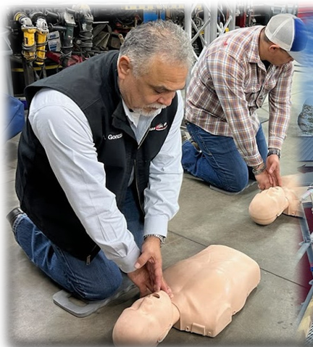
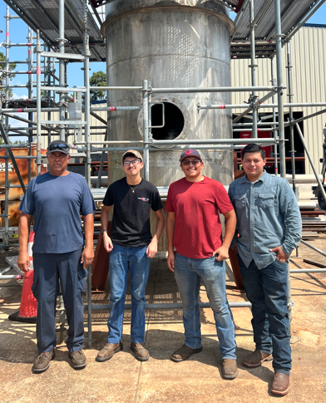
Summary
2025 SAFETY EXCELLENCE AWARDS | BEST PRACTICES SEMINAR

Slide 12
Questions?
2025 SAFETY EXCELLENCE AWARDS | BEST PRACTICES SEMINAR

