Slide 1
2025 SAFETY EXCELLENCE AWARDS | BEST PRACTICES SEMINAR
GENERAL CONTRACTOR EXTRA LARGE
BEST IN CLASS
Brown and Root provides industrial services to chemical, petrochemical, refining, and other sites and facilities. Our company offers engineering, construction, maintenance, turnaround, painting, scaffolding, insulation, and other services. Brown and Root is committed to the highest level of health, safety, and environmental performance. Brown and Root is committed to zero harm 24/7.

Slide 3
2025 SAFETY EXCELLENCE AWARDS | BEST PRACTICES SEMINAR
BEST PRACTICE
AGENDA / OUTLINE
Purpose
Execution & Implementation
Benefits & Results
Examples
Future Use & Applications
Summary & Wrap Up
Q&A

Slide 4
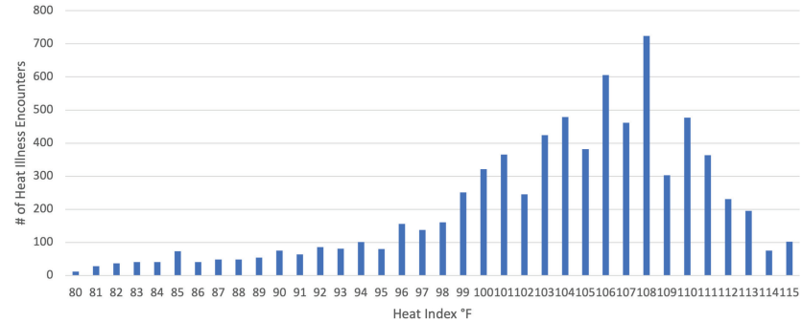
2025 SAFETY EXCELLENCE AWARDS | BEST PRACTICES SEMINAR
ZERO HARM-Reducing Heat Injuries
Heat-related illness encounters by average max heat index in Harris County, 2019-2023
The number of heat-related illnesses has increased by 329% between 2019 and 2023
Between 2019 and 2023, there were 7,627 total heat-related illnesses reported in Harris County
61% of heat-related illnesses occurred at a heat index of 103°F or higher
75% Americans are chronically dehydrated
How do you KNOW what your hydration level is?

Slide 5
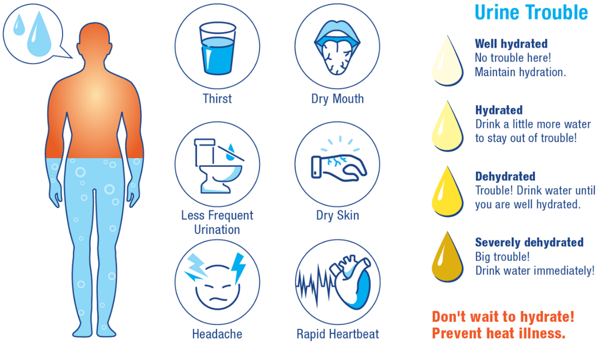
75% Americans are chronically dehydrated
2025 SAFETY EXCELLENCE AWARDS | BEST PRACTICES SEMINAR
How do we track Hydration?
Lab-based Testing
Complex
Expensive
Urine Specific Gravity
Unreliable Spot Check
Very Invasive
Urine Color
More Unreliable than USG
Left up to Worker’s discretion

Slide 6
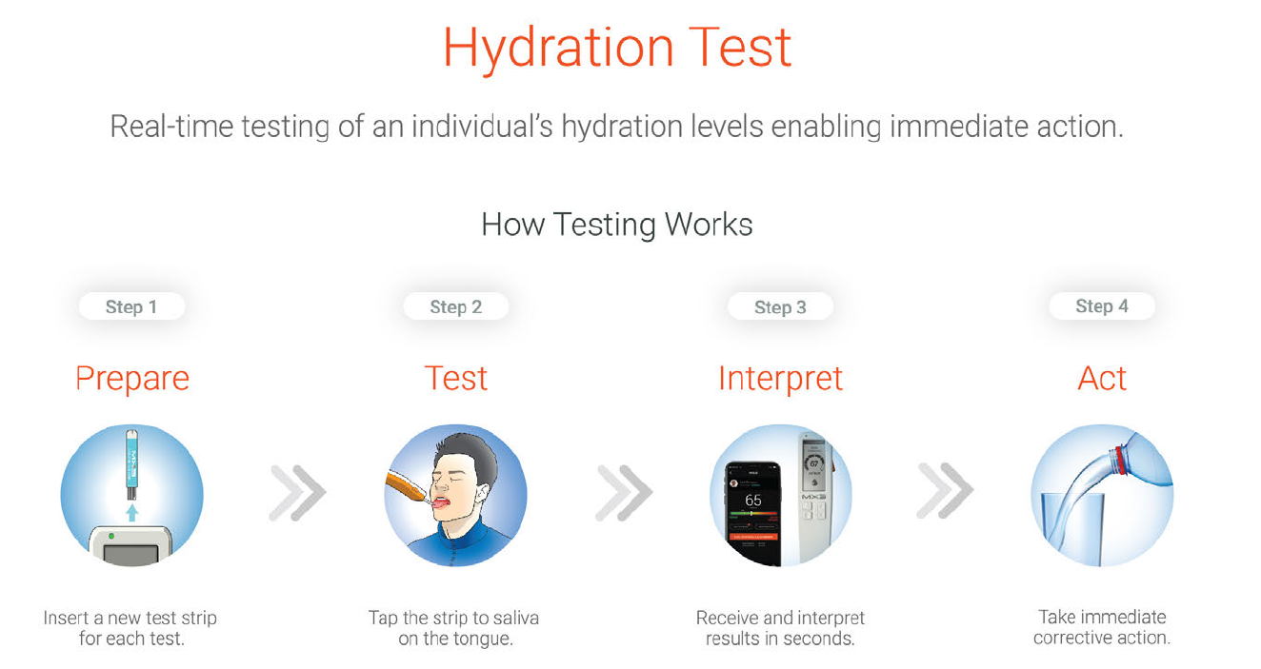
2025 SAFETY EXCELLENCE AWARDS | BEST PRACTICES SEMINAR

Slide 7
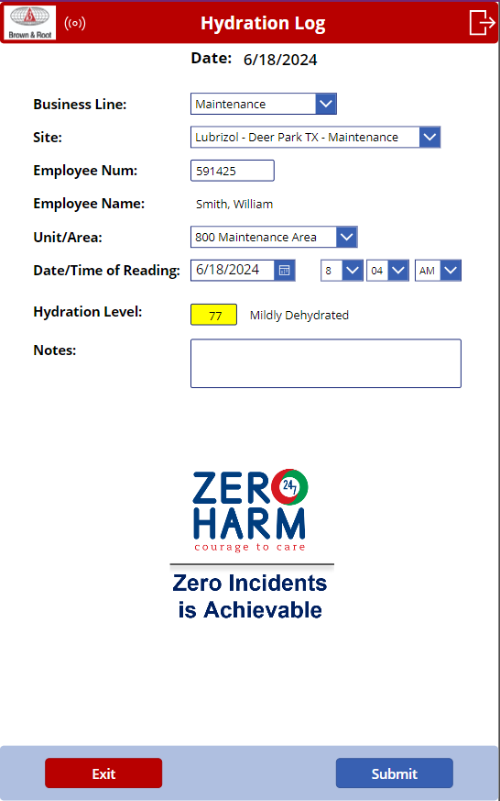
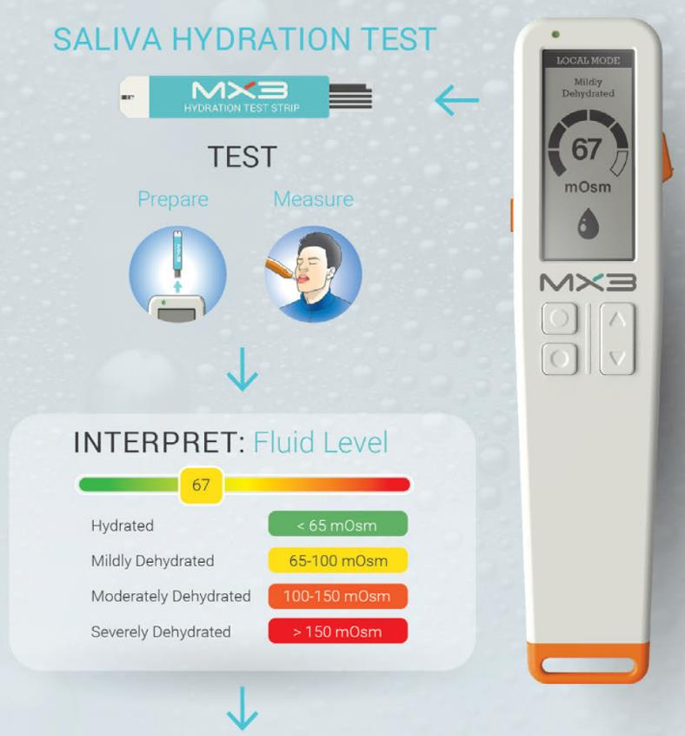
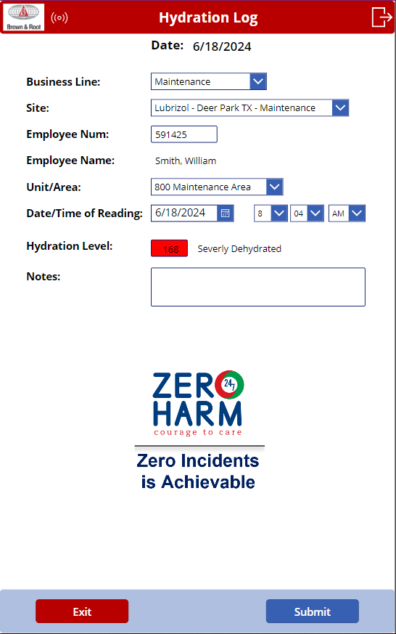
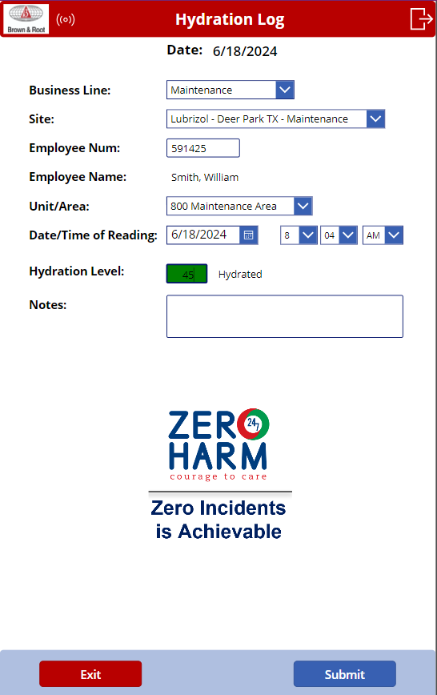
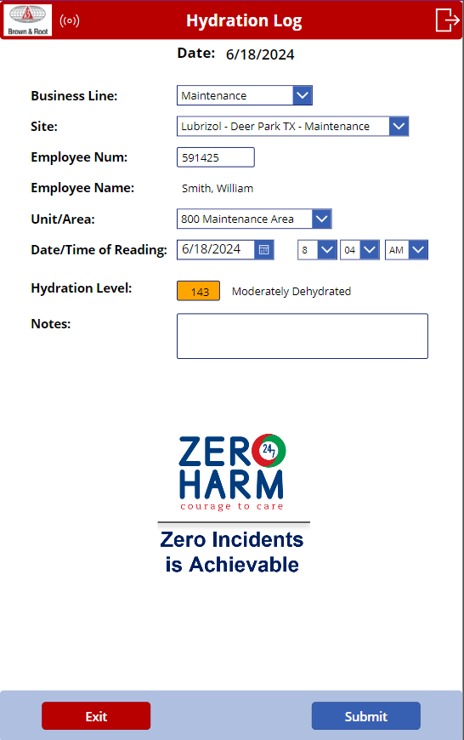
Power APP Hydration Log
2025 SAFETY EXCELLENCE AWARDS | BEST PRACTICES SEMINAR

Slide 8
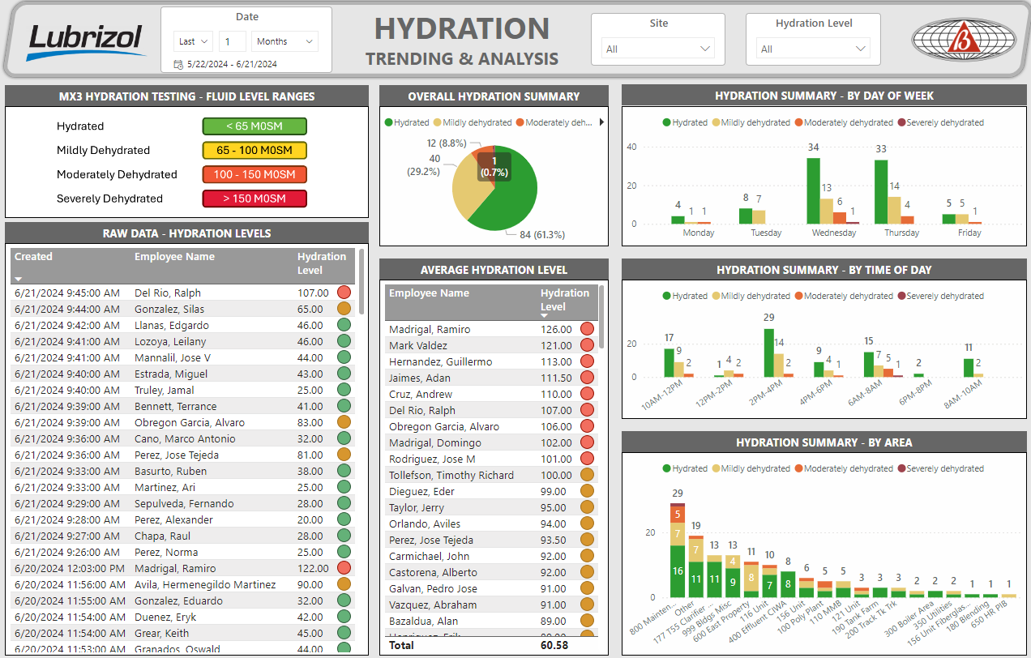
Technology to Combat Hydration
2025 SAFETY EXCELLENCE AWARDS | BEST PRACTICES SEMINAR
MX3 Hydration Testing System
Brown & Root implemented the MX3 Hydration Testing System to prevent heat related illnesses.
Portable solution for measurement of hydration anytime and anywhere
Number that it generates is a tangible representation of an individual’s state of hydration
Creates new levels of engagement with instant results to the individual and the dashboard which equips managers to analyze and adjust critical factors that cause heat illnesses
Confidential Client

Slide 9
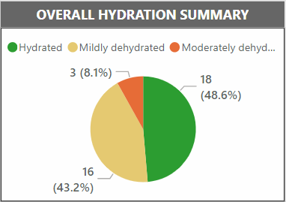
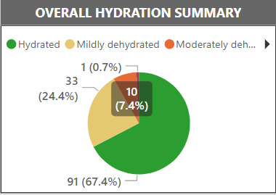
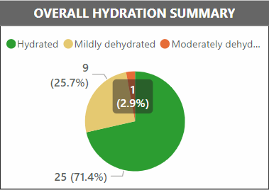
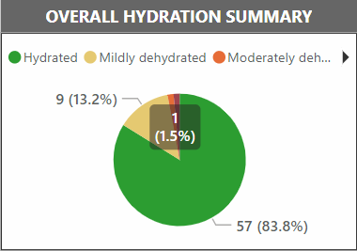
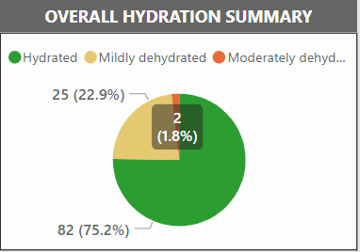
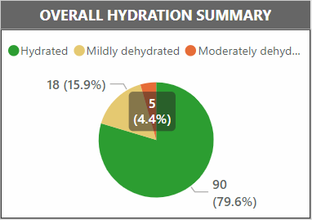
Brown and Root Case Study
2025 SAFETY EXCELLENCE AWARDS | BEST PRACTICES SEMINAR
We tested 50 people a day, which let us test roughly 75% of the work force per week
Week 1
6/9 to 6/16
Week 2
6/17 to 6/23
Week 3
6/24 to 6/30
Week 4
7/1 to 7/7
Week 5
7/8 to 7/14
Week 6
7/15 to 7/21
49.1
51.9
46.7
63.7
Hurricane Week 57.3
54.0
It gave a tangible result to the workforce so that they could act on.
Even after Beryl hit, our workforce continued to remain hydrated because we were able to maintain our focus on hydrations
The enhanced engagement that this tool provided allowed new and different conversations about hydration which led to a summer without a heat related incident at our pilot site.

Slide 10
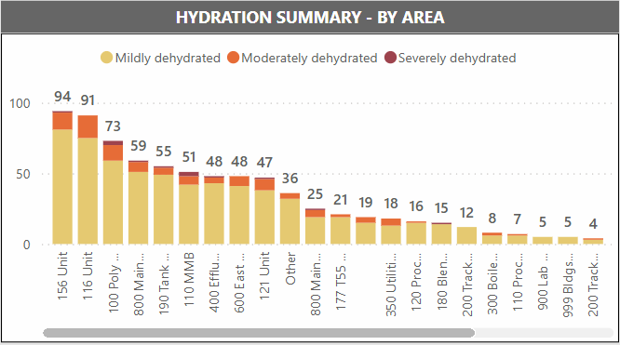
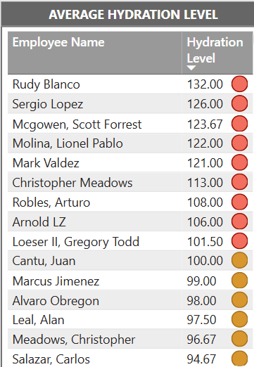
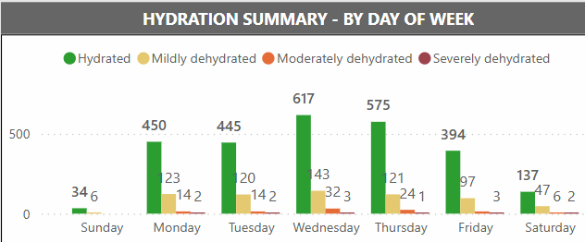
Putting the Data to use
2025 SAFETY EXCELLENCE AWARDS | BEST PRACTICES SEMINAR
Leadership Engagement
Tangible Results
Coaching Sessions
Heightened Awareness
Diagnostic Tool
Instant Health Condition Monitor
Data driven decision
Heat Mapping

Slide 11
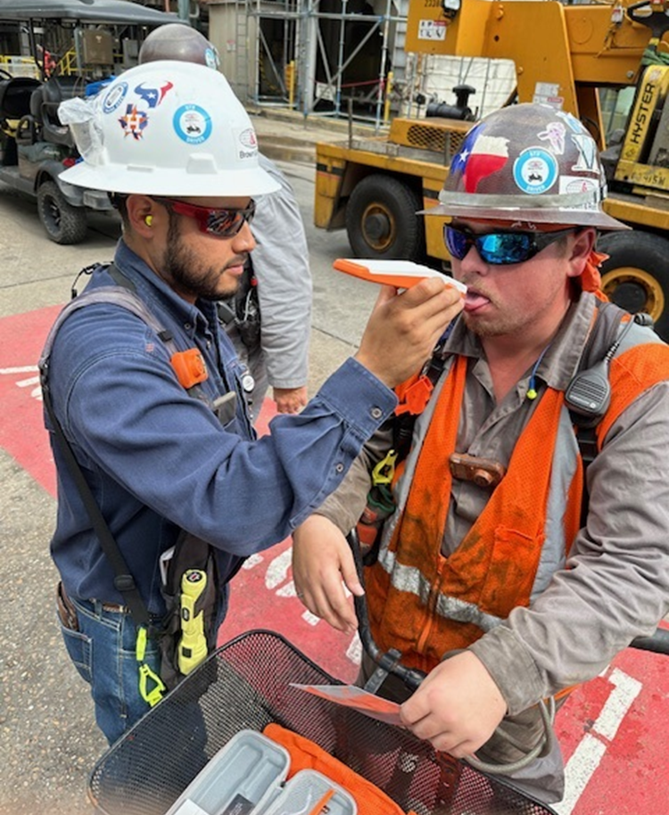
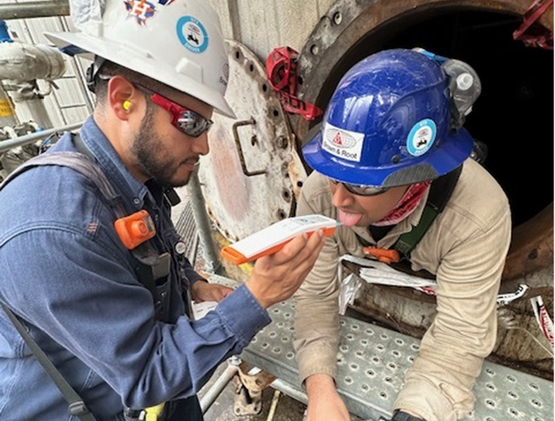
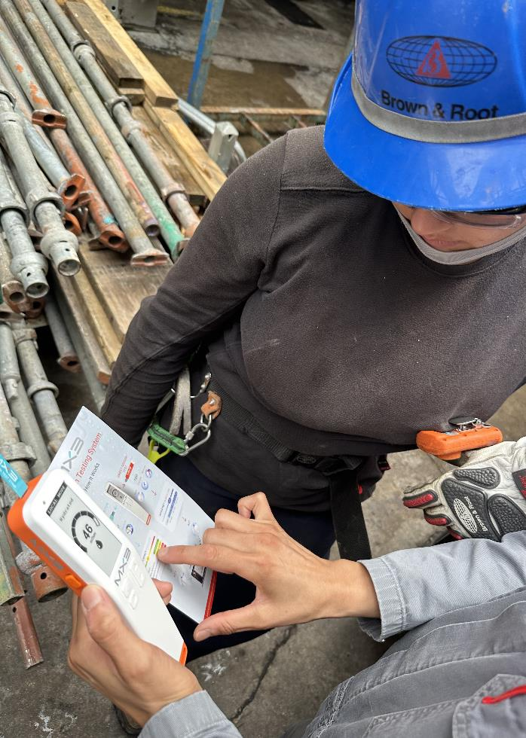
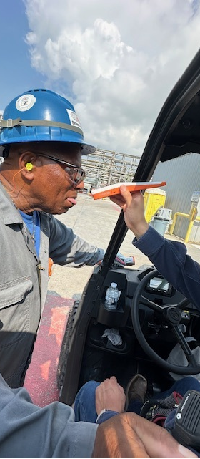
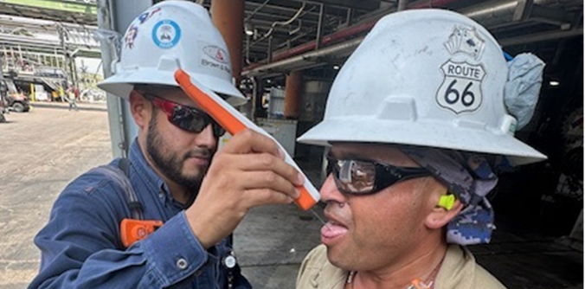
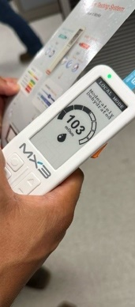
Summary
2025 SAFETY EXCELLENCE AWARDS | BEST PRACTICES SEMINAR

Slide 12
Questions?
2025 SAFETY EXCELLENCE AWARDS | BEST PRACTICES SEMINAR

