Slide 1


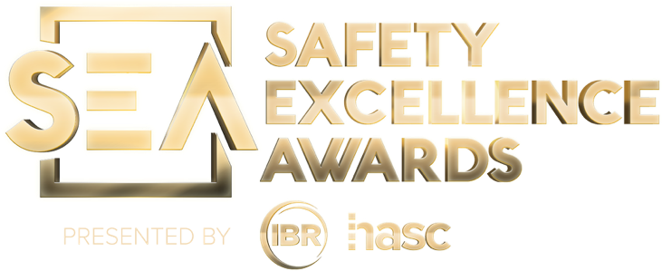
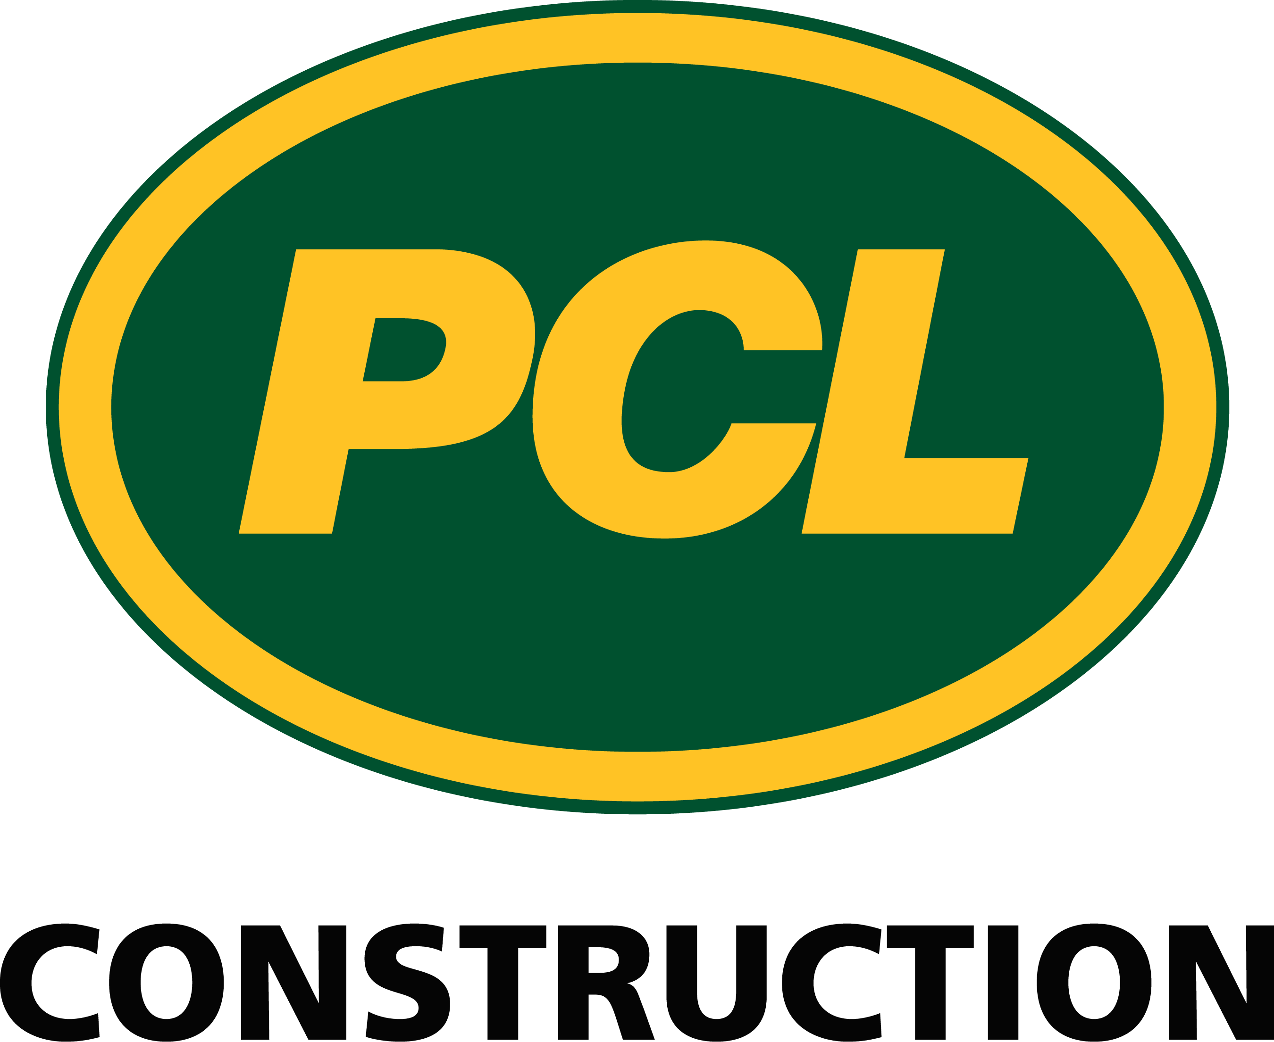
2025 SAFETY EXCELLENCE AWARDS | BEST PRACTICES SEMINAR
GENERAL CONTRACTOR LARGE
BEST IN CLASS
PCL Industrial Construction Company focuses on the heavy industrial market across the United States. We are a diversified, full-service heavy industrial contractor focused on safety, quality, and excellence. These diverse operations in the civil infrastructure, heavy industrial, and building markets are supported by a strategic presence in 31 major centers.

Slide 2
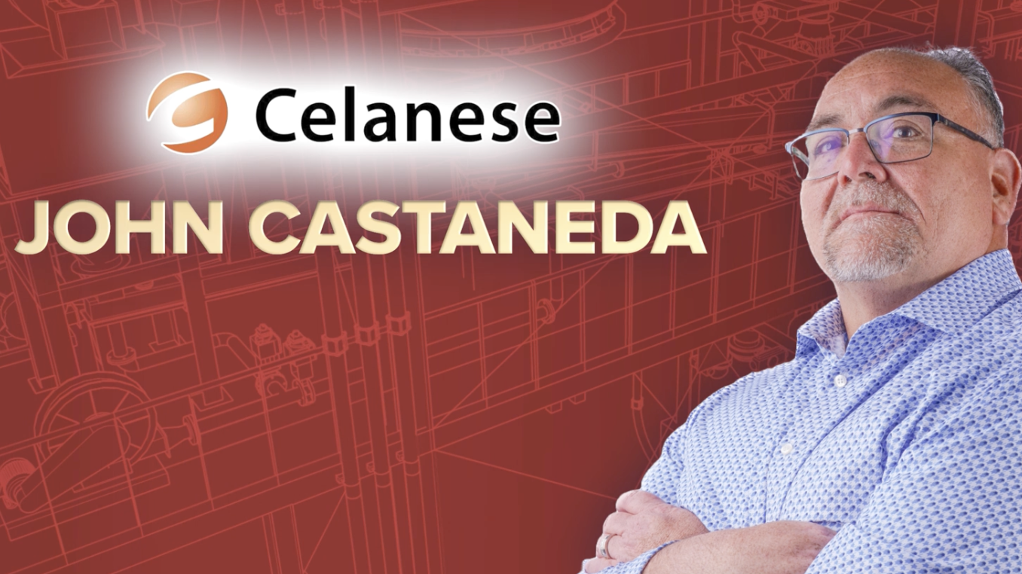

Slide 3
2025 SAFETY EXCELLENCE AWARDS | BEST PRACTICES SEMINAR
BEST PRACTICE
AGENDA / OUTLINE
Purpose
Execution & Implementation
Benefits & Results
Examples
Future Use & Applications
Summary & Wrap Up
Q&A

Slide 4
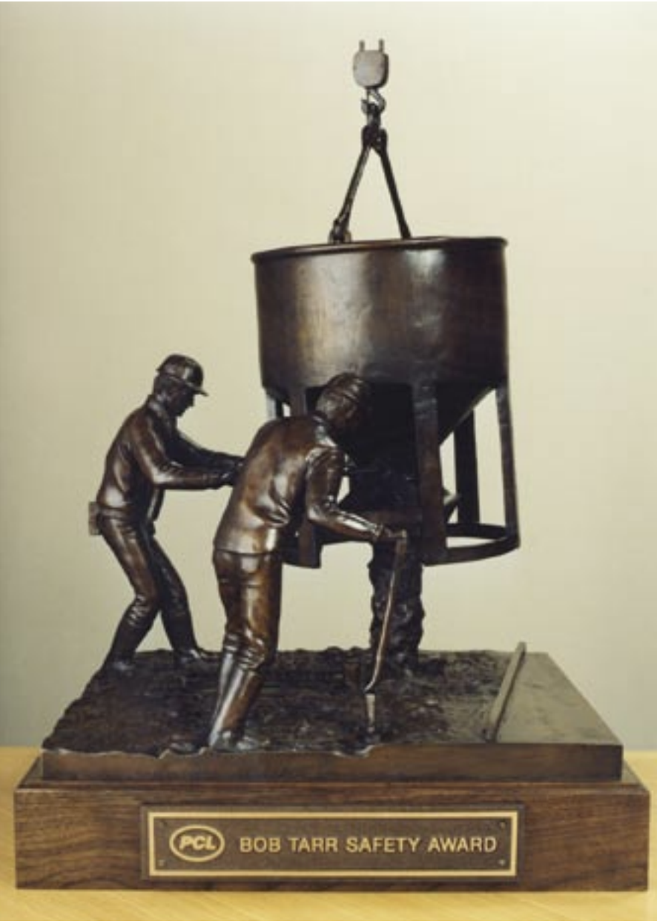

1. BEST PRACTICES
2025 SAFETY EXCELLENCE AWARDS | BEST PRACTICES SEMINAR
BOB TARR HSE Internal Audit/Award Program
Introduced in 1992 in memory of former CEO Bob Tarr of PCL.
Conducted every 2 years.
Purpose: Recognizes excellence in health, safety and environmental practices within PCL.
Award Criteria: Best combined score in accident frequency, severity, inspections, and audits.
Goal: To promote a culture of awareness, communication, and
accountability for an incident-free environment.
Presented in November to the PCL District that achieves highest
combined score.
Evaluated by the Executive Review Committee.

Slide 5
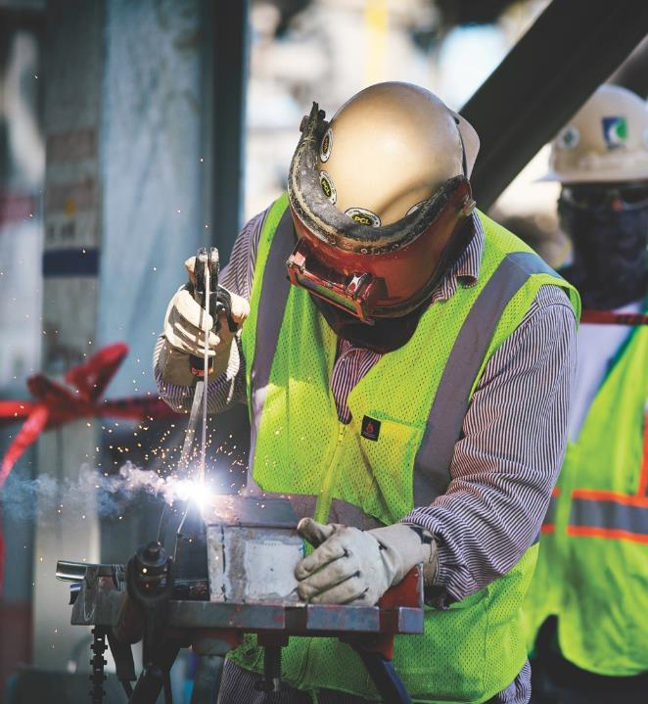
2. BEST PRACTICES
2025 SAFETY EXCELLENCE AWARDS | BEST PRACTICES SEMINAR
NCCER Based Training
National Center for Construction Education and Research (NCCER) sets the benchmark in safety training.
PCL offers evening classes throughout the week to help assist craft employees to become NCCER certified.
PCL has NCCER on-site instructors.
Classes Offered: Crane , Electrical, Instrumentation, Ironwork, Millwright, Pipefitting, Rigging, Safety, Welding
Understanding the challenges the construction industry faces with hiring and retaining craft professionals, PCL continues to remain committed to providing NCCER training for every project where it is feasible, or at a location nearby.

Slide 6
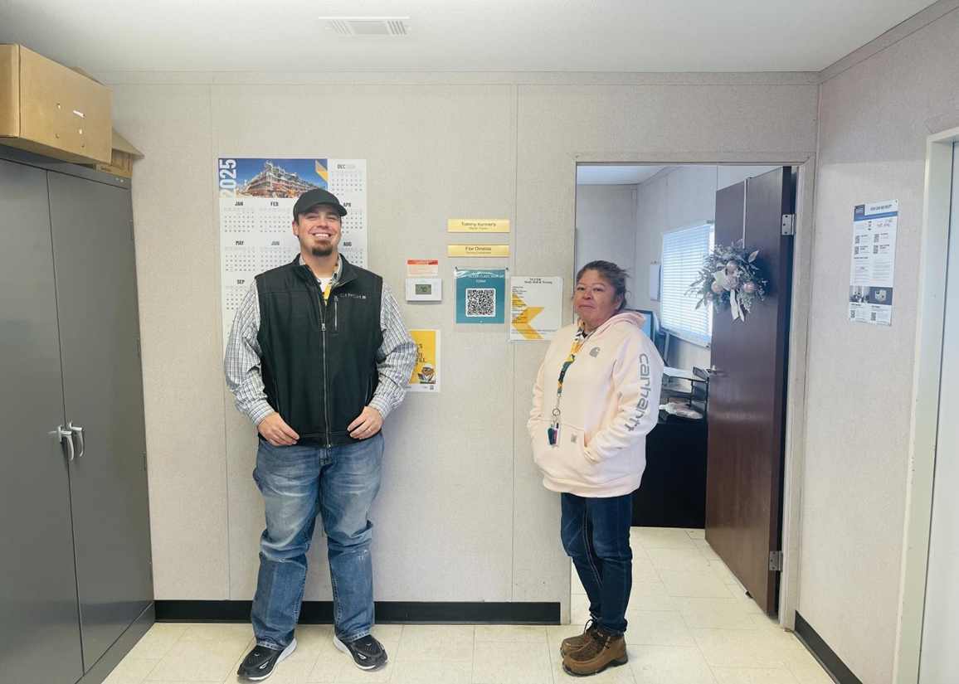
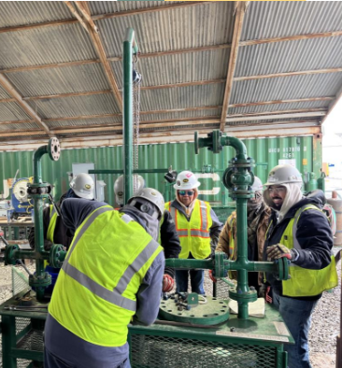

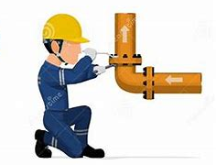
NCCER On-Site Support
2025 SAFETY EXCELLENCE AWARDS | BEST PRACTICES SEMINAR
Tommy Kennerly
Craft Training Specialist
Flor Ornelas
Training
Coordinator
Flange Management Course

Slide 7
3. BEST PRACTICES
2025 SAFETY EXCELLENCE AWARDS | BEST PRACTICES SEMINAR
PCL Certified Craft Program
A PCL specific program that recognizes key hourly employees (craft supervisors and craft professionals) for outstanding performance. It has also been developed to foster selection and recognition of the outstanding performers by offering them elite status in the PCL certified program.
WHO IS ELIGIBLE?
Journeyman – Foreman – General Foreman
In order to remain PCL Certified Status –
employees must continue to
meet expectations
WHAT ARE THE BENEFITS?
Vacation time
Higher wages
Priority placement on new projects
Career development Training
Recognition for being the elite of PCL
PCL Certified Swag

Slide 8
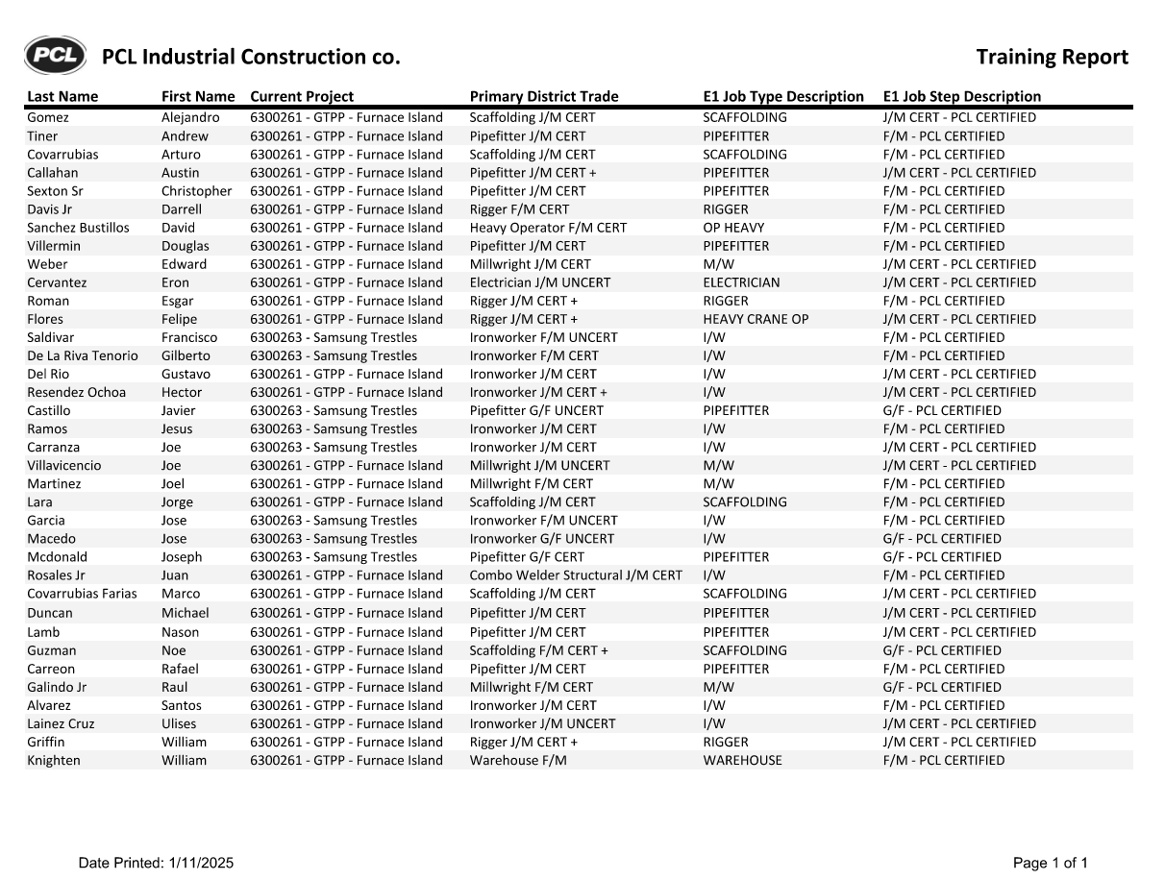
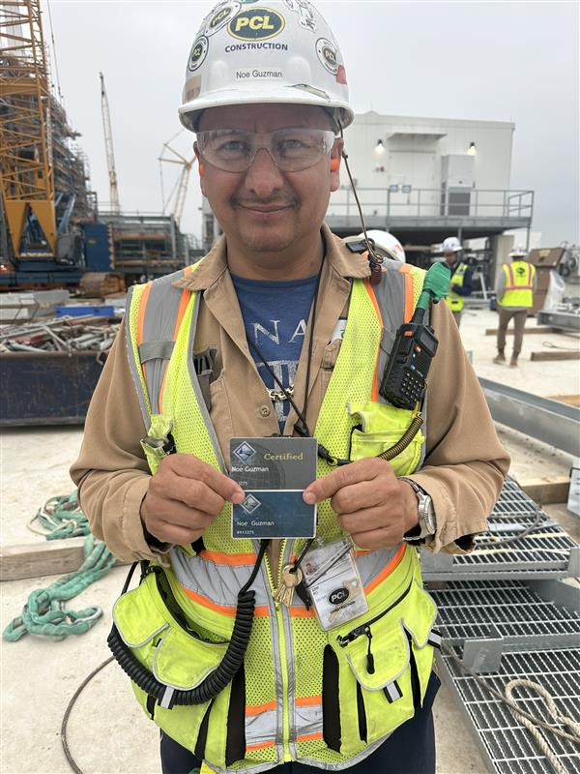
PCL Certified
2025 SAFETY EXCELLENCE AWARDS | BEST PRACTICES SEMINAR

Slide 9
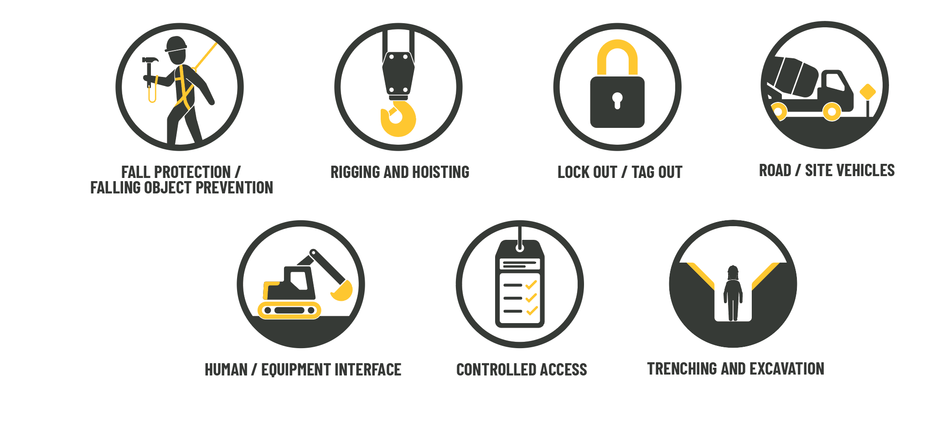
4. BEST PRACTICES
2025 SAFETY EXCELLENCE AWARDS | BEST PRACTICES SEMINAR
Serious Injury and Fatality (SIF) Prevention Campaign
Our goal with the SIF prevention campaign is to draw attention to serious injury and fatality (SIF) prevention and work toward our company wide goal of zero incidents. This campaign highlights our 7 Life Savings Absolutes (LSAs).

Slide 10
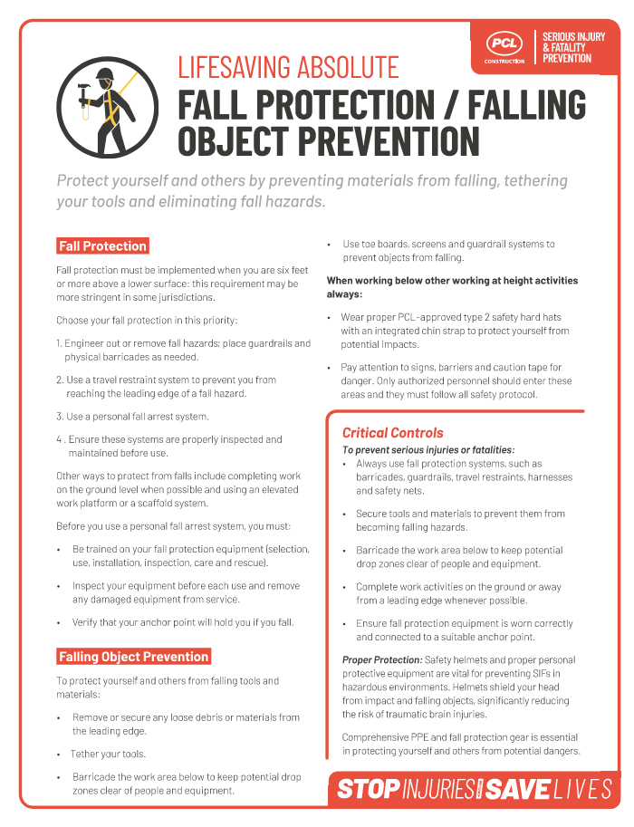
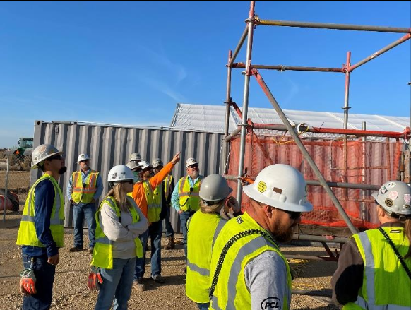
Serious Injury and Fatality
2025 SAFETY EXCELLENCE AWARDS | BEST PRACTICES SEMINAR
Hazard Recognition Training
&
SIF Communications

Slide 11

Questions?
2025 SAFETY EXCELLENCE AWARDS | BEST PRACTICES SEMINAR

